Slide 1
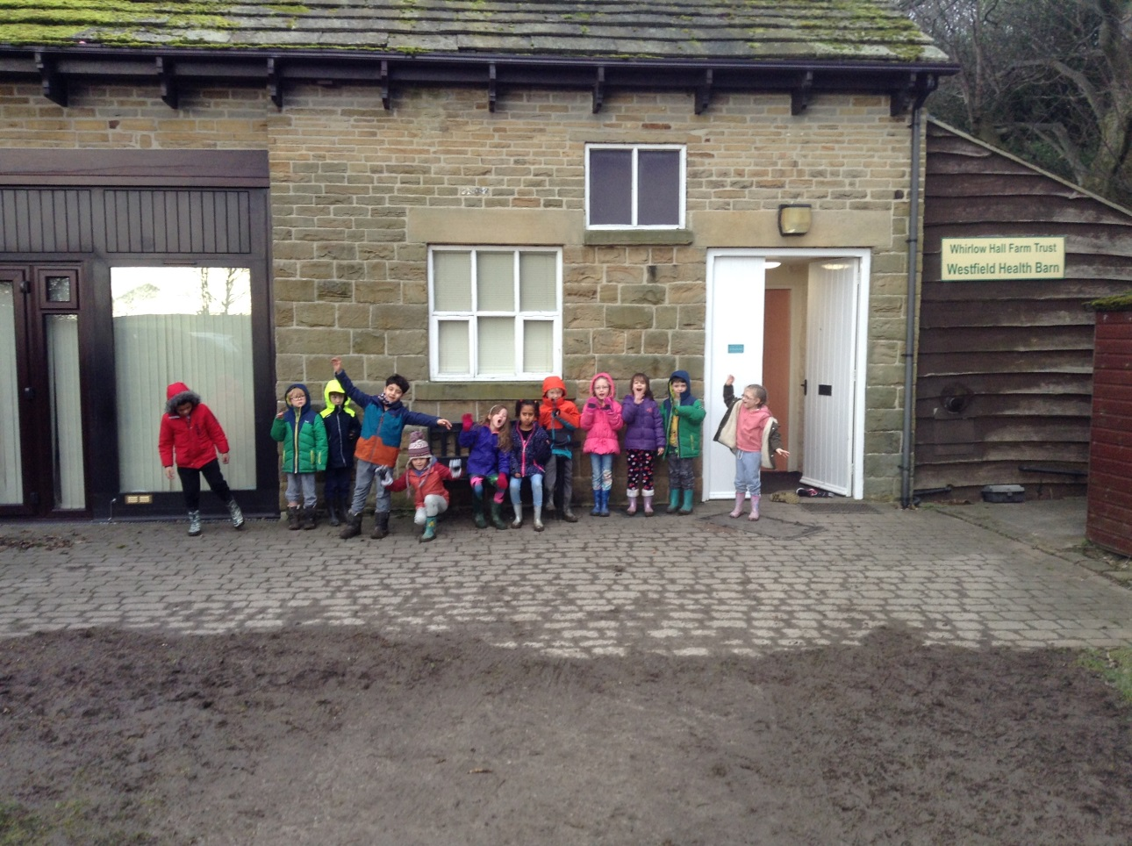
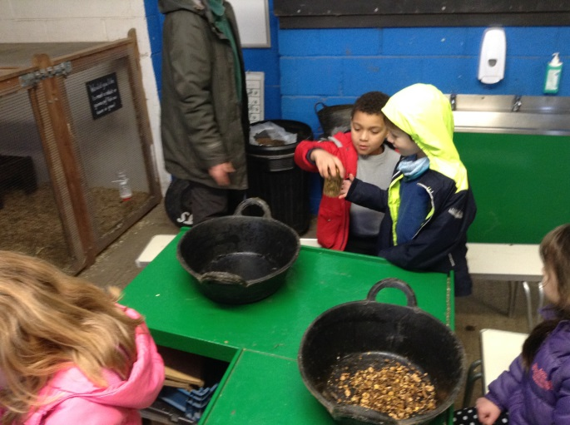
Whirlow Farm
January 31st to February 2nd 2018!

Slide 2
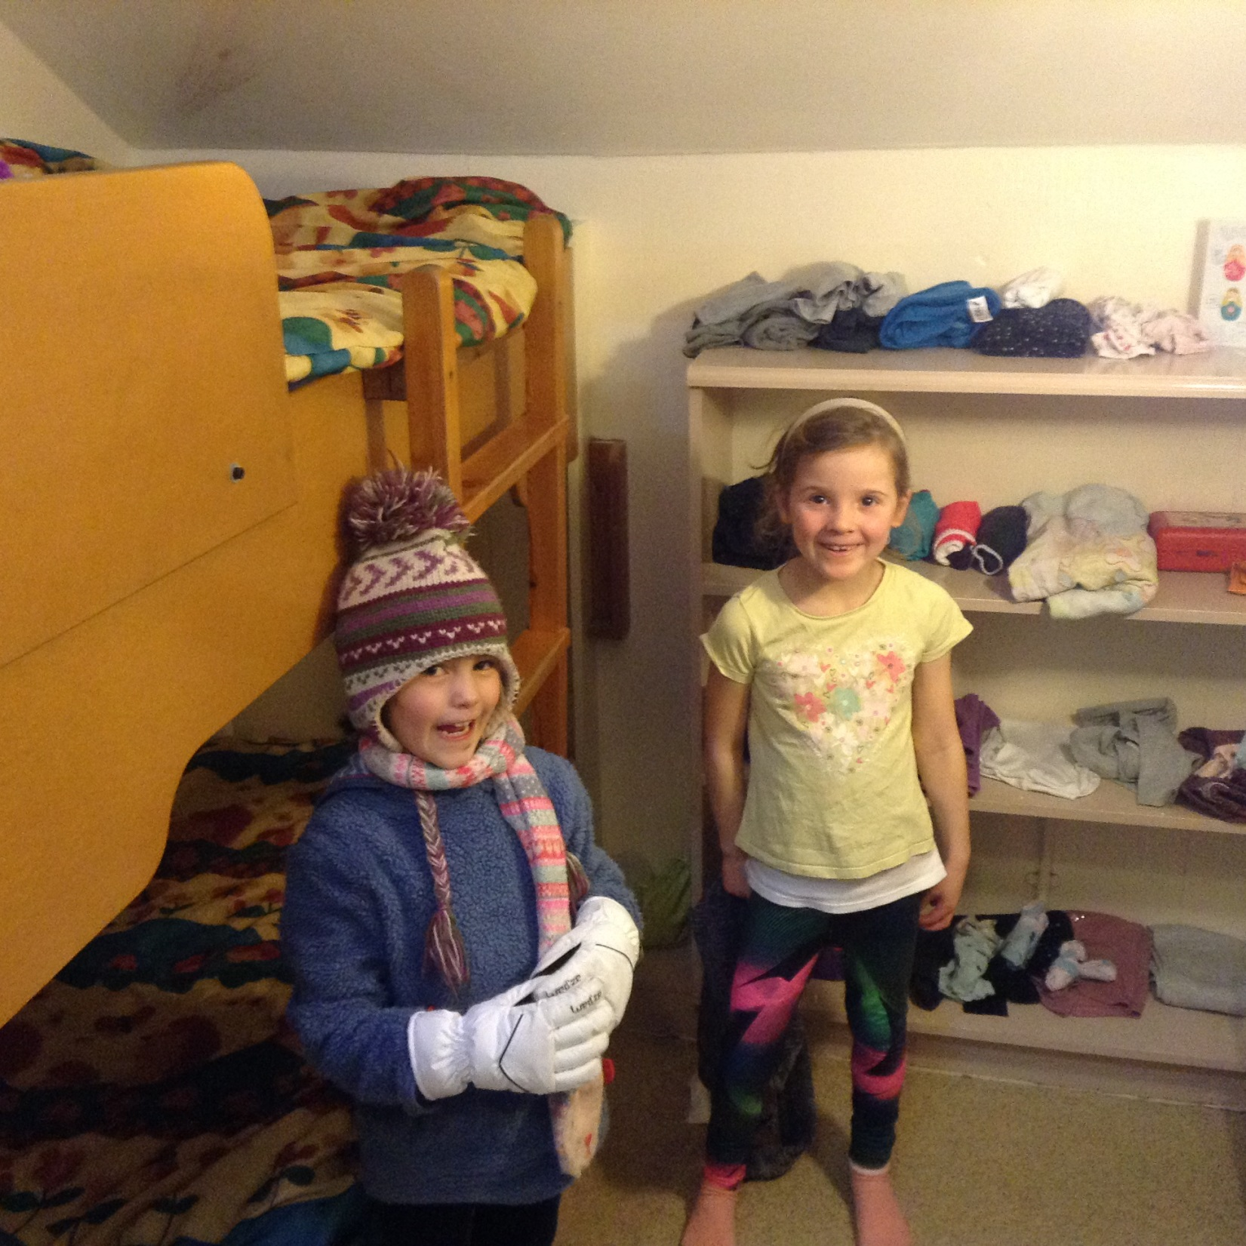
Let’s inspect the rooms! Who is the tidiest?

Slide 3
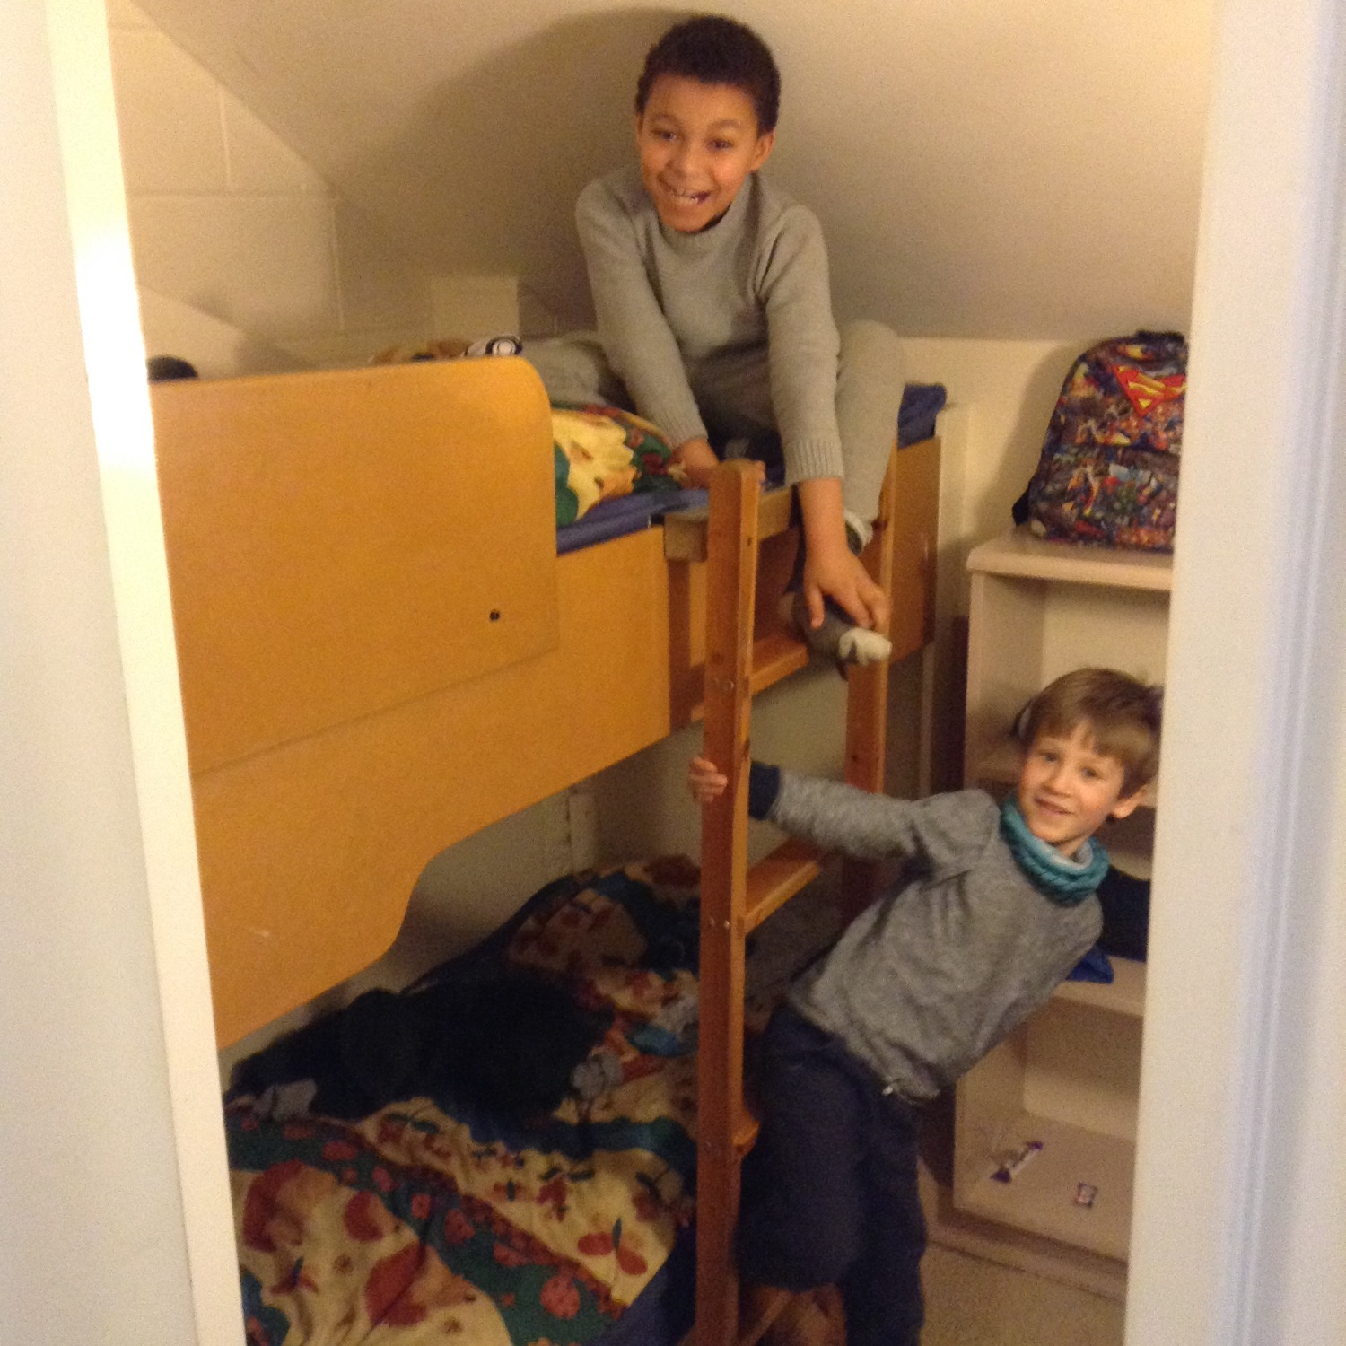

Slide 4
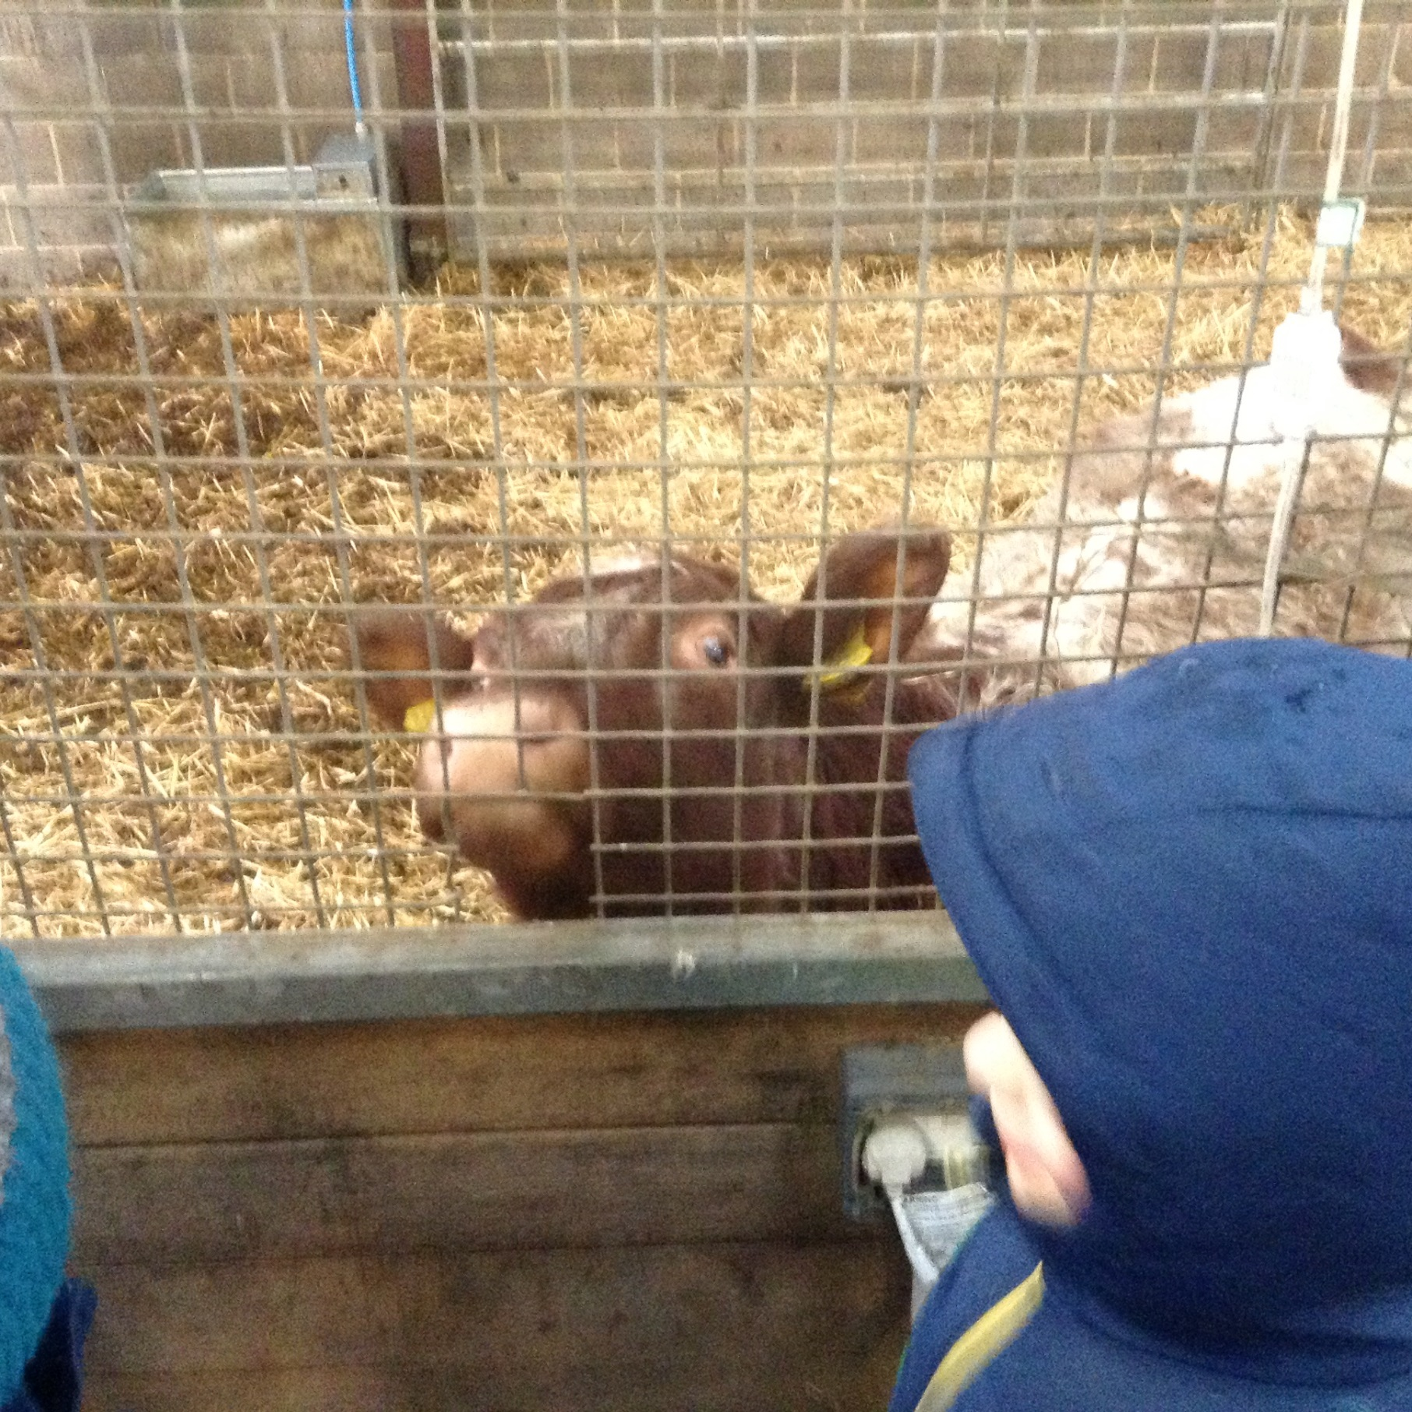
Howdy Seb!

Slide 5
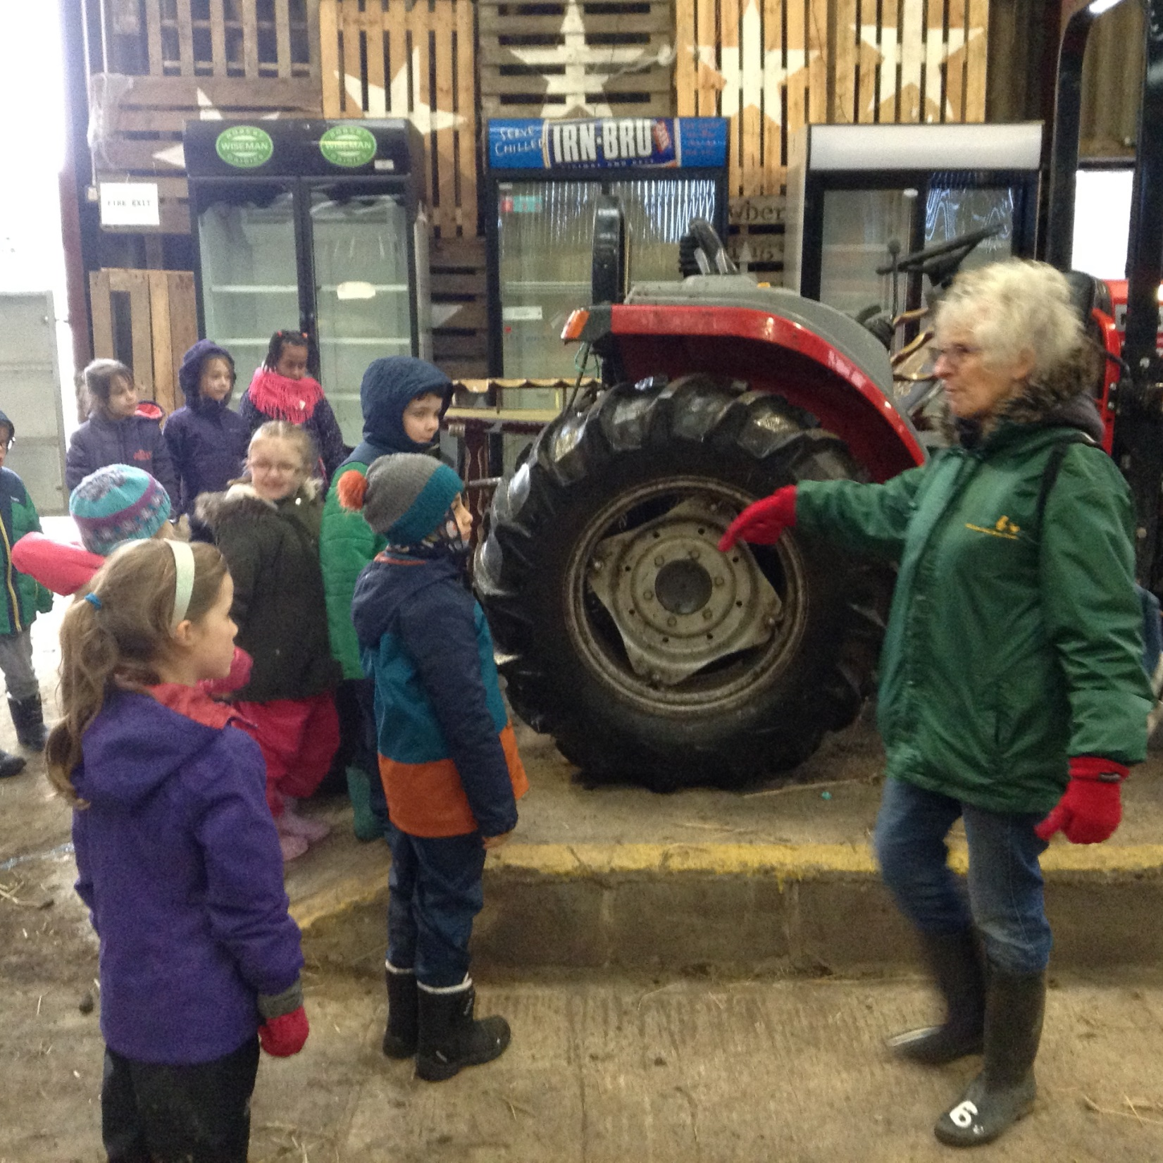
I wish I could drive that tractor!!

Slide 6
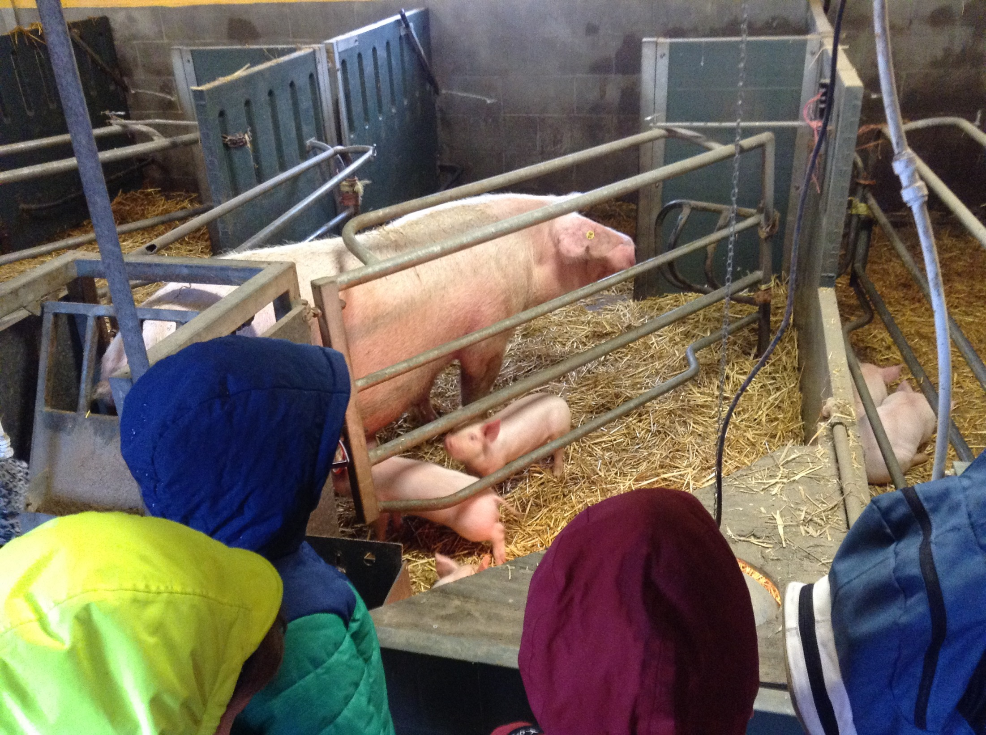
These piglets had warm lamps in their sty to keep them warm
This is the toilet area
for the pigs because
they are clean
animals.

Slide 7
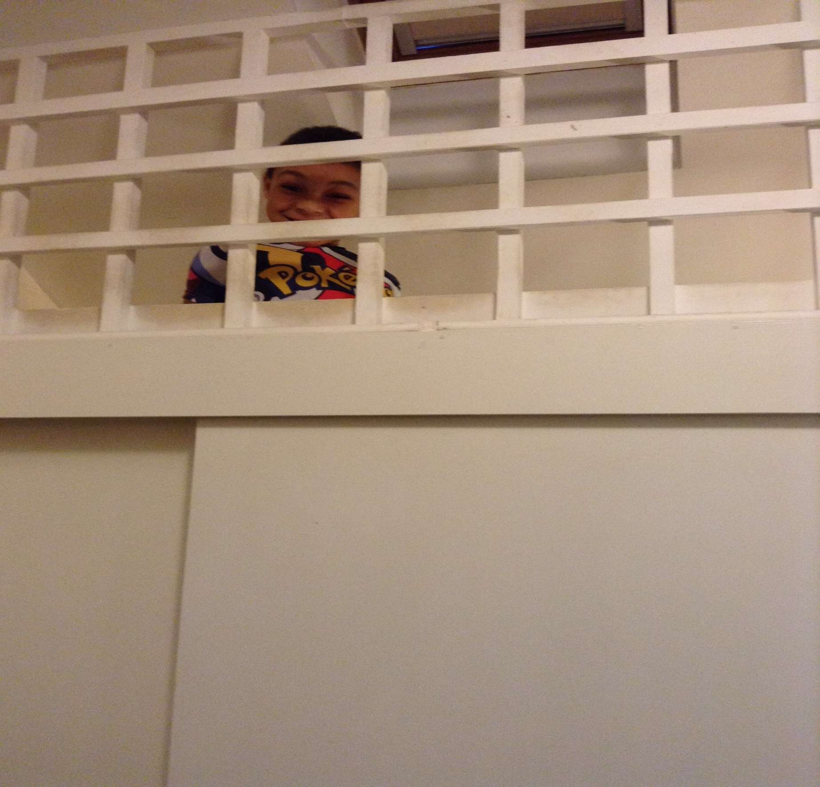
Night, Night Gruffalos!

Slide 8
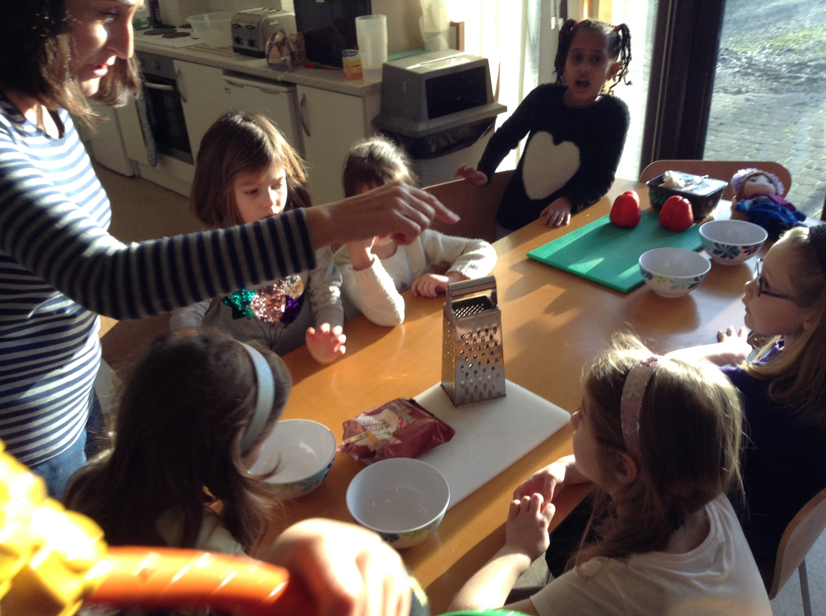
We need to make our pizzas for this
evening!
After breakfast, we made our pizzas for later that day.

Slide 9
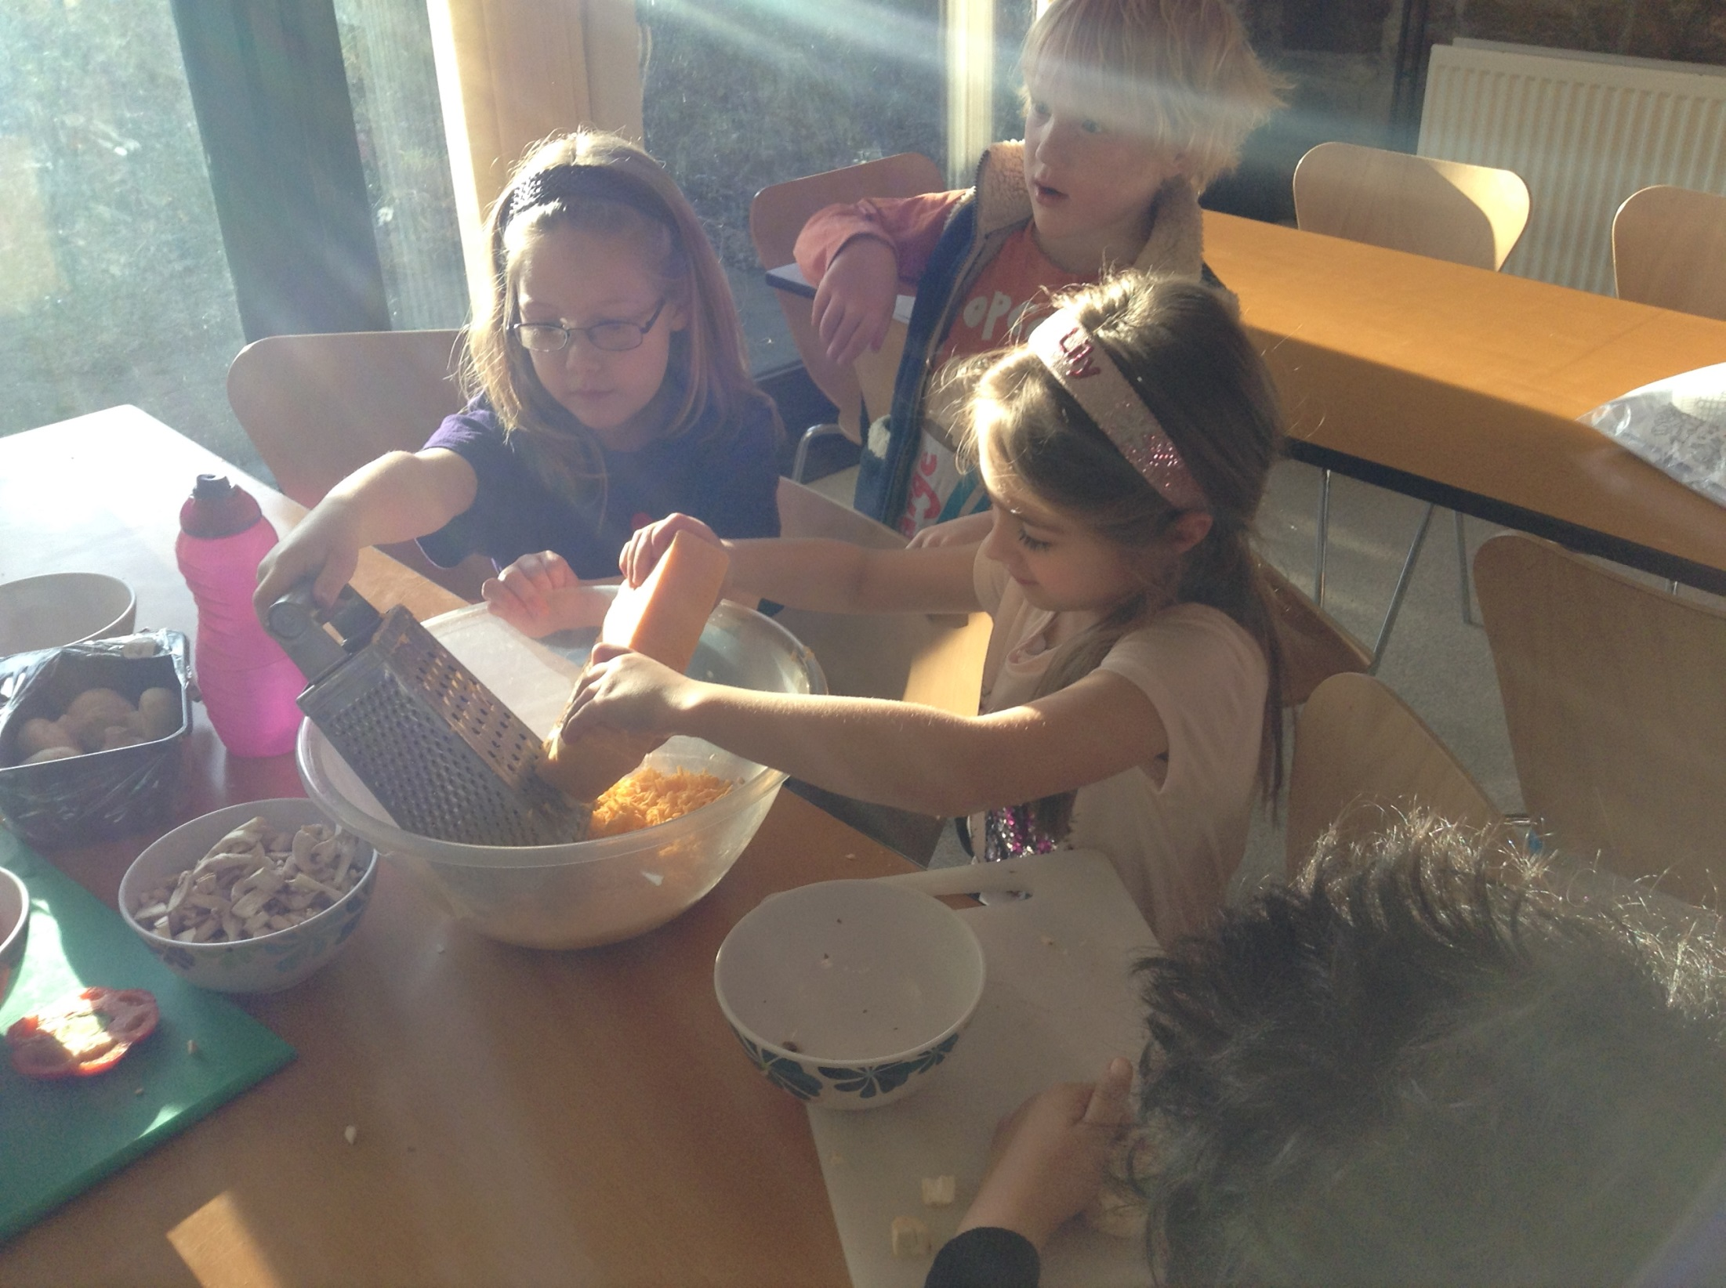

Slide 10
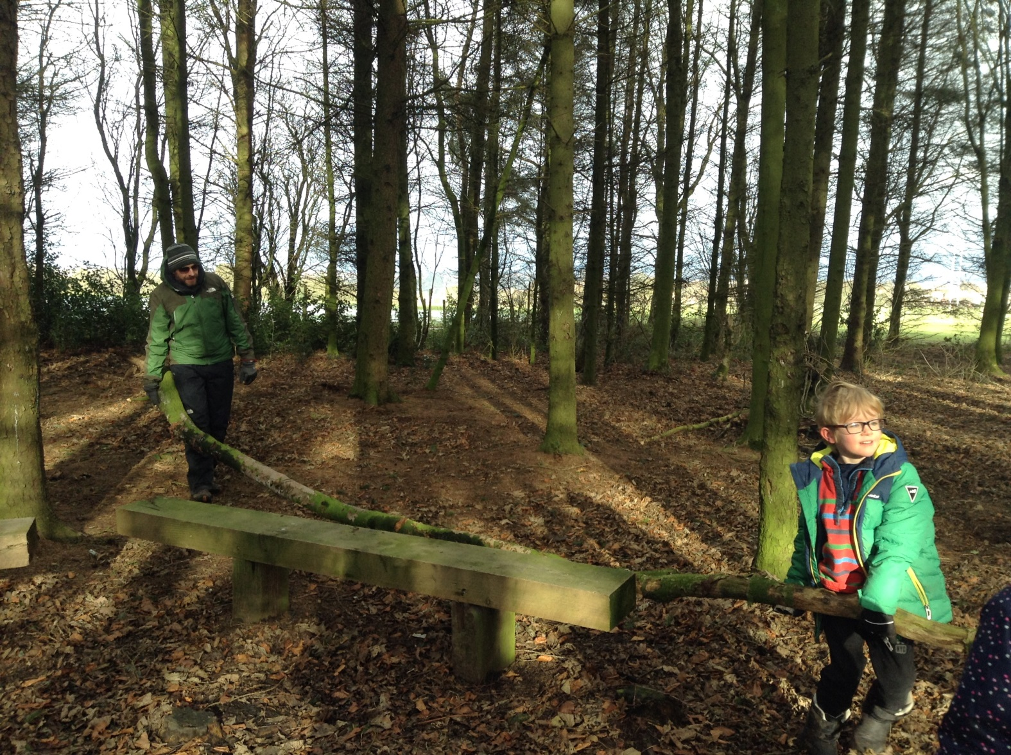
Den Making!

Slide 11
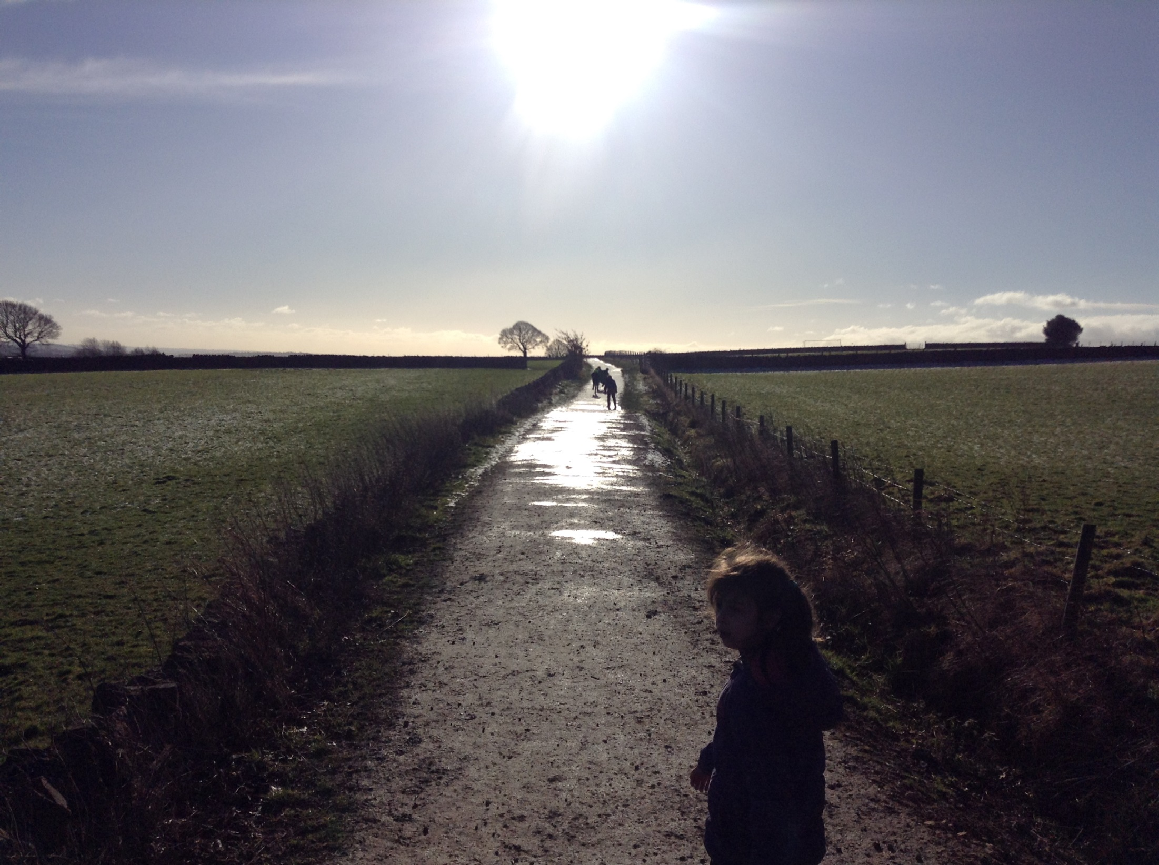
What a day!

Slide 12
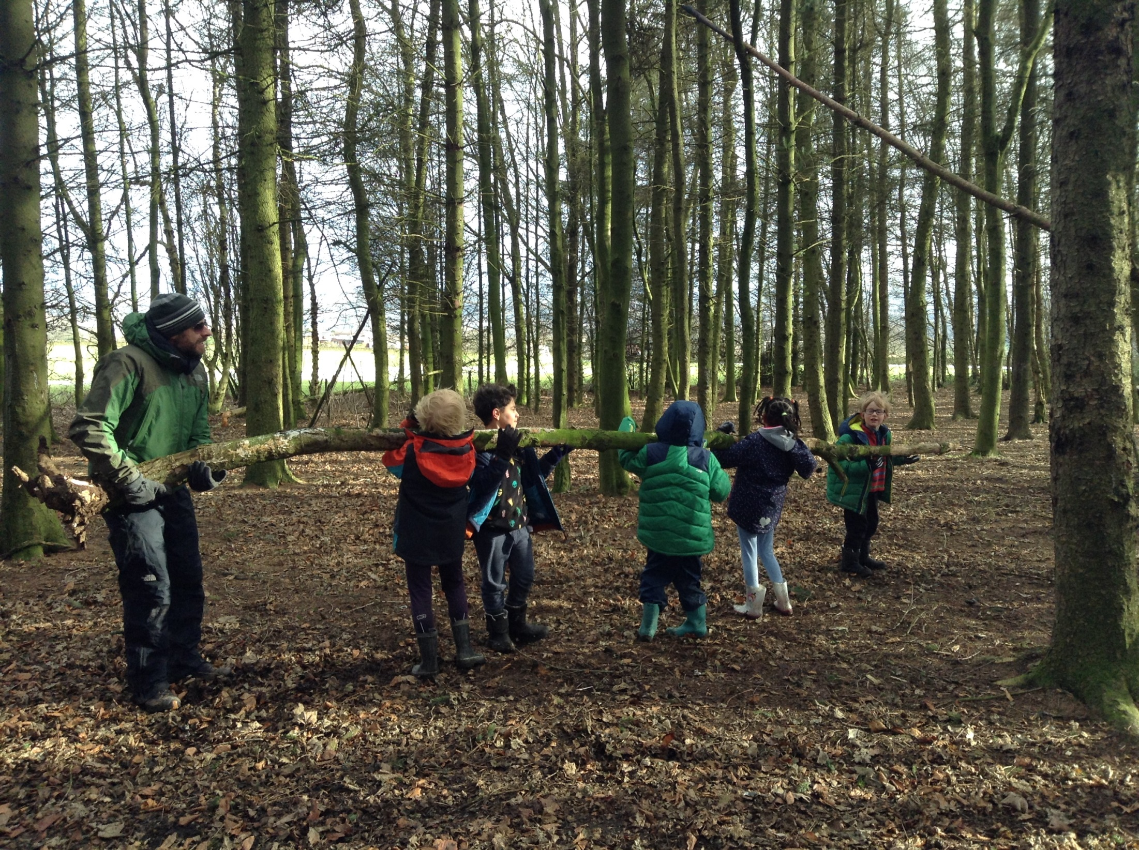

Slide 13
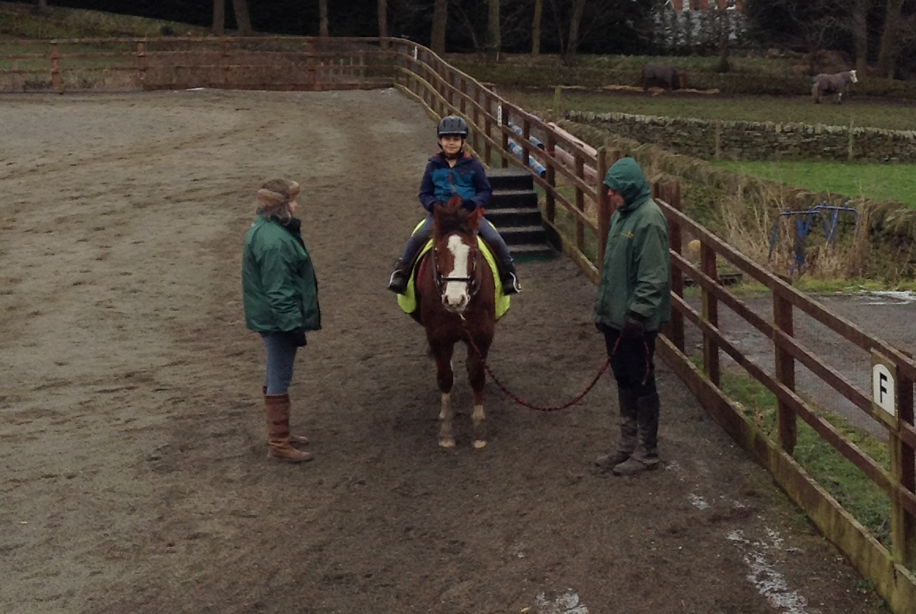

Slide 14
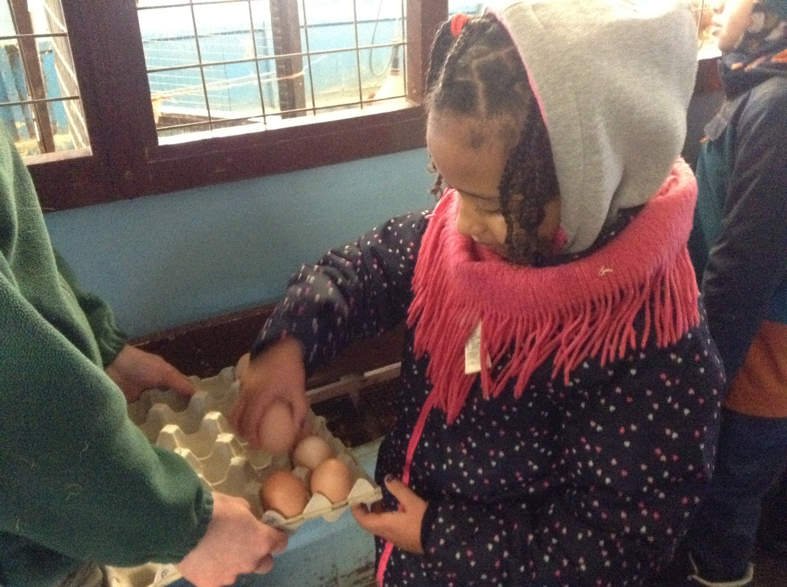
Collecting and counting eggs!

Slide 15
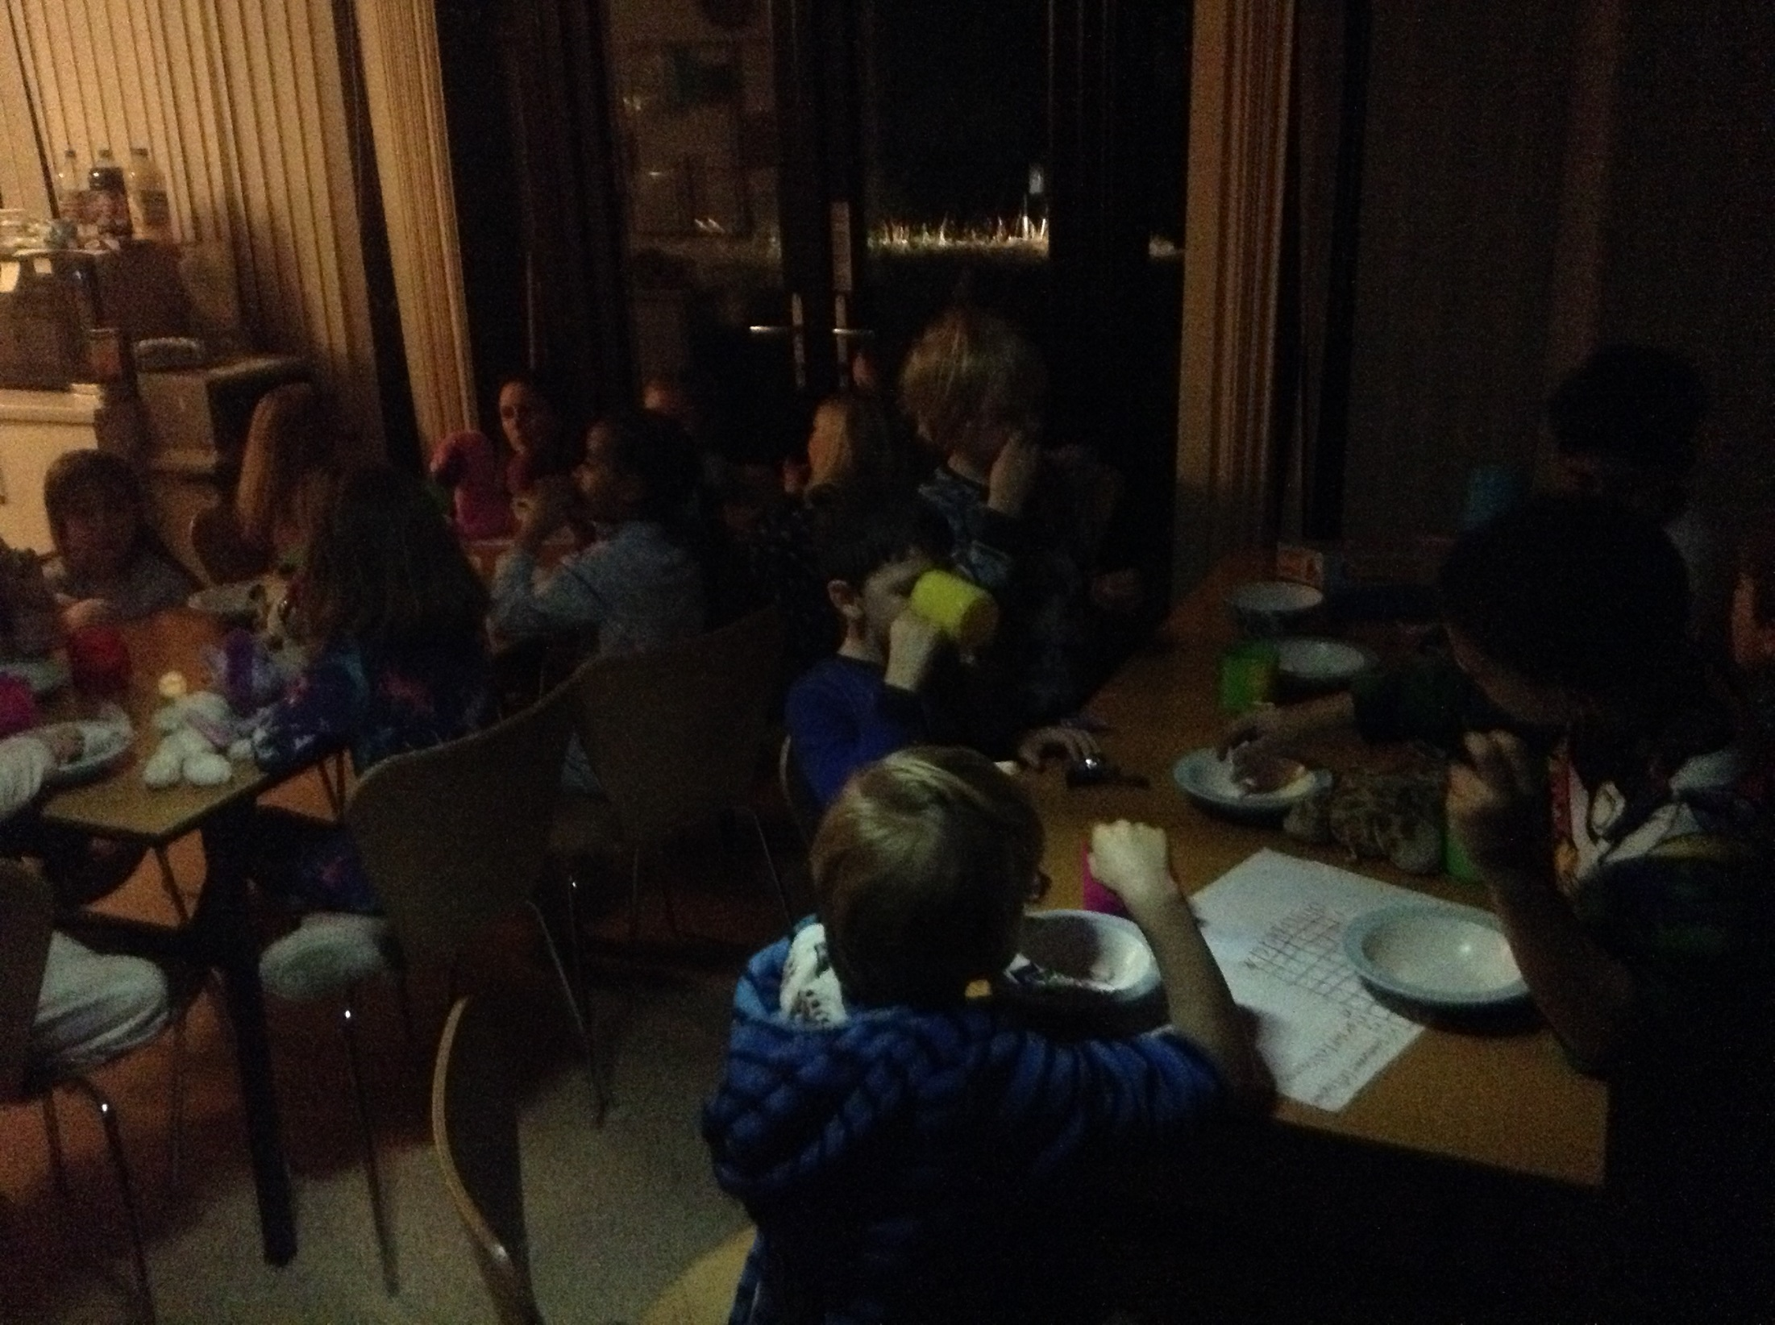

Slide 16
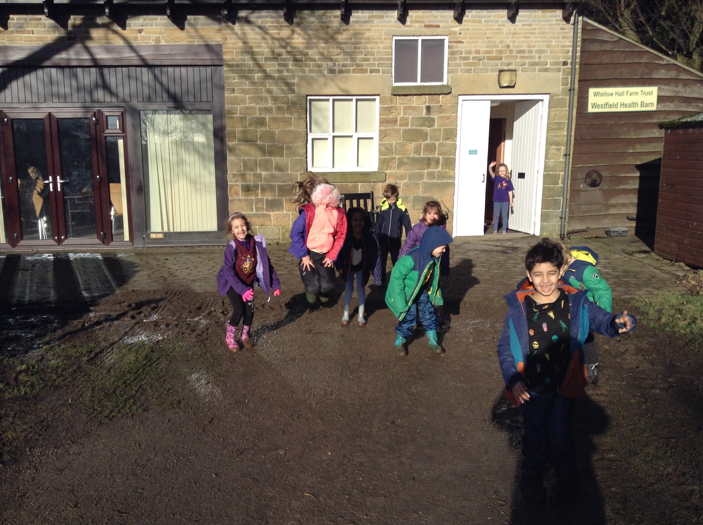
Bye, bye Whirlow! We will never forget the
last 3 days!

