Slide 1
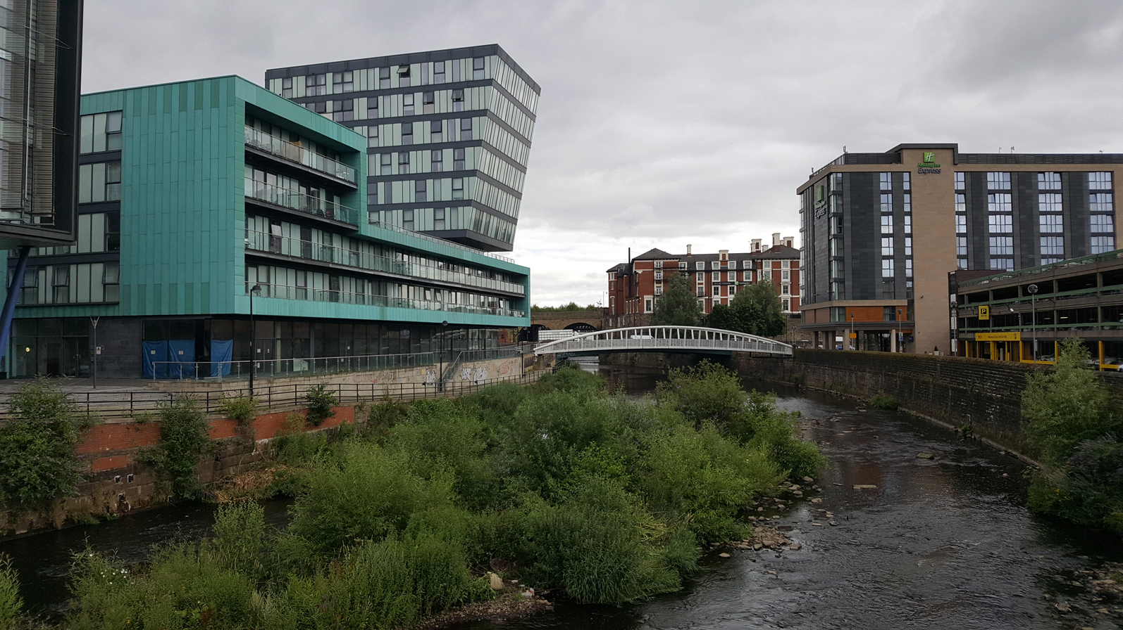
Restless Rivers

Slide 2
Floods
LO: To be able to explain the causes of flooding.
I can remember to:
name the four main causes of flooding.
cut out the photos (scissors or paint app).
read the captions to put the photo in the right place.
discuss how floods can be prevented.

Slide 3
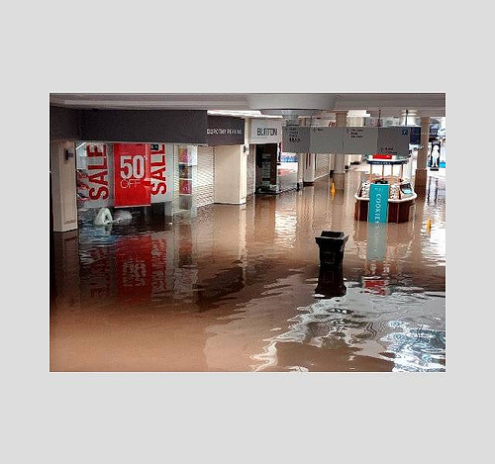
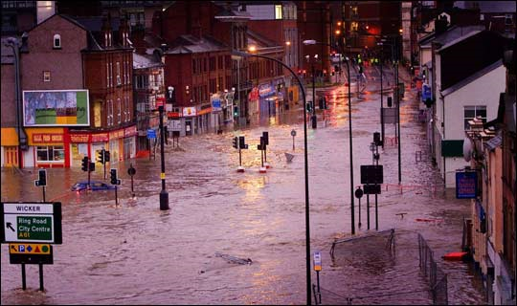
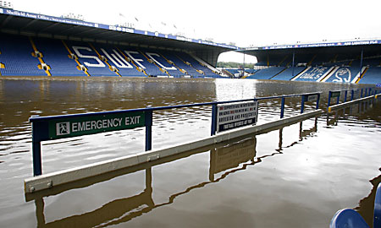
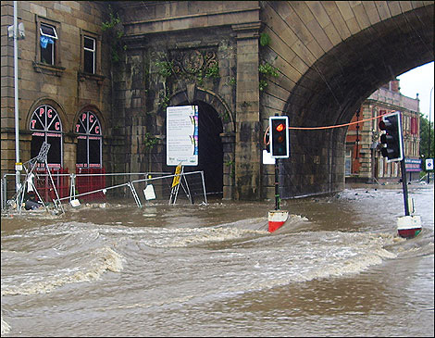
Floods
Let’s start off by looking at a flood that happened in Sheffield not too long before you were born. The Sheffield Flood 2007

Slide 4
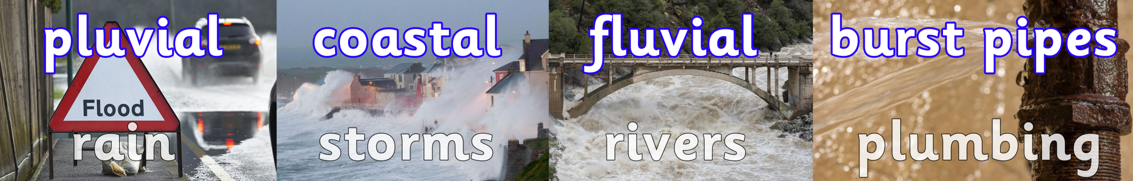
So, what causes a flood?
There are four main types of flooding that might occur.
Which one is least likely to happen in Sheffield?
Below, there are links to two videos that explain how floods occur.
Please watch both of them and then explain to your partner, parent or rubber ducky what the differences are between the four main types of flooding.
Simple overview with nice animation. Real life examples.

Slide 5
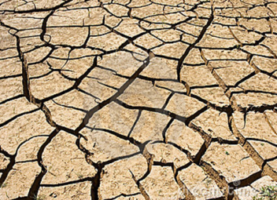
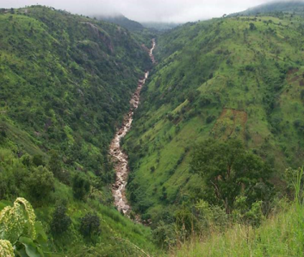
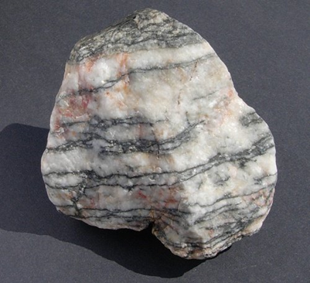
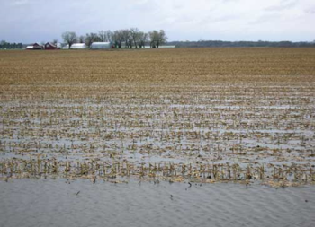
So, what causes a flood?
If the weather has been hot/dry the ground gets ‘baked’ and the rain can’t soak in very quickly. So it flows overland to the river.
If the surrounding land is steep or surrounded by mountains then water will flow down the sides (and end up in the river ) faster.
The type of rock is important. Some are permeable and let water through, other are impermeable and don’t.
If there has been a lot of rain water over a period of time the ground gets ‘saturated’ and can’t hold any more water.

Slide 6
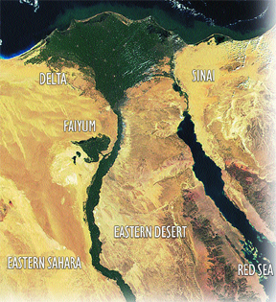
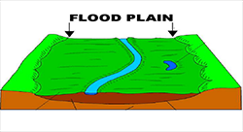
Is flooding a bad thing?
In some parts of the world, seasonal flooding is necessary. In ancient times, it was part of an Egyptian pharaoh's job to pray for the River Nile to flood. This yearly flood would make the soil fertile and nutritious for farmers to grow their crops in the flood plain.
Can you see where the plants are growing on the Nile flood plain?

Slide 7
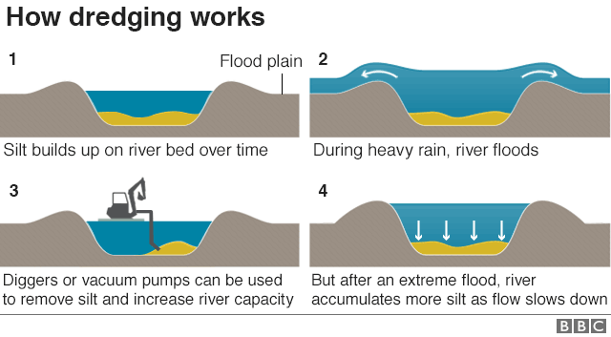
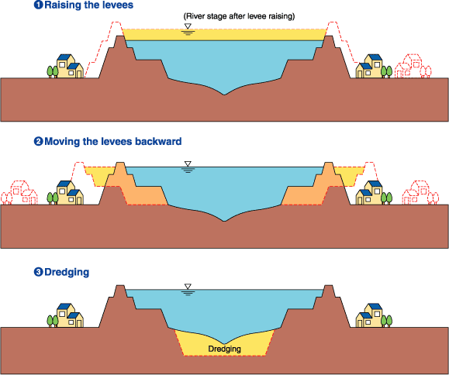
What can be done to prevent flooding?
Rivers can be modified to allow more water to flow through them. This makes them lower or shallower. Rivers can be dredged or widened. The banks can also be artificially raised to form levees.
Planting trees along the river bank also helps to reduce the movement of the river through erosion and to soak up excess water.

Slide 8
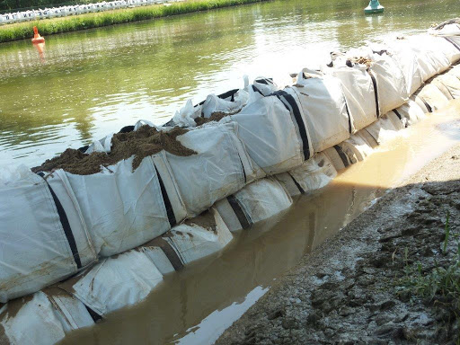
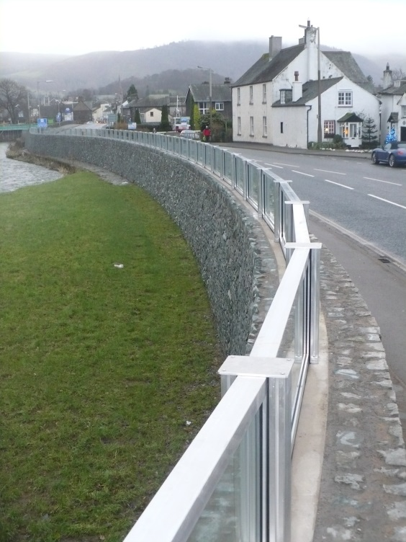
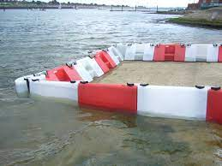
What can be done to prevent flooding?
Permanent barriers can be built like the windows here which extend the height of this river-side wall.
Temporary barriers can also be put up. These are typically inflated or filled with sand or (ironically) water.
What can be done about flooding?

Slide 9
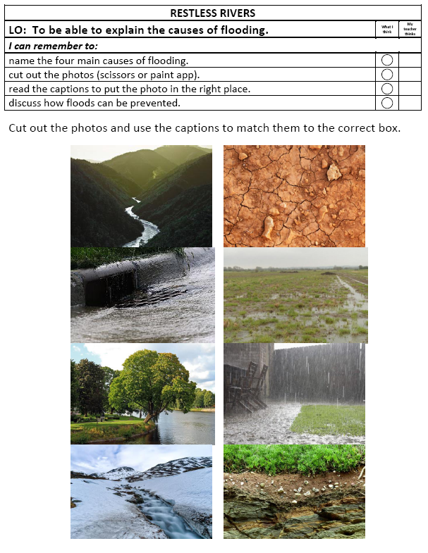
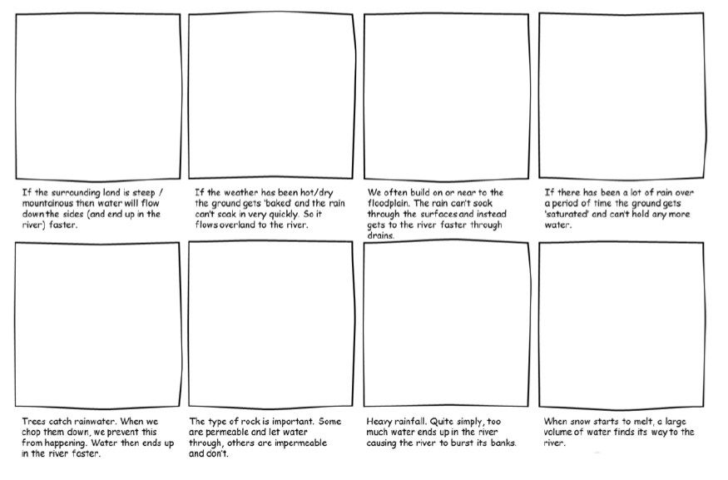
Your Task
Read the captions and match the photos to their descriptions.

