Slide 1
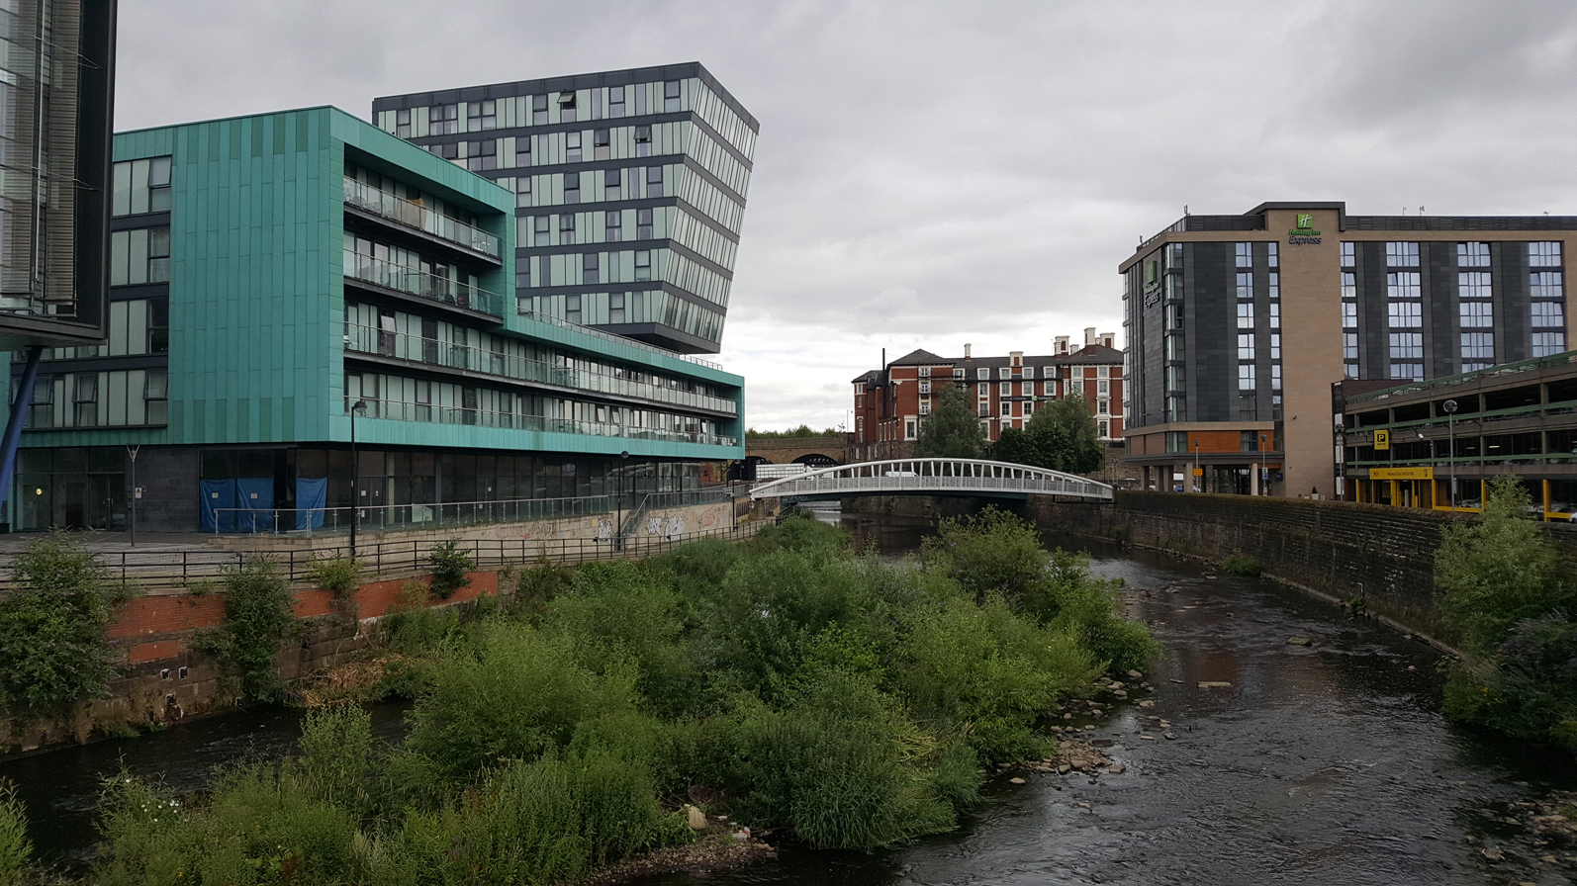
Restless Rivers

Slide 2
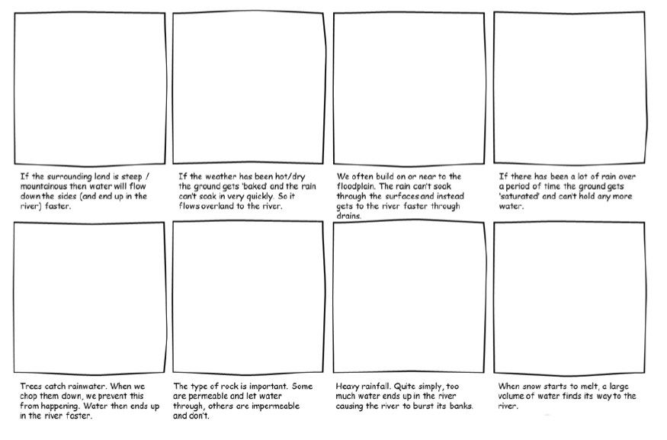
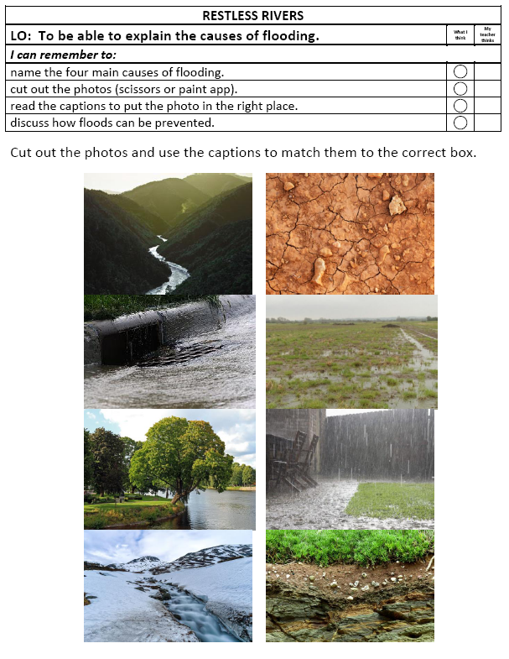
Your Task
Read the captions and match the photos to their descriptions.

