Slide 1
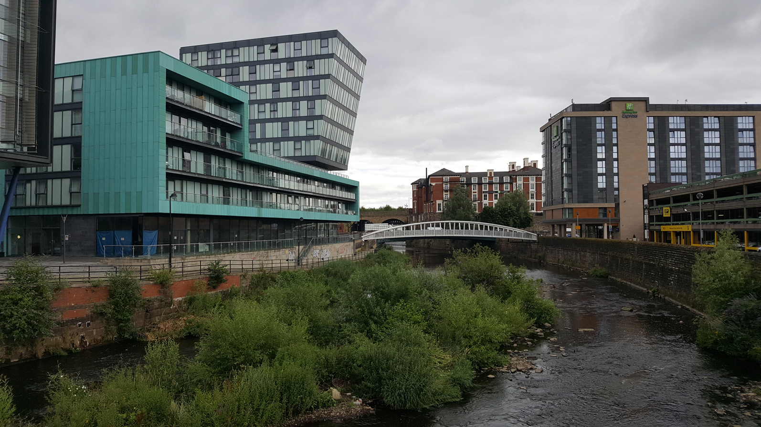
Restless
Rivers

Slide 2
What is a river?
LO: To be able to identify features of a river.
I can remember to:
perform the erosion and deposition chant.
match river terms to their definitions.
label a diagram of the journey of a river.

Slide 3
What exactly is a river?
With your partner, parent or teddy bear, discuss: What do you think a river is?
A river is a ribbon-like body of water that flows downhill (powered by the force of gravity) into the sea, a lake or another river.
There are other words that mean the same as river. Can you think of some?
Here are the most common, but there are more:
brook, stream, beck, creek, waterway, runnel
Here’s a way to remember the difference in size:
“You can step over a brook, jump over a creek,
wade across a stream, and swim across a river.”

Slide 4
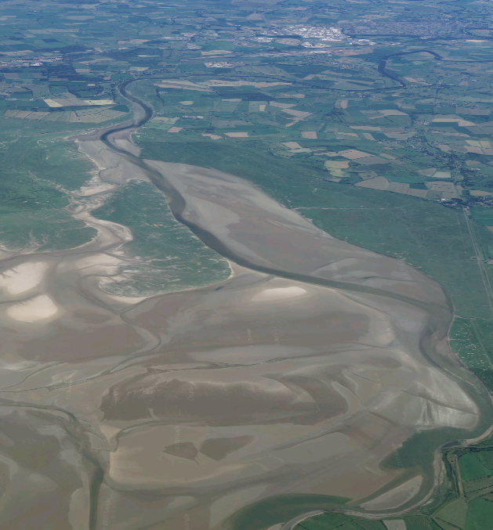
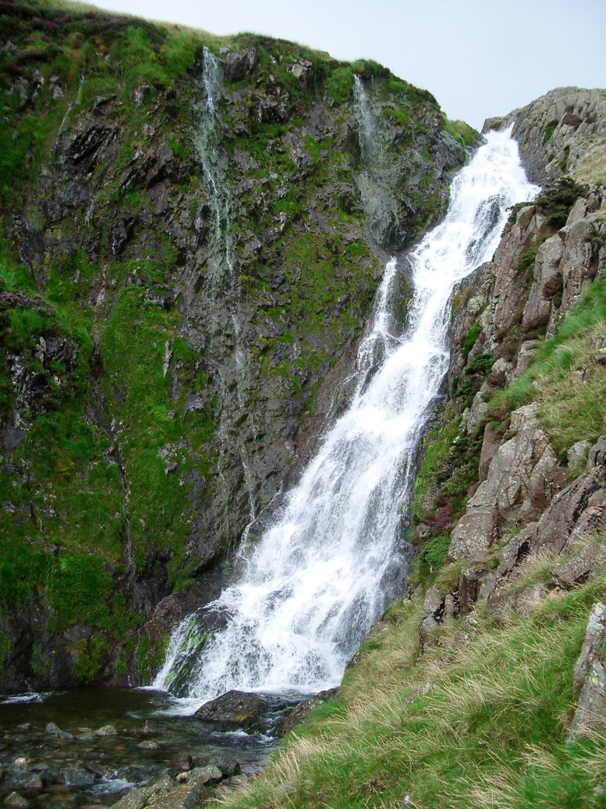
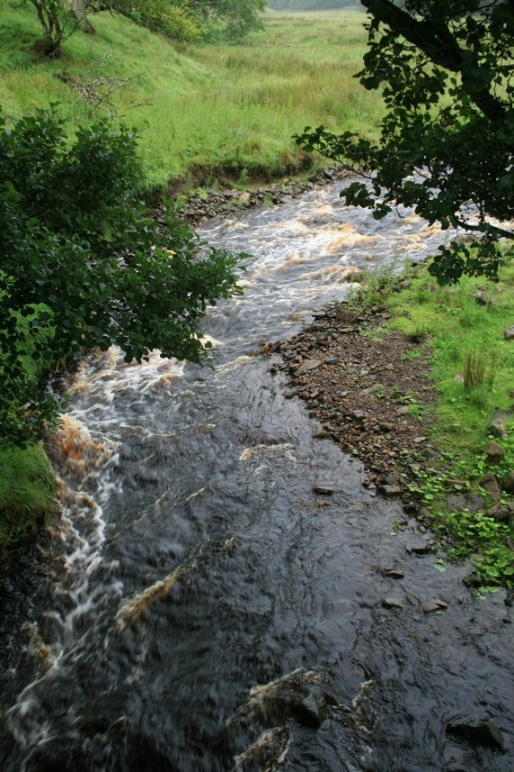
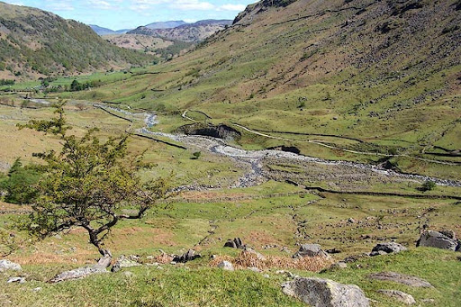
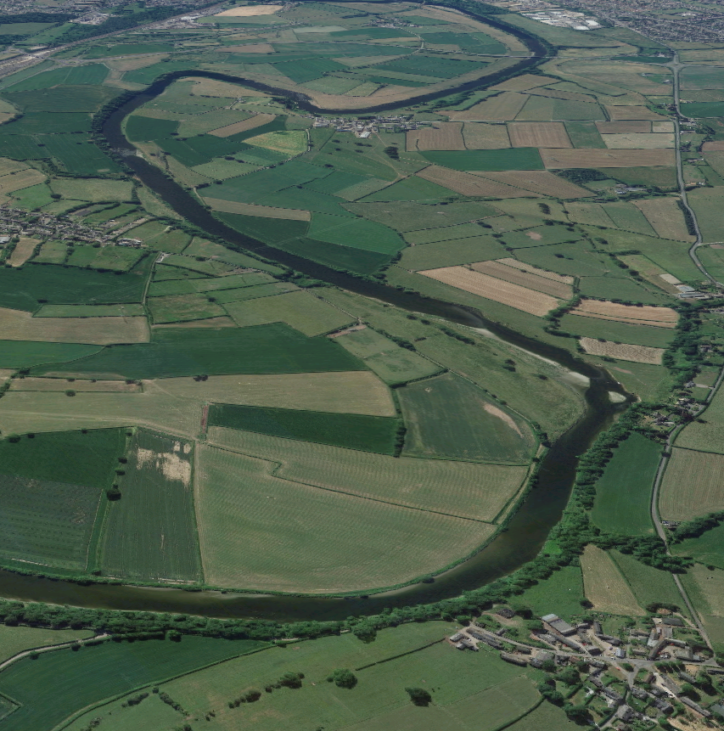
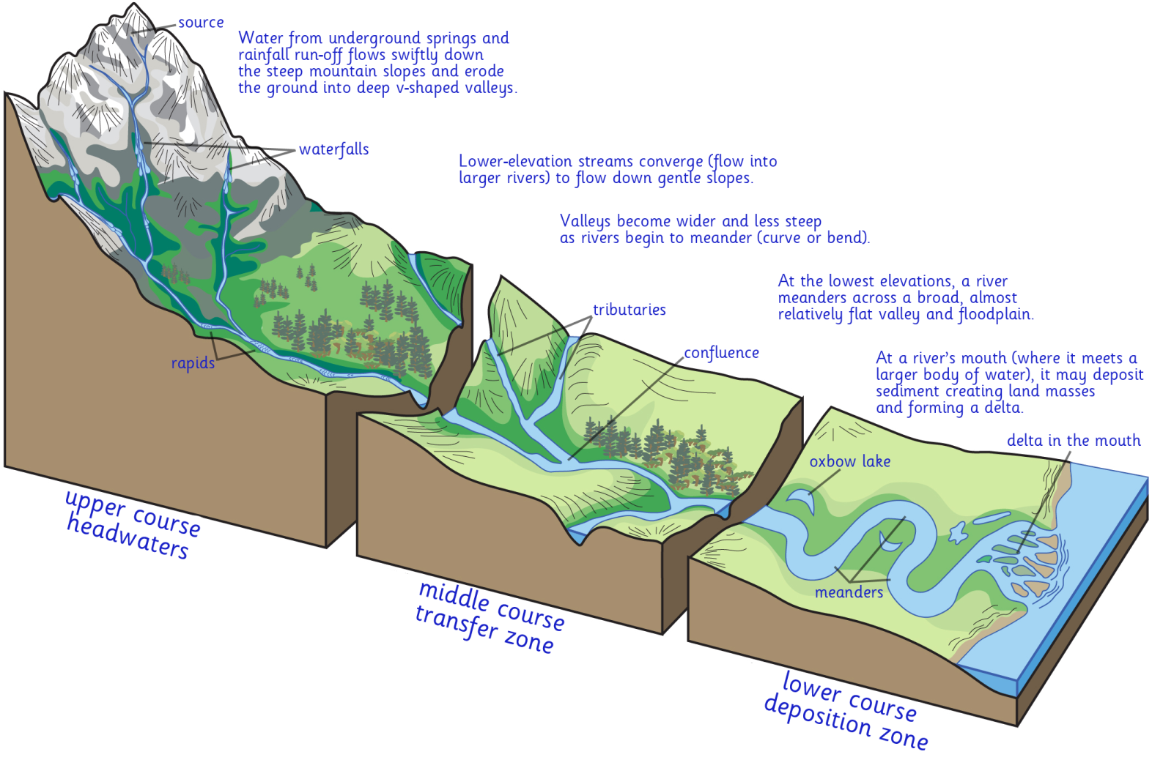
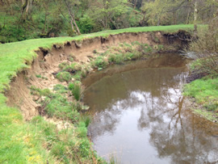
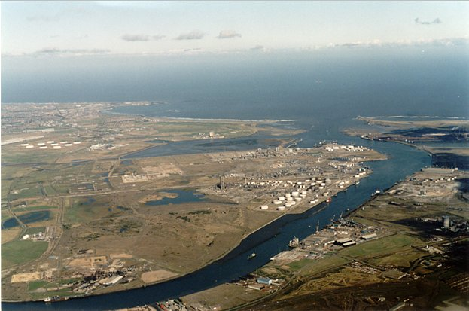
The Course of a River
While the water will always flow down the river channel, rivers don’t flow in exactly the same way all the way along.
There are three main stages of a river.
Middle course
The fast flowing water causes erosion, making the river deeper and wider.
Upper course
Shallow, narrow streams pick up speed as they drop over waterfalls.
Lower Course
The slowest part of the river. As the flow loses momentum, the eroded soil and rock is deposited, causing sediment to build up on the banks.

Slide 5
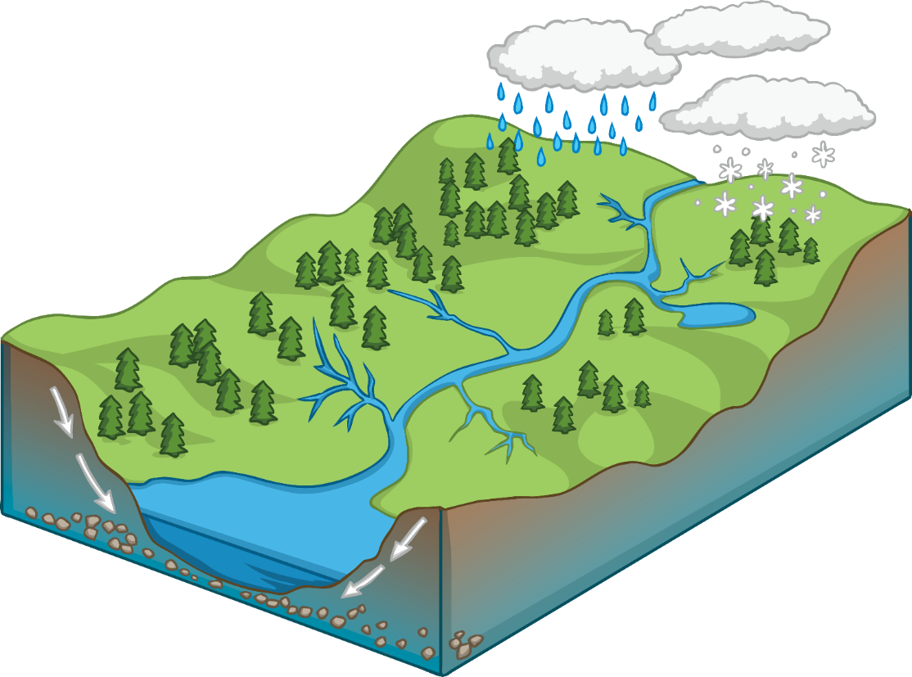
Click each point on the diagram to learn more.
Drainage Basin
Watershed – an imaginary line separating one drainage basin from another.
River channel – the area a river flows in, with banks on each side.
Source – the point at which a river starts its journey.
Drainage basin – the area of land drained by a river.
Tributary – a small river leading into a bigger river.
Confluence – where two rivers join together.
Mouth – where a river enters the sea.

Slide 6
What is erosion?
Click here to watch a video on how water erosion occurs in rivers. It’s obviously sped up quite a lot! This would take years or even decades in real life.
Erosion is an action of water flow (or wind) that removes soil, rock or dissolved material from the earth.
Small parts of the landscape are broken off from their resting places and carried away.
These bits of sediment are then deposited elsewhere. In the case of rivers, the erosion occurs at all levels (less in the rocky upper section, more in the soft soil in the middle section).
As the river slows down in the lower section, it no longer has the momentum to carry heavy sediment, so it deposits it on its river bed or along its bank.
Watch this animation on how erosion and deposition changes the shape of rivers.

Slide 7
Erosion and Deposition
Listen to this chant and then have a go at performing it yourself to help you remember what the river water does to rocks and soil.
Break, move, drop.
Break, move, drop.
All of these processes happen to a rock. (repeat)
Weathering breaks it,
Erosion takes it.
And when the motion stops,
Deposition drops.
Wind and water moving around,
Gravity pulls it down.
Watch the chant

Slide 8
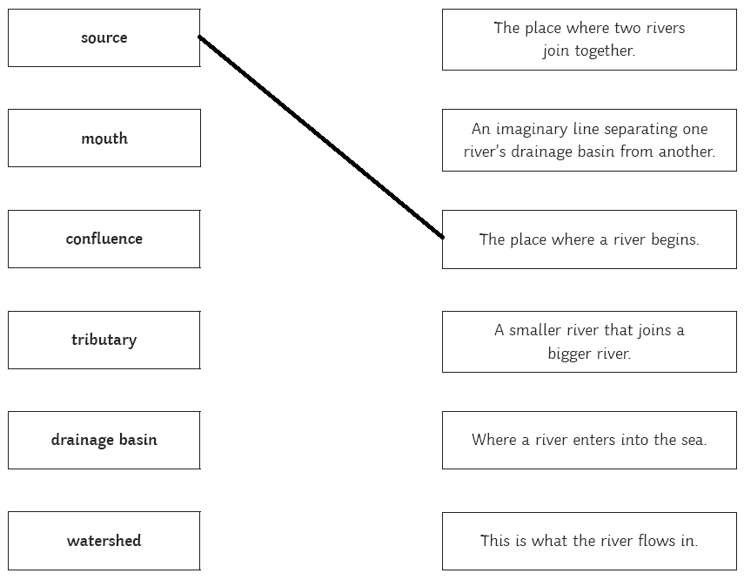
Your Tasks
Can you match these terms to their definitions?
One has been done for you.
Look at the next task.
Check your answers.

Slide 9
Your Tasks
Can you match these terms to their definitions?
One has been done for you.

Slide 10
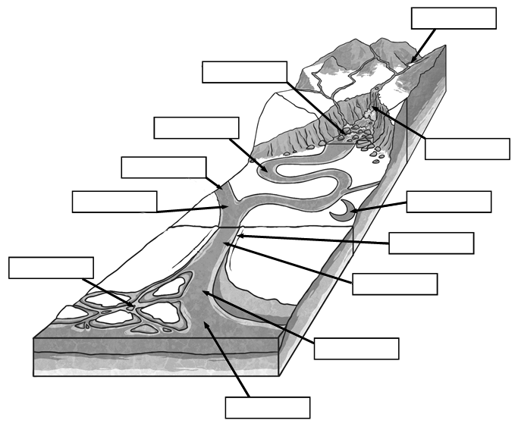
Your Tasks
Use the word bank to label this diagram of a river.
Can you also label the upper course, middle course and lower course?
Check your answers.

Slide 11
Your Tasks
source
rapids
Use the word bank to label this diagram of a river.
Can you also label the upper course, middle course and lower course?
meander
waterfall
tributary
confluence
oxbow lake
bank
delta
channel
estuary
mouth

Slide 12
So, to recap…
Can you explain your answers to these questions to your partner, parent or teddy bear:
What is erosion?
What happens at the upper course of a river?
Which course would you find an estuary in?
What is a confluence?

