Slide 1
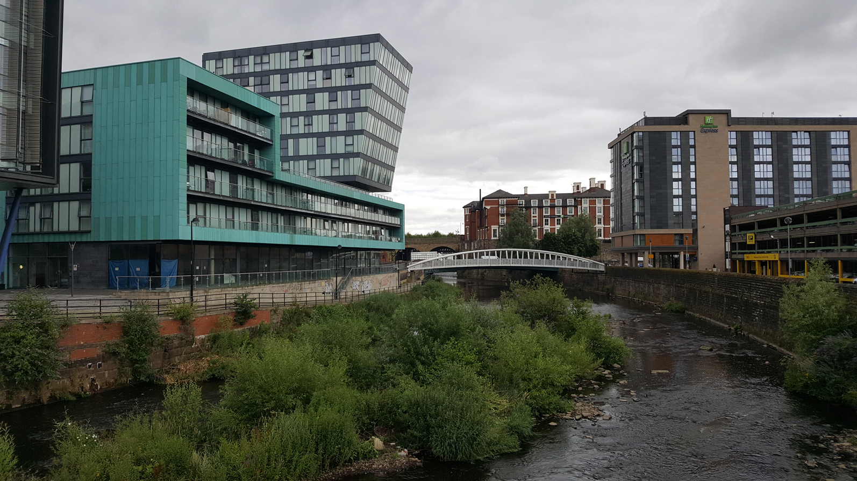
Restless Rivers

Slide 2
Rivers in the UK
LO: To be able to identify rivers in the United Kingdom.
I can remember to:
name major rivers in Sheffield and in the rest of the UK.
label the seas surrounding the British Isles.
use a map to identify rivers by their shape and the shape of the coastline.
*follow a river on a map to see where it begins and ends.

Slide 3
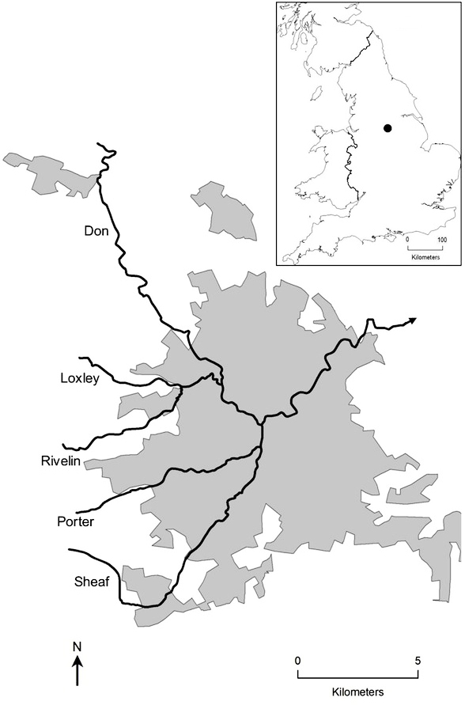
What are the 5 main rivers in Sheffield?
River Don
River Sheaf
Porter Brook
River Loxley
River Rivelin

Slide 4
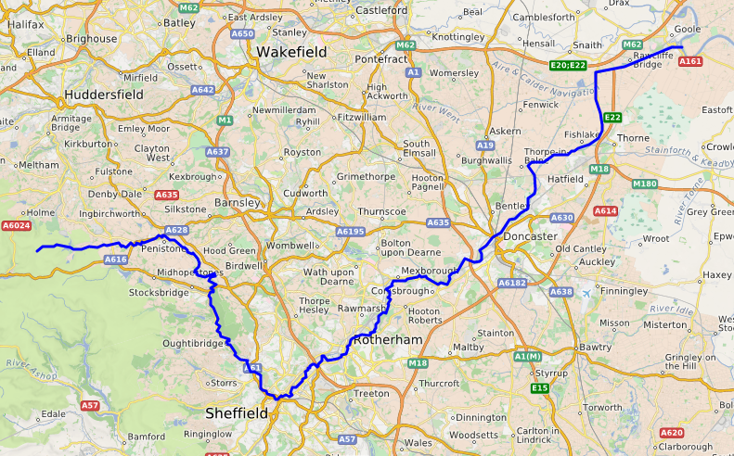
River Don
The major river that flows through Sheffield is the River Don.
The name Don is Celtic – it means water.
It rises in the Pennine mountains and flows for 70 miles (110 km) eastwards, through the Don Valley, via Penistone, Sheffield, Rotherham, Mexborough, Conisbrough and Doncaster.
It originally joined the River Trent, but was redirected in the 17th century to flow into the River Ouse.
Back to Sheffield’s Rivers
Move on to the rest of the UK

Slide 5
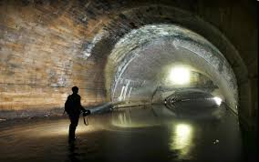
River Sheaf
Sheffield gets its name from the River Sheaf (Sheaf-field).
Interestingly, the Sheaf has been built over and now runs partially under the city of Sheffield. It flows through a Victorian-age tunnel system called the Megatron (not the Transformers villain).
The Sheaf flows through Dore and Totley, passing London Road. It runs underground until it pours into the River Don near Castlegate.
Back to Sheffield’s Rivers
Move on to the rest of the UK

Slide 6
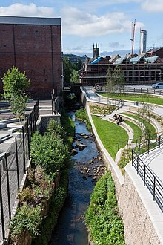
Porter Brook
Porter Brook takes its name from its brownish colour, similar to the colour of Porter, a brownish discolouration obtained as it passes over iron-ore deposits on its course from the source.
It flows through Endcliffe Park into the City centre where is joins the River Sheaf.
Back to Sheffield’s Rivers
Move on to the rest of the UK

Slide 7
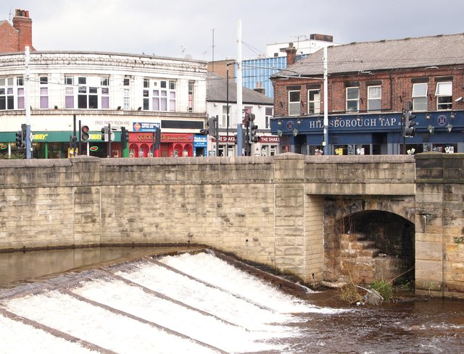
River Loxley
Its source is a series of streams which rise some 10 miles (16 km) to the north-west of Sheffield on Bradfield Moors, flowing through Bradfield Dale to converge at Low Bradfield.
It flows easterly through Damflask Reservoir and is joined by Storrs Brook at Storrs, near Stannington, and the River Rivelin at Malin Bridge, before flowing into the River Don at Owlerton, in Hillsborough.
Back to Sheffield’s Rivers
Move on to the rest of the UK

Slide 8
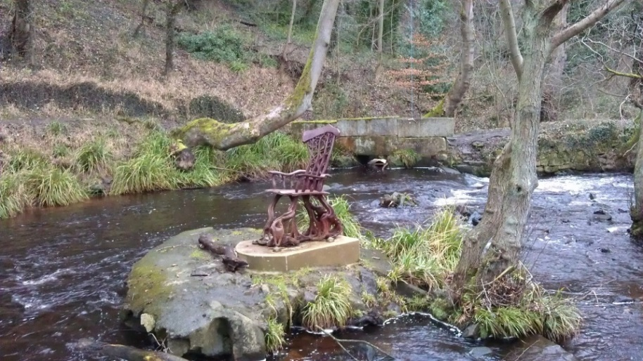
River Rivelin
The Rivelin Valley, through which the river flows, is a ​3 1⁄2-mile-long woodland valley which includes the popular Rivelin Valley Nature Trail that was created in 1967. The valley has farmland on its gentler upper slopes.
A relatively fast-flowing river, the Rivelin is fed by a constant release of water from the nearby moorland peat.
Its flow was exploited for centuries as a power source, driving the water wheels of up to twenty industries (forges, metal-working and flour mills) along its course.
Back to Sheffield’s Rivers
Move on to the rest of the UK

Slide 9
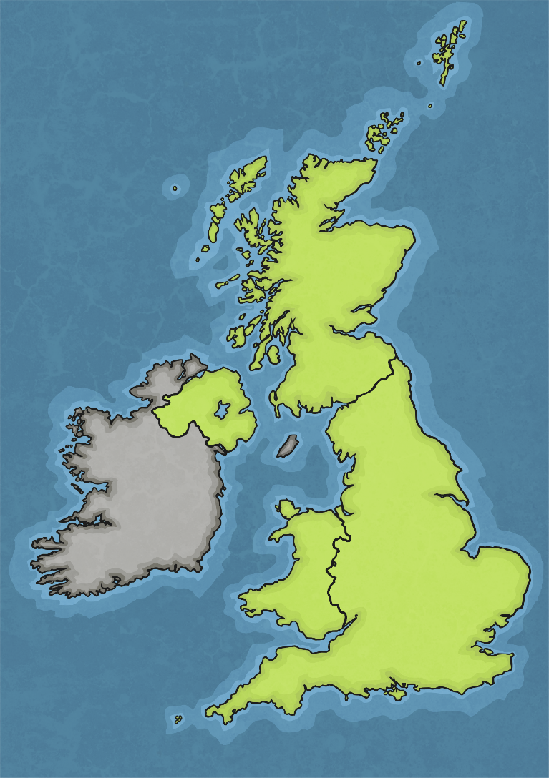







The Seas Around Us
Do you know where each label should go?
?
?
What clues might help us?
Irish Sea
Atlantic Ocean
English Channel
North Sea

Slide 10
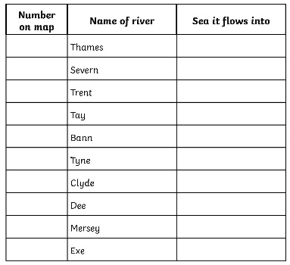
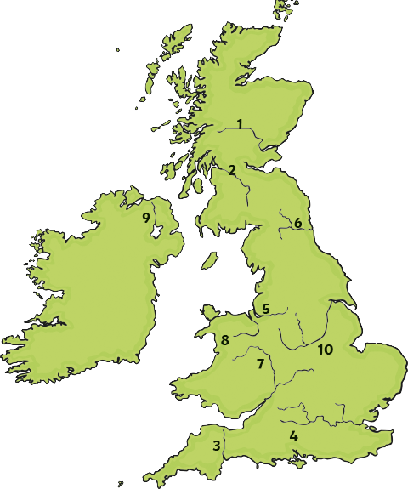
Your Tasks
4
North Sea
Using an atlas, the map that I’ve provided or Google Maps, find the River Thames.
Which number is it on the map shown here?
Which sea does it flow into?

Slide 11
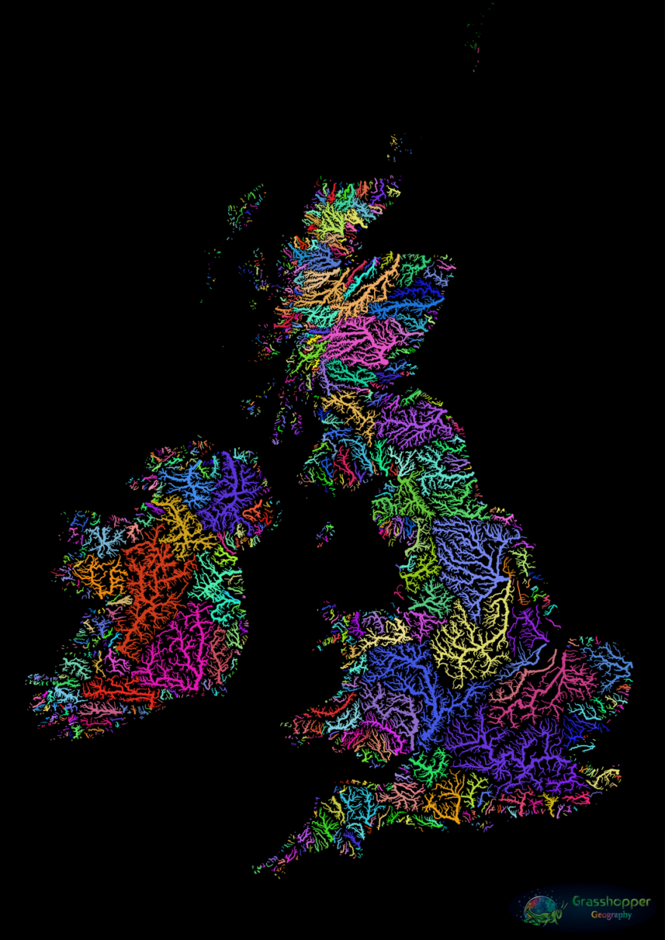
Explore on your own
Rivers can be very interesting things.
Look at the image to the left. It’s been created to show all of the rivers that are connected. You can see how the tributaries flow into the main river, which always reaches the sea.
Choose a river and use Google Maps to follow it from it’s source to the coast.
Which towns does it flow through?
Does it flow into another river?
Do other rivers join it?
Which sea does its water empty out into?

