Slide 1
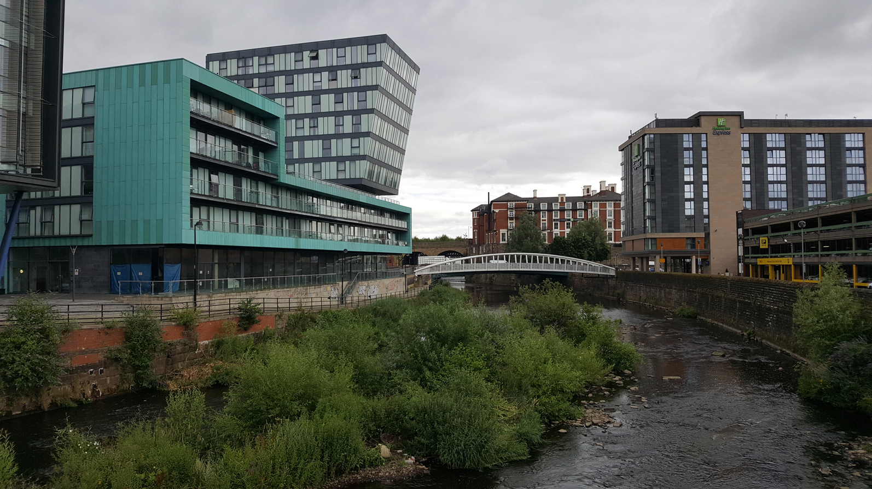
Restless Rivers

Slide 2
Quick recap:
With your partner, parent or imaginary unicorn, answer these two questions:
What exactly is a river?
What are the five main rivers that flow through Sheffield?
A river is a ribbon-like body of water which flows downhill into another river, a lake or the sea.
The Rivelin flows into the Loxley. The Porter joins the Sheaf.
Both the Loxley and the Sheaf are tributaries of the River Don.

Slide 3
How humans use rivers
LO: To be able to explain how humans use rivers.
I can remember to:
read and discuss the information.
think of ways that rivers help us.
think of how those river uses could cause problems.

Slide 4
So, why are rivers so vital to human life?
Most human settlements are near a river.
This it because fresh water is essential for human survival. We need to drink it, we need to use it to help our food grow.
What else do we use rivers for? Quick video.

Slide 5
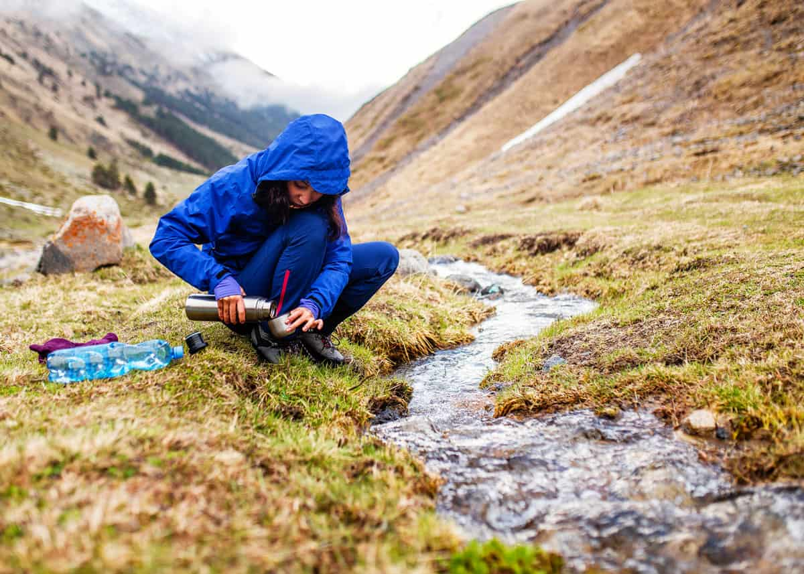
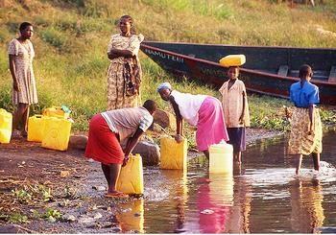
Drinking Water
Rivers are used for drinking water.
In the upper course, it is usually safe to drink because the water has been filtered as it comes out of the ground.
By the time the water gets to the lower course, however, it should be treated in a water treatment plant.

Slide 6
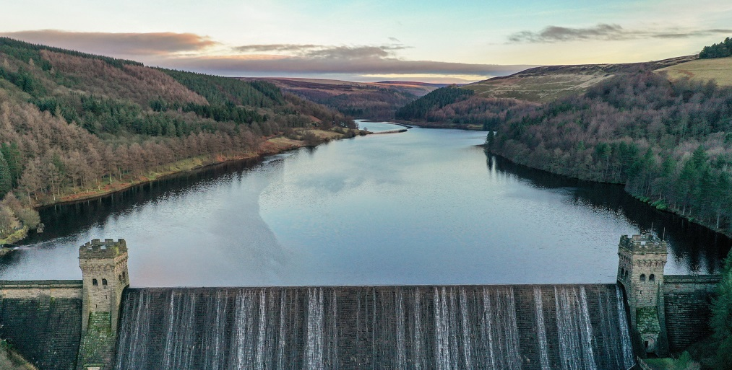
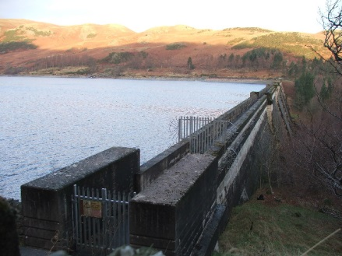
Drinking Water
In the UK, we get most of our drinking water from reservoirs.
Reservoirs are created by building a dam or weir on a river (like the rivers Derwent and Ashop in the Derwent Valley) or by enlarging an existing lake (like Haweswater in Cumbria, which has recently been piped to provide water as far away as Manchester).
Above: Sheffield’s water comes from the Howden, Derwent and Ladybower reservoirs in the Upper Derwent Valley.
Right: Haweswater.

Slide 7
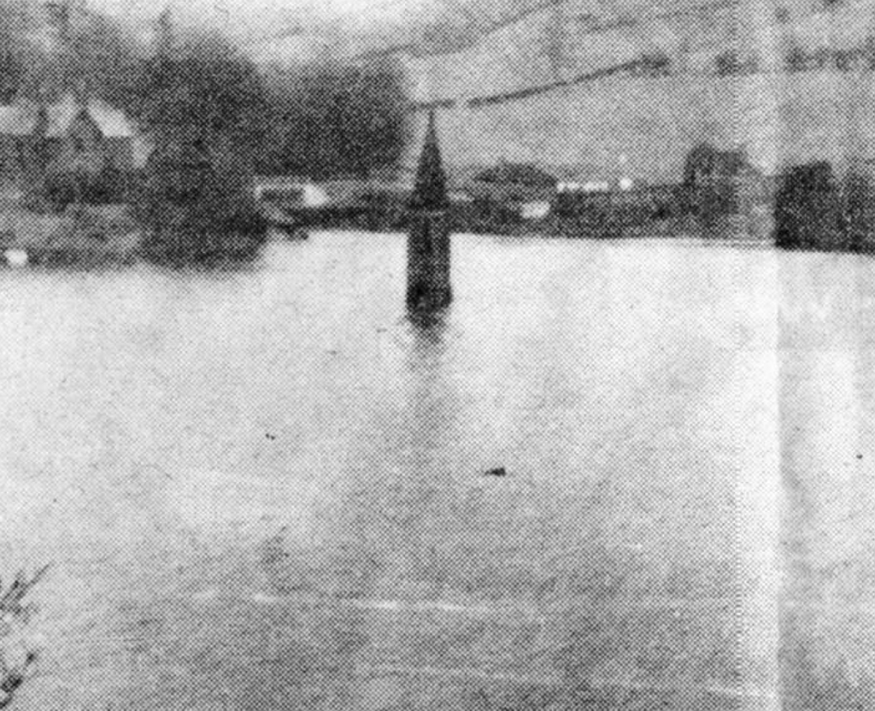
Drowned Villages
Interestingly, in both of these examples, villages needed to be abandoned in order to create the reservoirs.
The villages of Ashopton and Derwent were submerged in 1946 when the Ladybower was filled. The village of Mardale Green was drowned by the expansion of Haweswater in 1935.

Slide 8
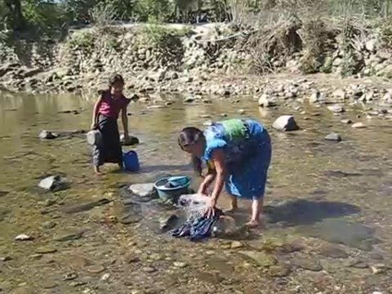
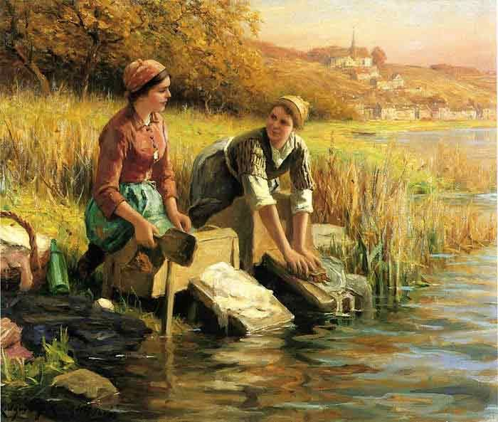
Washing
Rivers have been used by people for washing clothes (and themselves) for thousands of years.
While we don’t use rivers to wash clothes now (unless you’re camping), they are still used in some parts of the world.
If soap or other cleaning products are used, plant and animal life can be damaged.

Slide 9
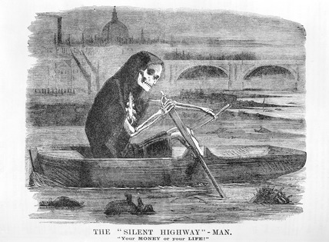
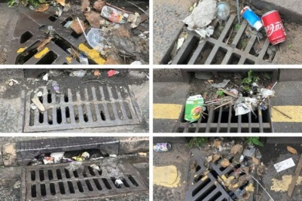
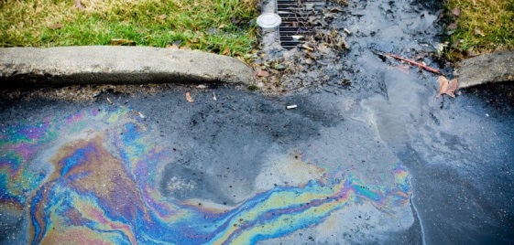
Waste
Since the start of the Industrial Age, rivers were used to get rid of unwanted waste. This included rubbish, oil and human waste (that we put in the toilet)!
Now, our waste isn’t supposed to go into our rivers and our toilets are connected to a different plumbing system which takes the waste to a treatment plant. However, anything that goes down the drain will end up in a river.
In Victorian London, the Thames was so polluted that it made the air stink!

Slide 10
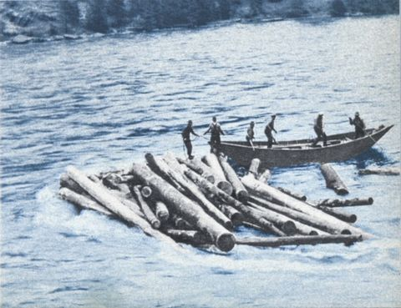
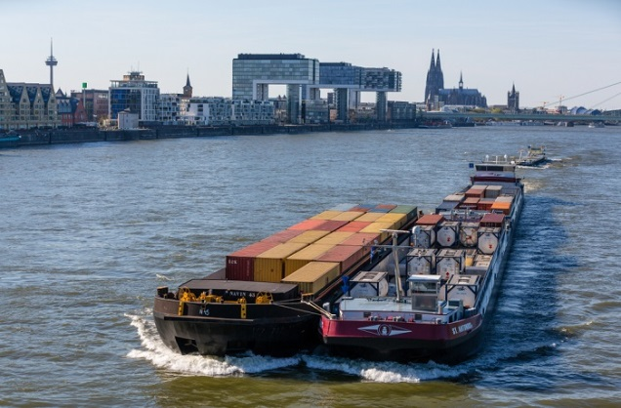
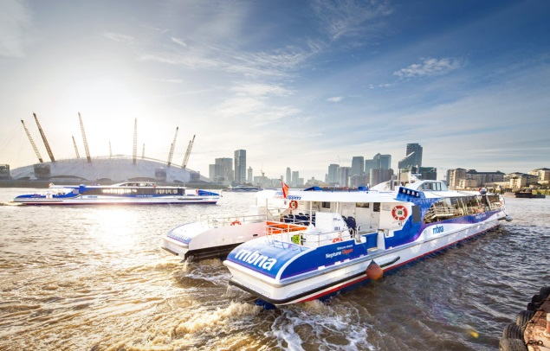
Transport
Rivers have been used for thousands of years as transportation routes.
The Anglo-Saxons called the sea the ‘whale road’. This gives you a idea of how important waterways were in connecting people. Many Anglo-Saxon towns were built in places where the old Roman roads crossed navigable rivers.
In more modern times, rivers have been used to float logs downstream from where they were cut down to the timber mills. They have been used to transport goods in shipping containers and they have been used as water buses or taxis to get around a large city.
How might petrol powered boats affect the river?

Slide 11
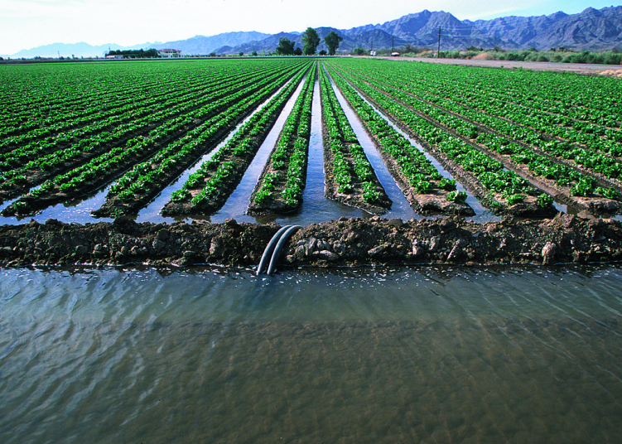
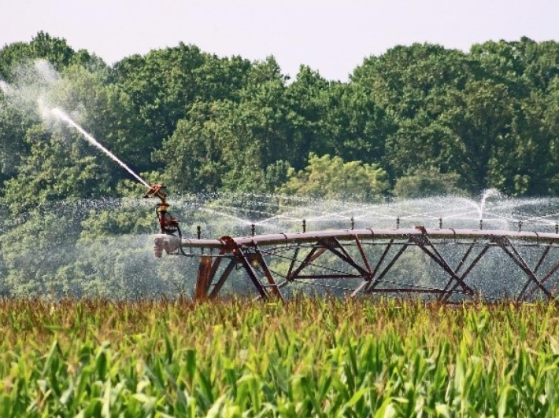
Irrigation
By digging channels between their crops, farmers can take some water from a river to make sure that their fields are watered, but their crops don’t drown.
The use of pipes to siphon the river helps to control the flow. Sprinklers can even be attached to the pipes to spread the water more evenly.
What would happen if too many farms tried to use the water?

Slide 12
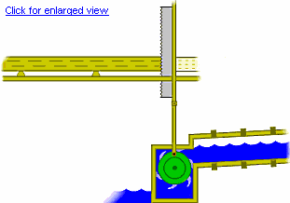
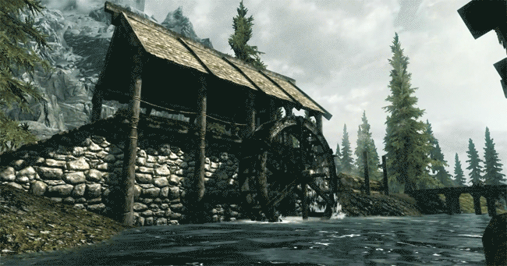
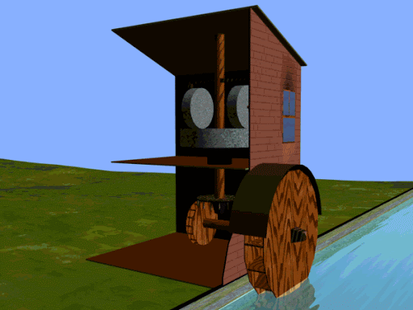
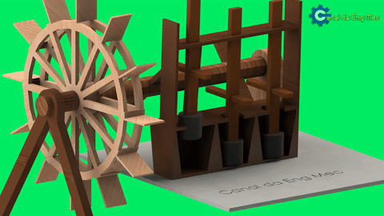
Power - Then
The invention of the water wheel changed the world. By using the power of the river, cogs could turn machines which made people’s work much easier.
This began with grinding wheat to make flour, but would eventually power saws, looms and other machines.
In Rivelin Valley Park, you can still see the weirs built to raise the water level (so a water wheel would turn) and the remains of the mill houses.

Slide 13
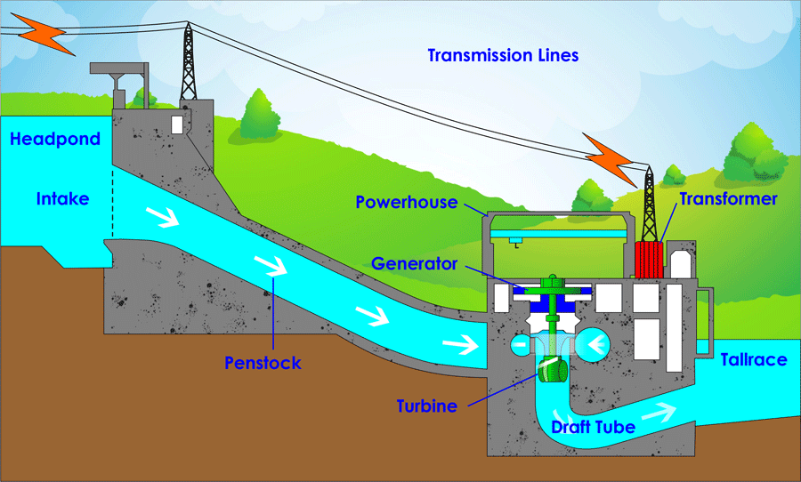
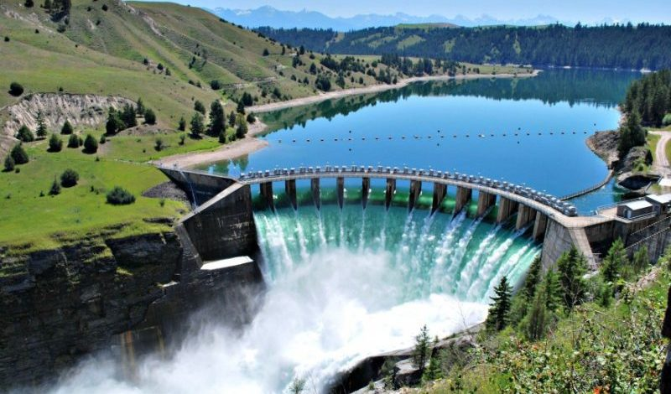
Power - Now
The concept of the water wheel has been developed to generate electricity.
The extra power built up by building a dam means that the water can turn the generator wheels quickly and produce a strong electrical charge.
This is then sent via cables to local substations to provide electricity for homes and businesses.

Slide 14
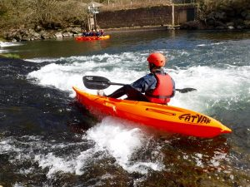
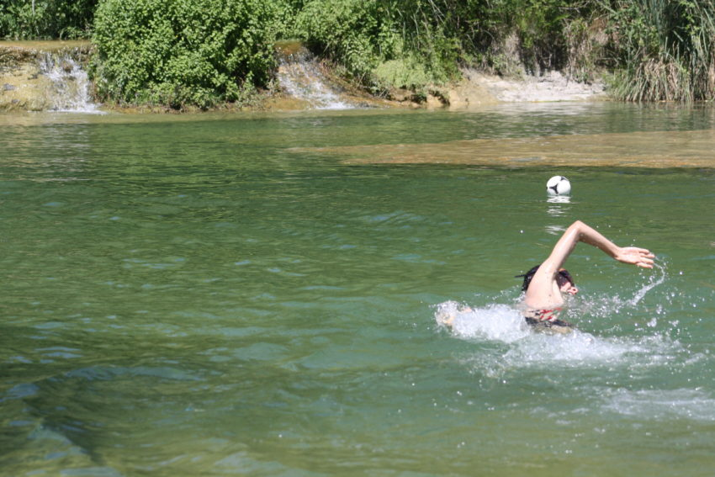
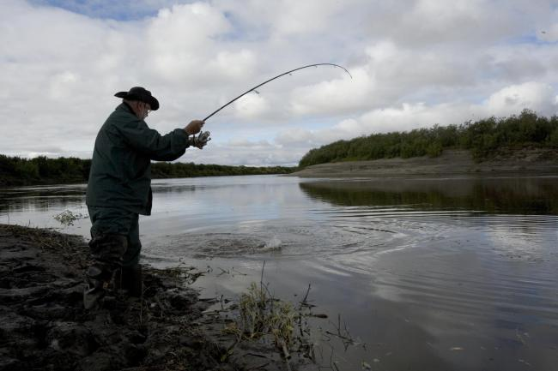
Leisure
Finally, playing in water is fun! People enjoy swimming, canoeing and ghyll scrambling (climbing rivers and waterfalls).
People also enjoy fishing in rivers. Most commercial fishing happens out at sea, but fishing in rivers for food or for fun is a popular individual or small group activity.

Slide 15
Your Task
Your task today is to think of the different ways that humans use rivers and to come up with some positives and negatives of each use.
Think about how each river use affects human beings and the wildlife that thrives in a river habitat.

