Slide 1
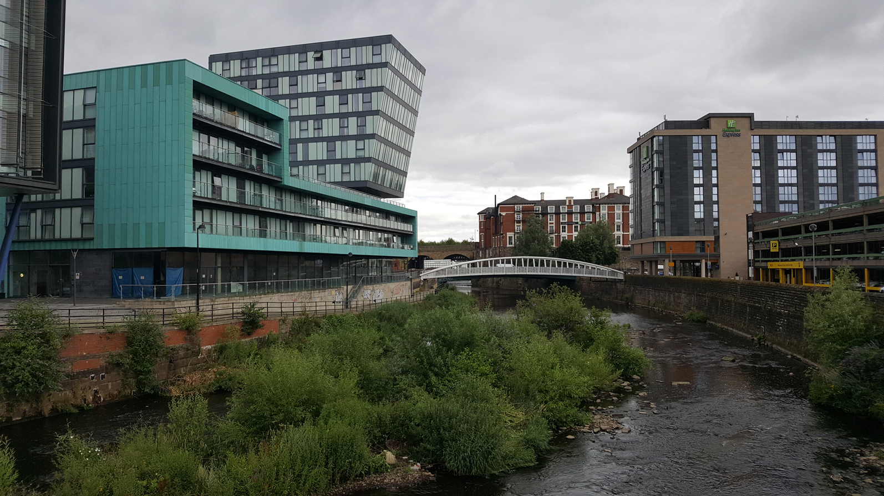
Restless Rivers

Slide 2
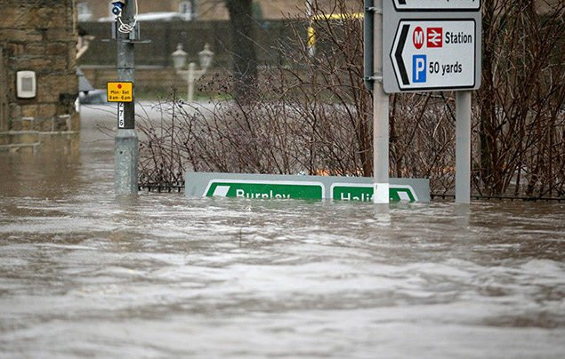
Quick recap:
Tell your partner, parent or remote-controlled submarine what the four main causes of flooding are.
Rainfall
Rivers breaking their banks
Coastal flooding
Burst pipes

Slide 3
Flooding: A Case Study
LO: To be able to consider how floods affect people.
I can remember to:
read the information and watch the videos.
discuss effects of the flooding on the Cumbrian people.
sort the nine statements into the diamond by order of importance.
*explain why you’ve chosen that order.

Slide 4
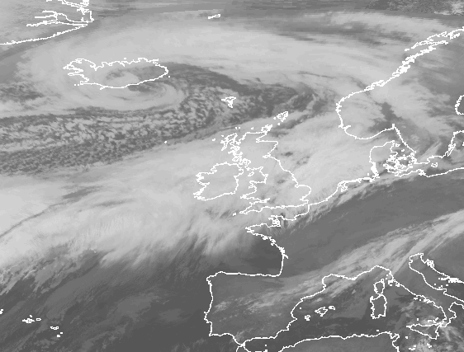
Storm Desmond - December 2015
In early December of 2015, a large storm brought strong winds (up to 81 mph) and heavy rain to Northern Europe.
In the UK, the worst affected areas were Cumbria, parts of Lancashire and the Scottish border.

Slide 5
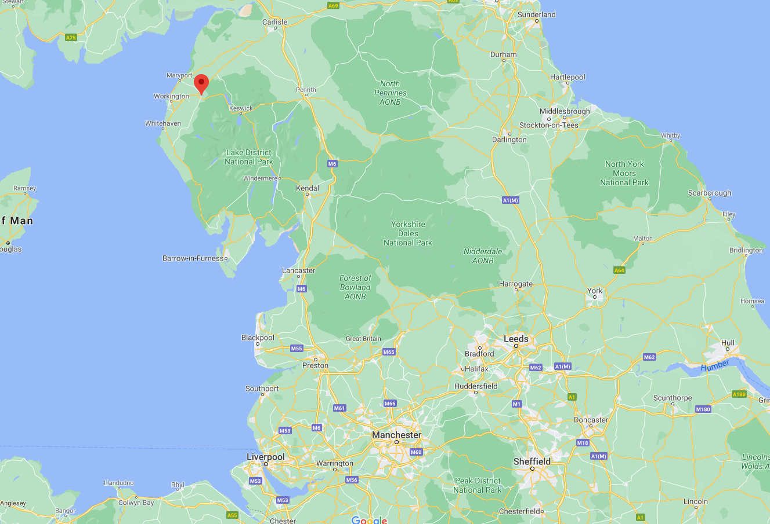
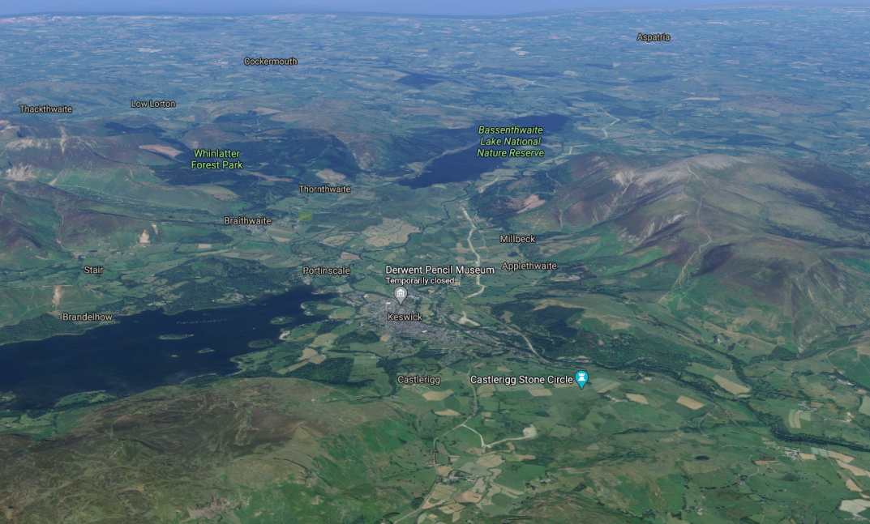
Where is Cumbria?
Cockermouth
Central Cumbria is very mountainous and contains many lakes – it is known as the Lake District.

Slide 6
How did Storm Desmond affect Cumbria?
There are plenty of videos covering the aftermath of Storm Desmond, but I’ve collected the best. Once you’ve watched these you’ll have a really clear idea of how the unexpected flooding of December 5/6th 2015 affected the people of Cumbria.
Essential:
Channel 4 News – Watch this first, as it gives you a good overview.
Keswick Flood Defences – Report on the defences from 2012. They were built following the 2009 floods. They also interviewed Mr Earl’s old physics teacher – Dr Thompson!
Keswick Flood Defences – Here you can see how they worked. Later in the day, the water started spilling over the top.
Flooded Twice! – Glenridding was flooded twice - first by Storm Desmond and then by Storm Eva five days later.
Extra footage:
BBC News – This one’s long, but good. Feel free to scan through or put on x1.5 or x1.75 speed.
Drone Footage of Carlisle – You can really see how the floods affected the city here. It’s interesting to see how the castle’s defences protected it though!
Helicopter Footage – See the damage to towns, roads and fields.
Cockermouth – It’s easy to mistake the main street for the River Derwent here (and difficult to spot the River Cocker flowing past the castle & Jennings Brewery to join the Derwent), but you can see just how many homes and businesses were affected.

Slide 7
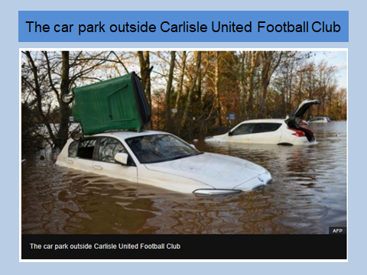
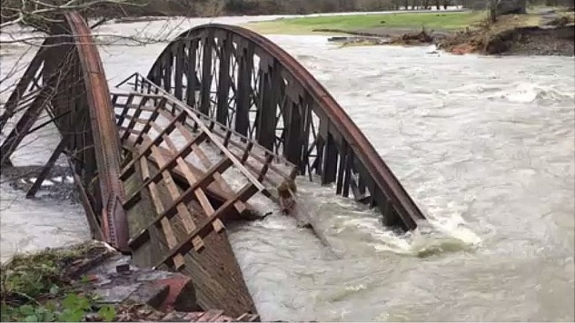
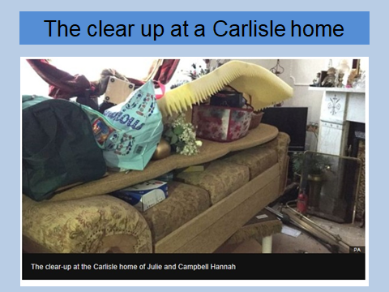
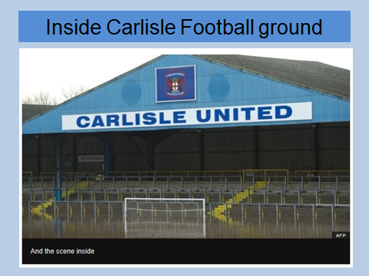
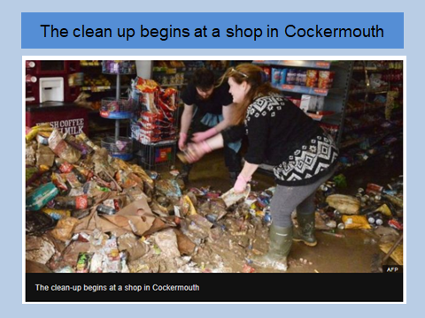
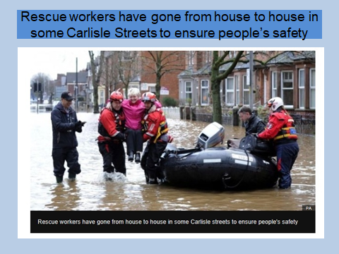
How did Storm Desmond affect Cumbria?
Keswick to Threlkeld bridge

Slide 8
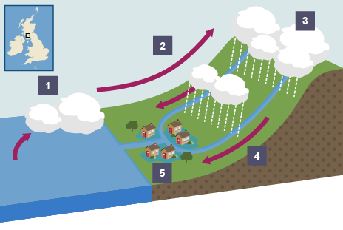
Why did it affect Cumbria so badly?
Warm air from the mid-Atlantic moved towards land due to the prevailing wind.
The warm air was forced upwards by the Cumbrian Mountains.
As the air cooled, it condensed to form heavy rain. The weather front stopped over Cumbria.
A wet Autumn meant that the ground was already saturated, so the falling rain poured straight into the Cumbrian rivers.
The confluence of two rivers at (Derwent & Cocker) is at Cockermouth and Keswick is near the confluence of the Greta and Derwent, which led to significant flooding in both towns.
The rainfall was so heavy that flood defences in Keswick and Cockermouth failed.
The build-up of towns means that it’s difficult for the ground to absorb water.

Slide 9
How did the flooding affect Cumbria?
Social
Over 43,000 homes across Cumbria and Lancashire suffered from power cuts.
Approximately 5,200 homes were affected by flooding.
One person died in Cumbria.
About 40 schools closed in Cumbria.
Economic
Rail and road services were disrupted.
Many businesses suffered through damage to property and stock.
The estimated cost was £500 million across Cumbria. The government provided £50 million for flood victims and businesses.
Insurance companies have had to pay out an estimate of up to £325 million to residents and businesses.
Environmental
Rivers were significantly altered with increased rates of erosion.
Heavy rain washed nutrients from soil.
Vegetation was flooded, causing habitat loss.

Slide 10
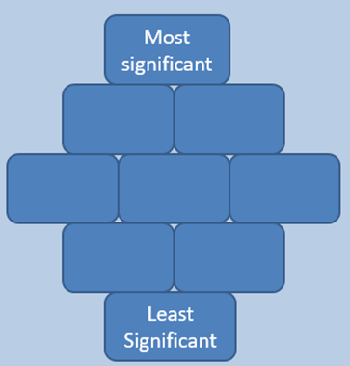
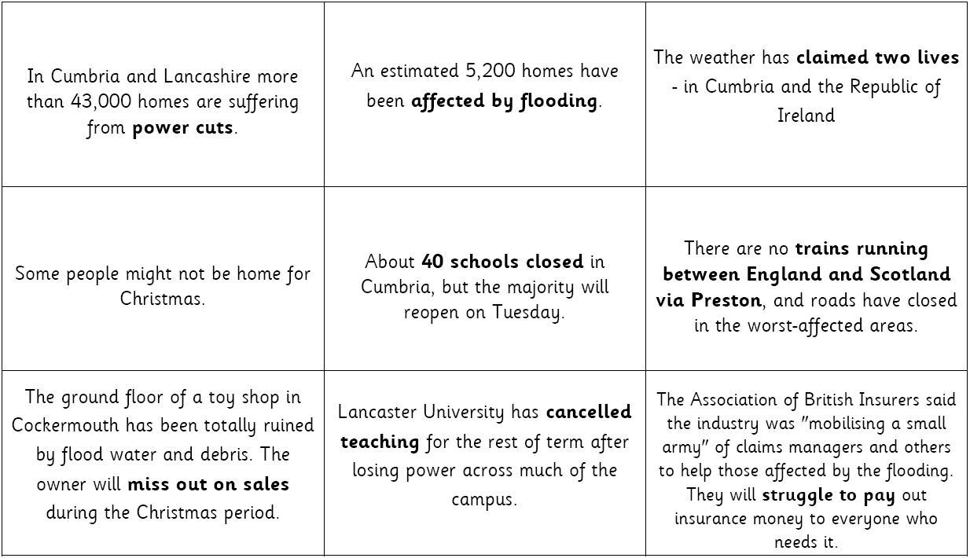
Your Task
Sort these nine statements into a diamond.
The ones that affected people the most should be at the top and the ones that were less disruptive should be at the bottom.

