Slide 1
The mystery
If Germany had 824 fighter planes while Britain had only 600, and if Germany was training 800 new pilots a month and Britain only 200, why then did Germany lose the Battle of Britain?
When it took just 5 minutes for German planes to cross the channel but 15 minutes for British planes to take off and engage in battle once they had been spotted.

Slide 2
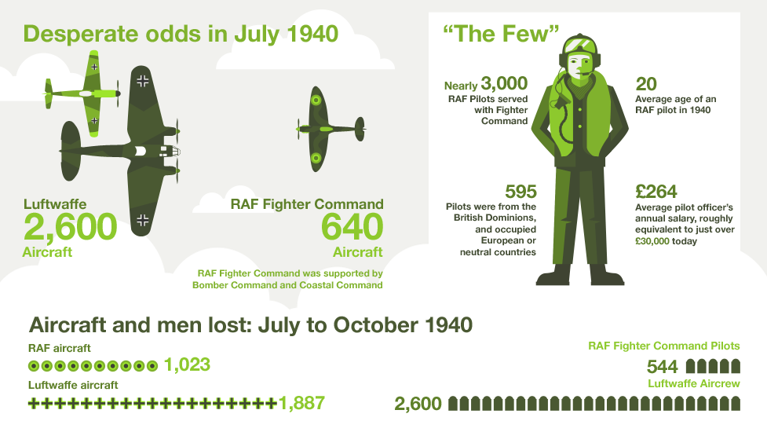

Slide 3
Clue1
The losses

Slide 4
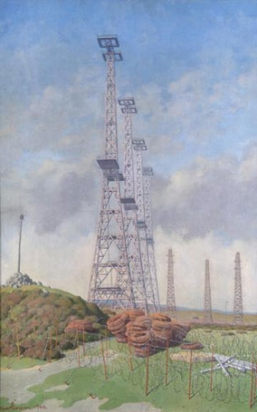
Clue 2
Radar
Radar could be used to detect and locate incoming enemy aircraft. It worked by sending out radio waves which would bounce off solid objects at a distance, enabling operators to detect German planes before they reached British shores.

Slide 5
Clue 3
Plane production
The Germans were making only about 150 new planes a month whereas the British were producing over 550.

Slide 6
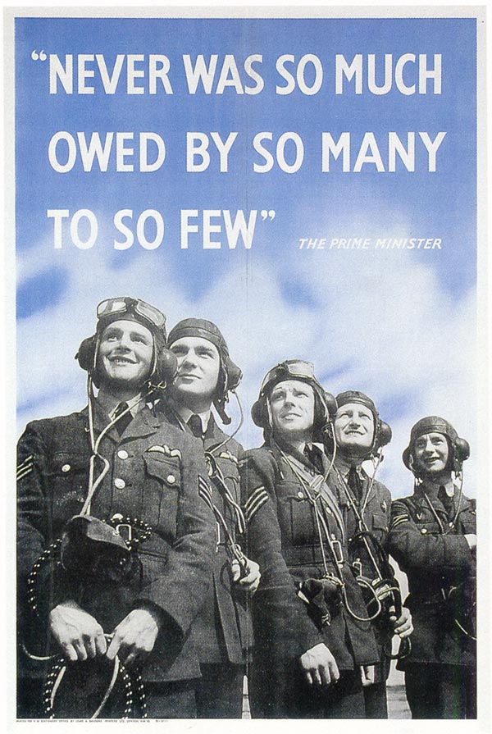
Clue 4
Britain’s pilots

Slide 7
Clue 5: a German pilot’s view
The German Messerschmitt Bf 109 (Me-109) was quicker than the Hurricane and about the same as the Spitfire. I think our guns were better too. On the other hand, the British fighters could turn tighter than we could. I also felt that the Bf 109 could not take as much punishment as the British planes.

Slide 8
Clue 6: the myth
Few moments in British history have been so mythologised, however. Woven into the story is the image of plucky Little Britain, David against the Goliath of Nazi Germany.
We portray ourselves as backs-to-the-wall amateurs, with those young and gallant Few, the last line of defence against the mighty Germans – after all, the Home Guard were not going to be much good against hordes of Panzers. By a whisker, we held out – but it was a close run thing and thank God Hitler decided to switch from attacking airfields and turned on London instead. It was tough on the East End, but it gave the RAF breathing space and the fight back was on.

Slide 9
Clue 7: Latest thinking
Britain won the Battle of Britain because it was ready and prepared to fight such a battle. It had the world's first and only fully co-ordinated air defence system, aircraft production that was out-producing Germany at a ratio of 2:1 and had the mechanisms to fight a long war. The Luftwaffe had poor intelligence, was under strength for the task in hand, used poor tactics and only managed to knock out one airfield for more than twenty-four hours in the entire battle.

