Slide 1
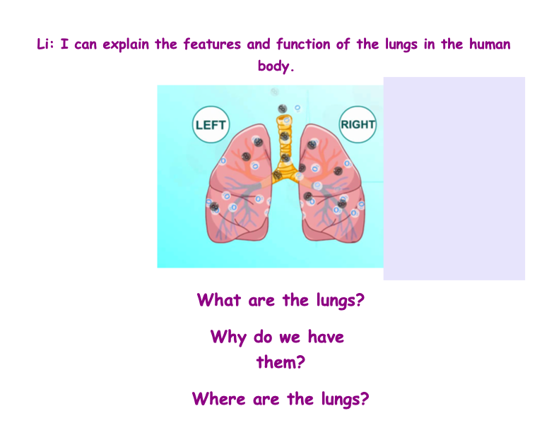

Slide 2
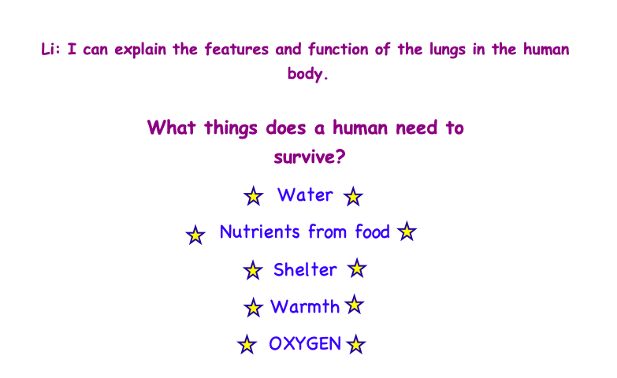
https://www.youtube.com/watch?v=8NUxvJS-_0k
We need lungs to help the body take in oxygen!

Slide 3
Top 10 facts
1) Most vertebrate animals (animals with spines) have two lungs.
2) Your left and right lungs aren’t exactly the same. The lung on the left side of your body is divided into two lobes while the lung on your right side is divided into three. The left lung is also slightly smaller, allowing room for your heart.
3) The highest recorded "sneeze speed" is 165 km per hour.
4) The capillaries in the lungs would extend 1,600 kilometres if placed end to end.
5) We lose half a litre of water a day through breathing. This is the water vapour we see when we breathe onto glass.
6) People who have a large lung capacity can send oxygen around their body faster. You can increase you lung capacity with regular exercise.
7) As well as other parts of your body and your general health, smoking is bad for your lungs. Smoking can cause lung cancer among other lung-affecting diseases.
8) You can live with one lung – it limits your physical ability but doesn’t stop you from living a relatively normal life. Many people around the world live with just one lung.
9) The lungs are able to float on water since they contain so many air sacs. If you breathe out in a swimming pool, you start to sink as the air sacs are empty.
10) The word "lung" originates from the Old English word "lungen". It means "light" (not heavy), probably because people realised that lungs from a slaughtered animal float in water.

Slide 4
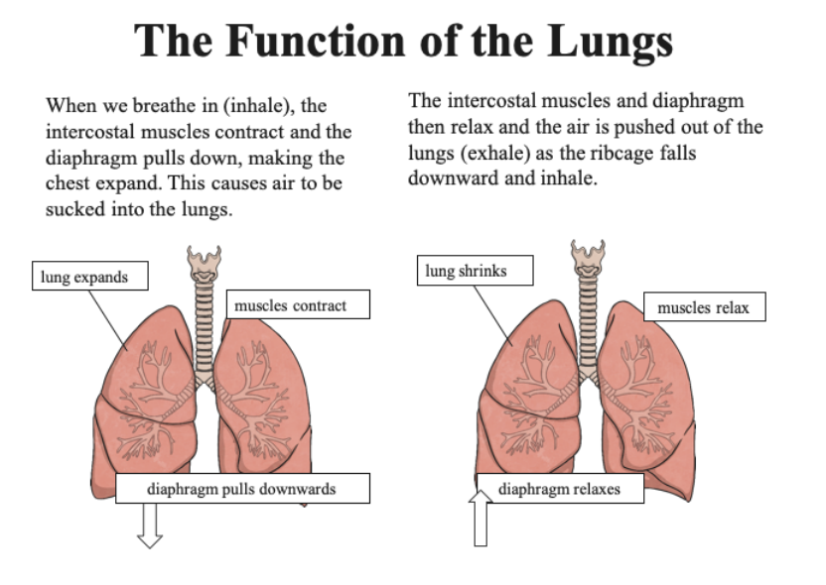

Slide 5
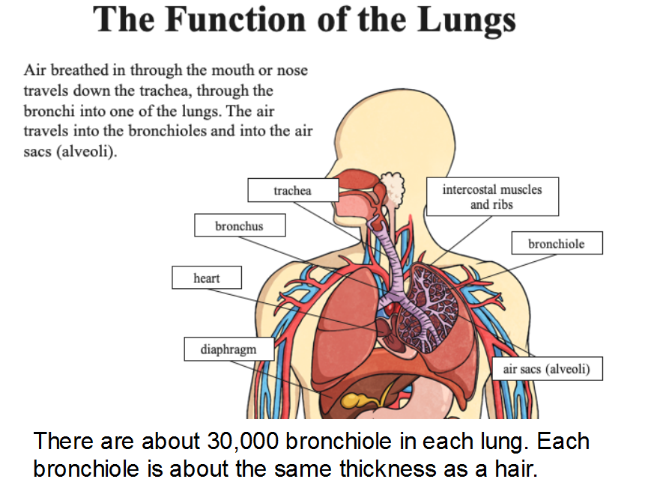

Slide 6
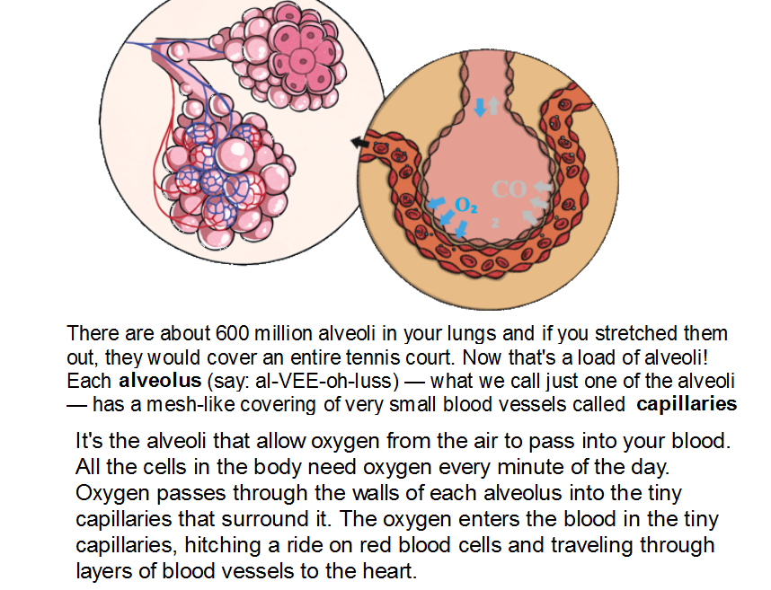

Slide 7
QUIZ TIME!
Click on the link below to take a quiz on the lungs. You will see if you were correct straight away!
Quiz
https://www.dkfindout.com/uk/quiz/human-body/quiz-yourself-on-lungs-and-breathing/

Slide 8
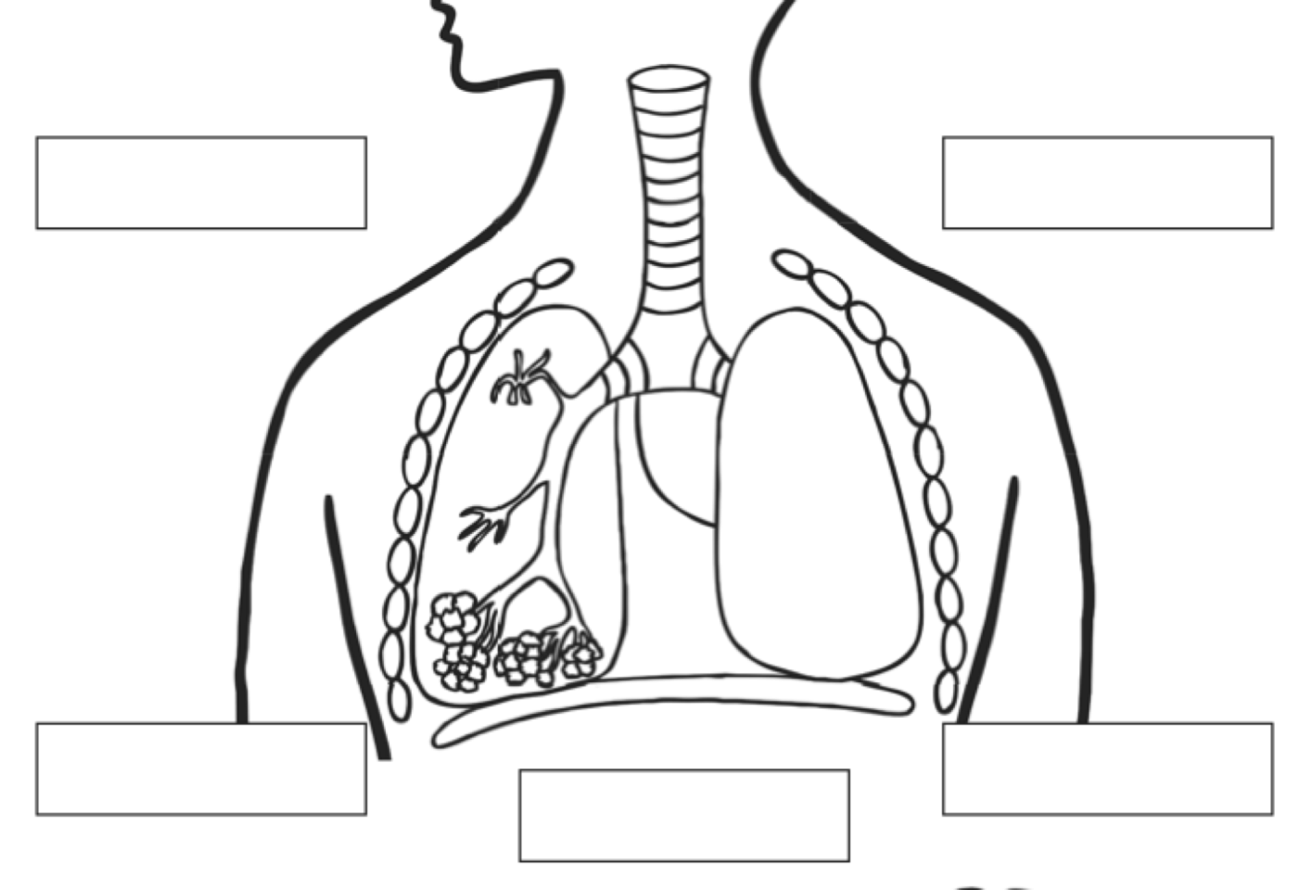
Activity 1 – Label the diagram below
1)
5)
2)
4)
3)
trachea
bronchiole
diaphragm
bronchus
alveoli

Slide 9
Activity 2 – Watch the following video, then fill in the blanks below.
https://www.youtube.com/watch?v=3uFsUBY3Whs&feature=emb_logo
Alveoli are surrounded by a network of blood vessels called ______________. When we breathe in, there is more oxgygen in the _____________ then in the ___________ . Diffusion then happens as gases always move from an area of ________ concentration to an area of low concentration. Oxygen molecules then dissolve along the thin membrane of the alveolus into the ___________ vessels. This oxygenated blood then returns to the ____________. Carbon dioxide (a waste product) then moves from the blood into the _____________.

