Slide 2
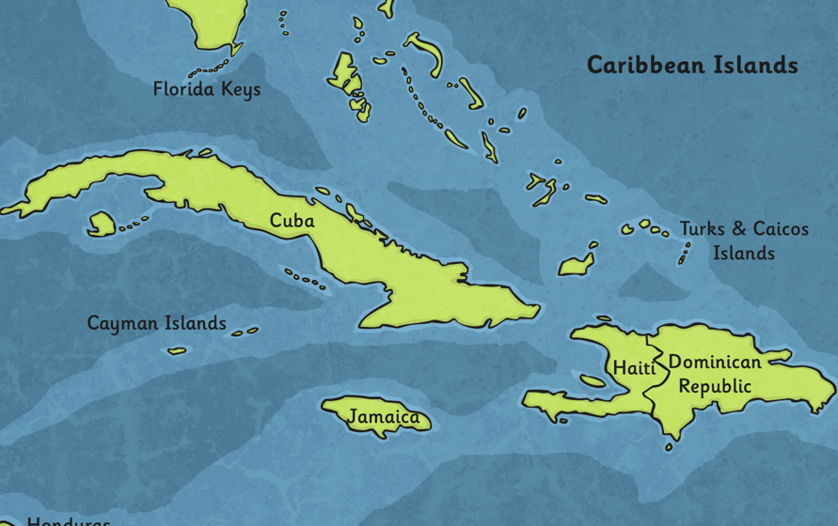
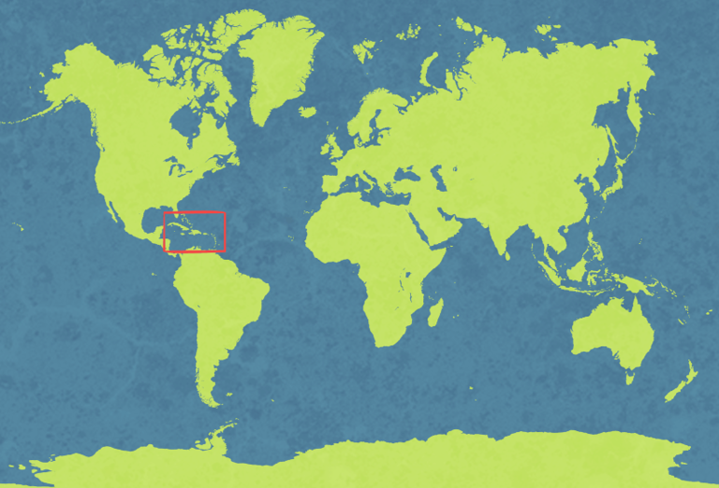
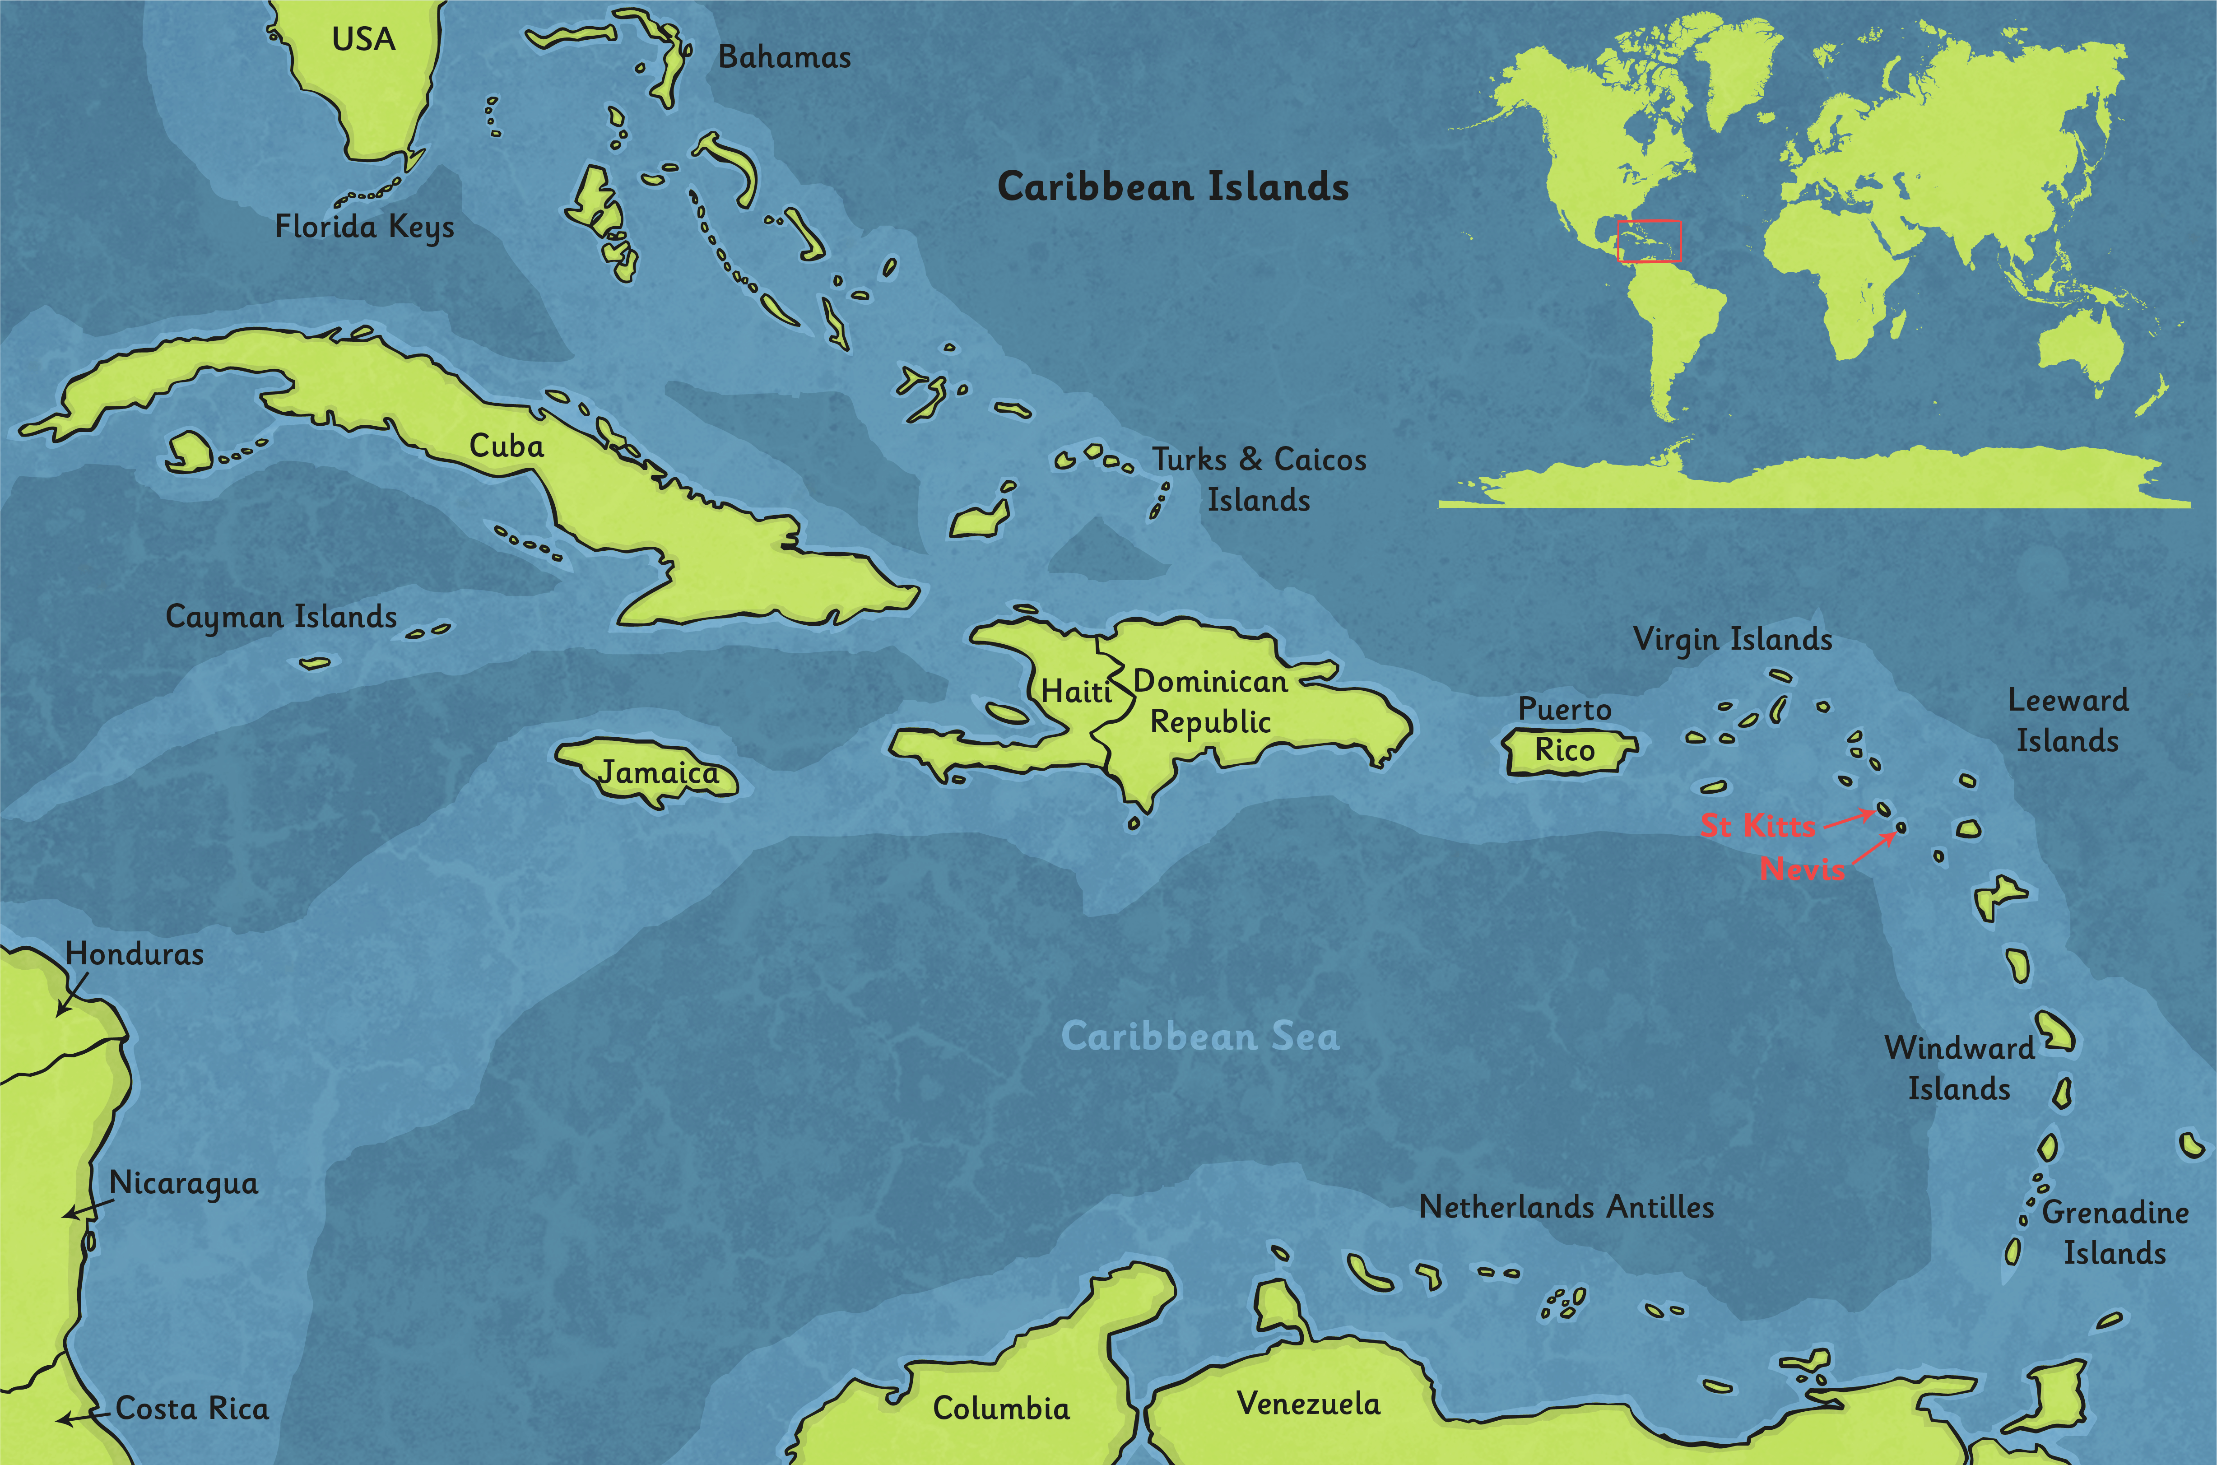
Where in the World Is It?
Jamaica is an island in the Caribbean, which is part of the North American continent.
It is one of 28 island nations in the Caribbean and is located close to Haiti, Cuba and the Dominican Republic.

Slide 3
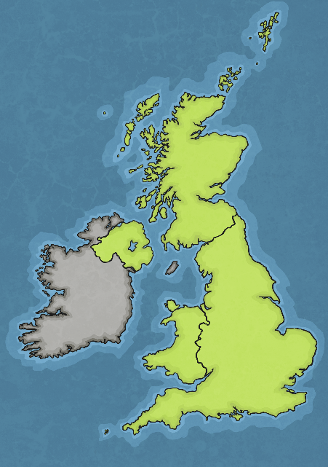
How Big Is the Island?
Think about it
Bigger than the United Kingdom?
The same size as the United Kingdom?
Smaller than the United Kingdom?
Click the map to find out

Slide 4
How Big Is the Island?
Answer
Jamaica is 11,000 Square Kilometres
Jamaica is 22 times smaller than the United Kingdom!

Slide 5
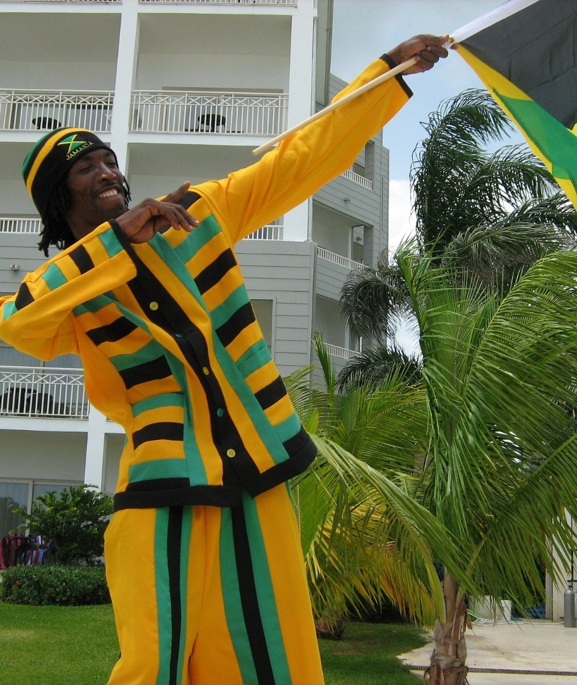
How Many People Live There?
Think about it
More than the United Kingdom?
Jamaica is 22 times smaller than the United Kingdom!
Less than the United Kingdom?

Slide 6
How Many People Live There?
Answer
2.8 Million People Live in Jamaica
This is 23 times less than the population of the United Kingdom.

Slide 7
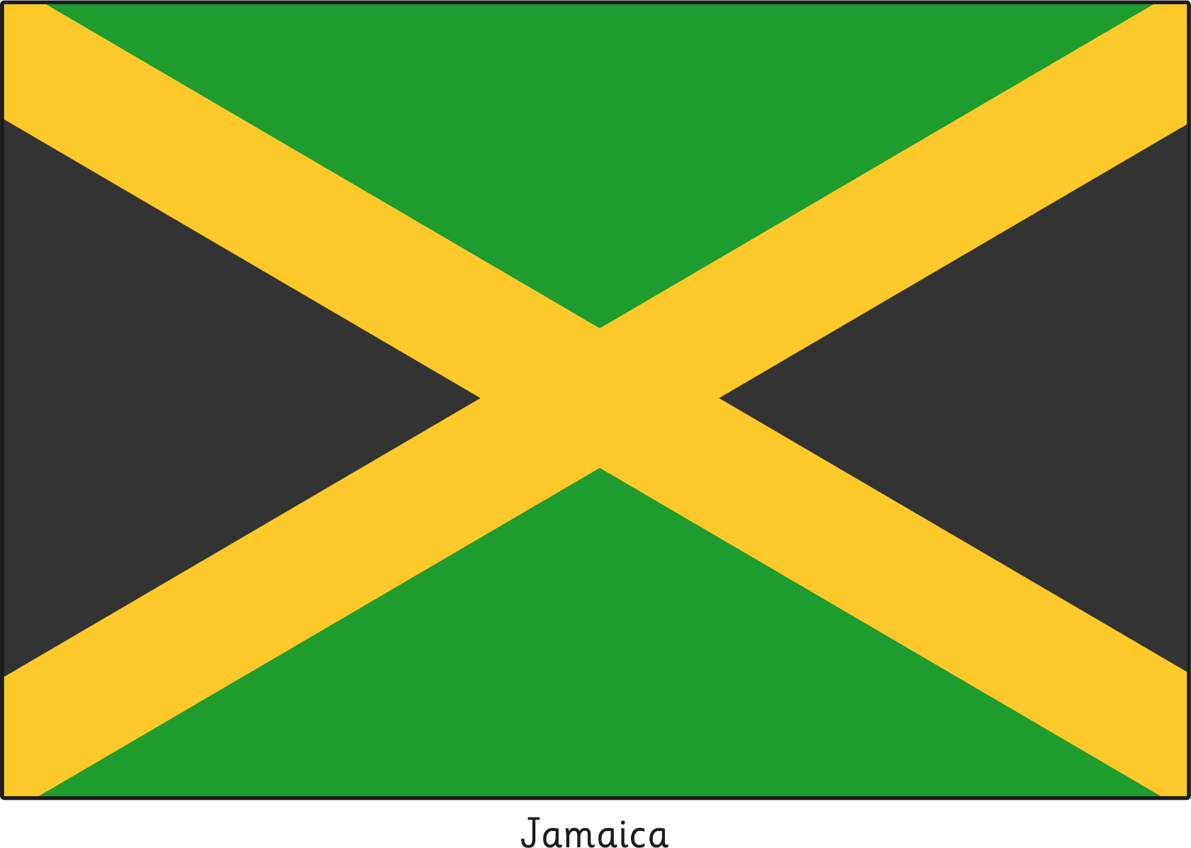
The Jamaican National Flag
It is one of only two flags in the world without any of the colours red, white or blue.
The flag was created for independence from Great Britain on 6th August 1962.
Black represents the strength and creativity of the people which has allowed them to overcome hardships.
Yellow is for the wealth of the country and the
golden sunshine.
Green is for the lush vegetation of the island.

Slide 8
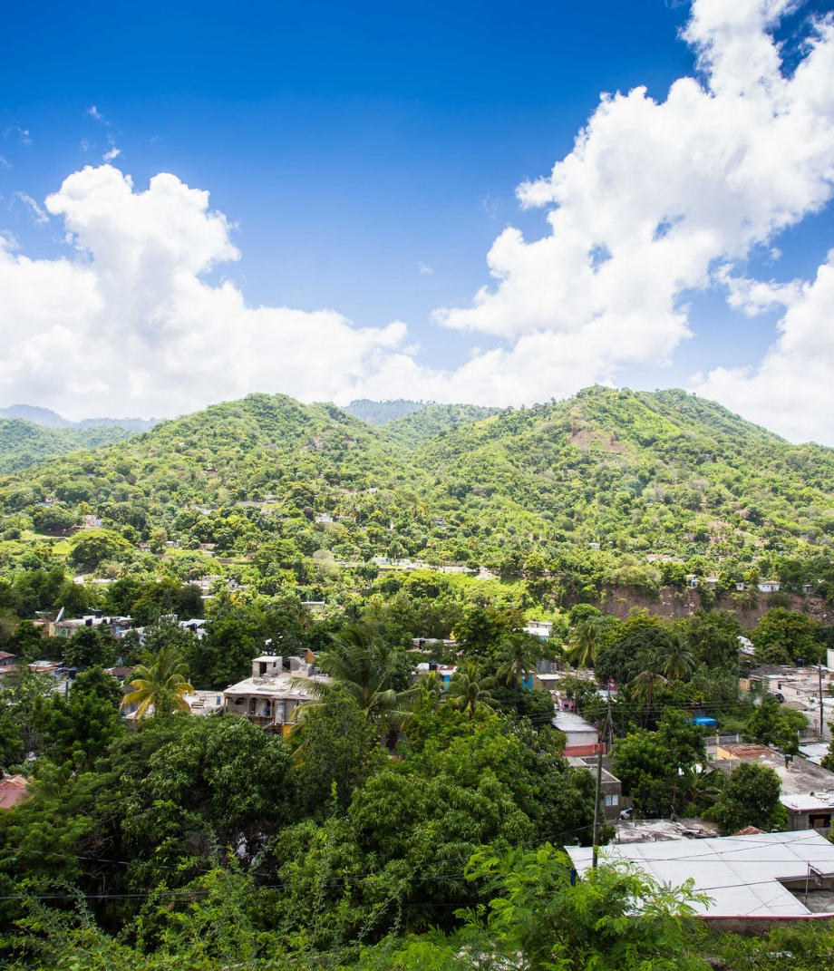
What the Island Looks Like
The Blue Mountain Range runs the length of the island and the highest peak is 2256 metres.
That is higher than the highest mountain in the British Isles,
Ben Nevis in Scotland, which is 1345 metres.
The island also has lots of beautiful beaches.
Photo courtesy of Loïc Cas (@flickr.com) - granted under creative commons licence – attribution

Slide 9
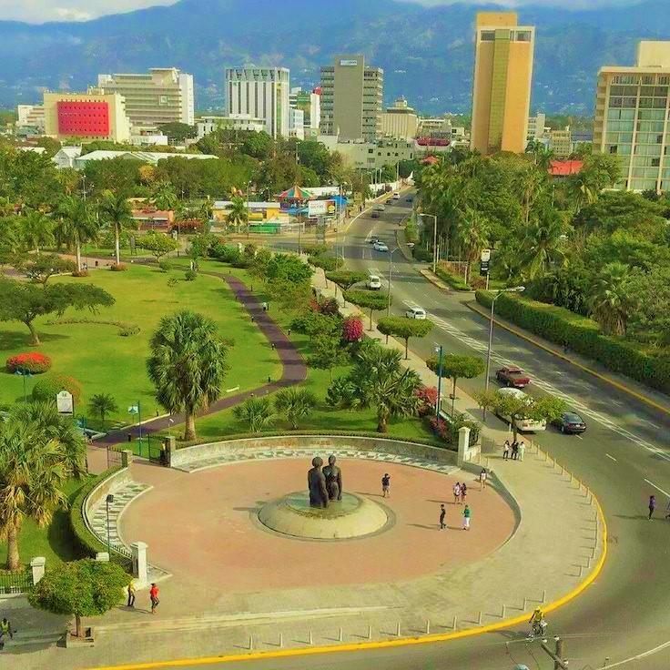
Capital City
Kingston is the capital city
of Jamaica.
Kingston is a vibrant city with a rich history of music, architecture and culture. There are many beautiful parks to visit as well as a modern waterfront area.
Kingston also has a wide variety of restaurants, hotels and beautiful scenery which attracts millions of tourists every year.
Photo courtesy of KingstonPharaoh (@Wikimedia commons), CC BY-SA 4.0

Slide 10
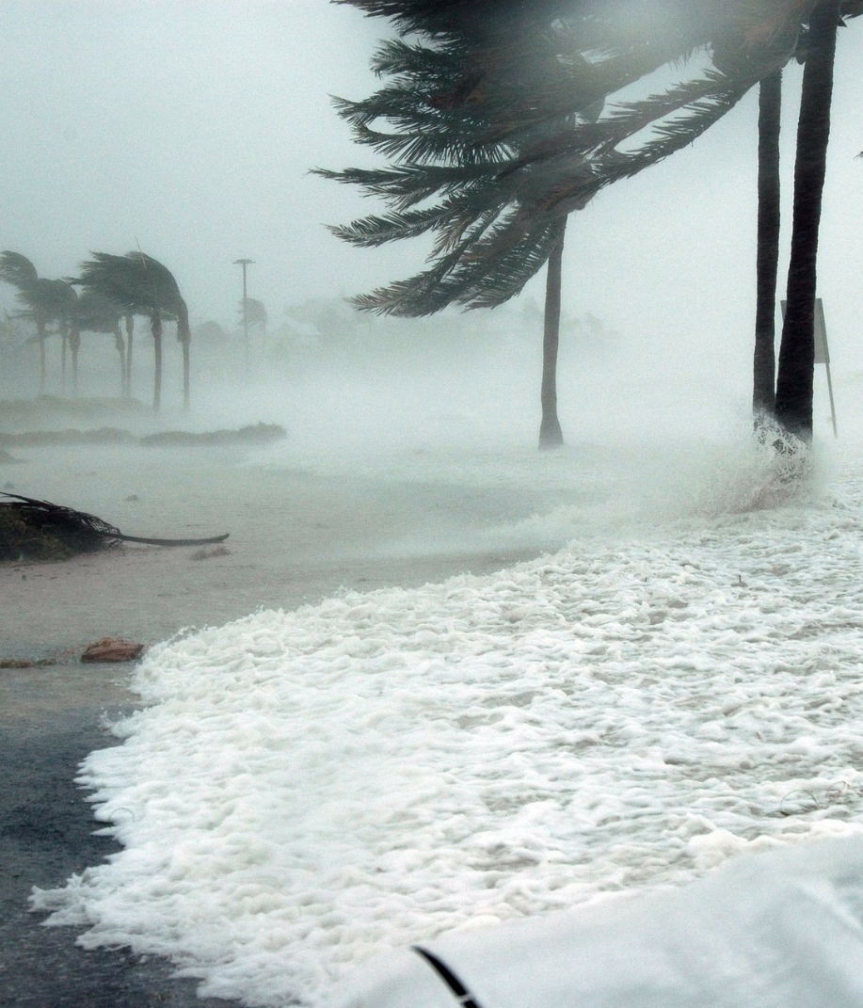
Weather Watch
Jamaica has a tropical climate, meaning it is warm all year round.
However, it does have a rainy season which lasts from late April to October.
Jamaica also lies within the Atlantic hurricane belt, meaning it is at risk of experiencing hurricanes between June and November.

Slide 11
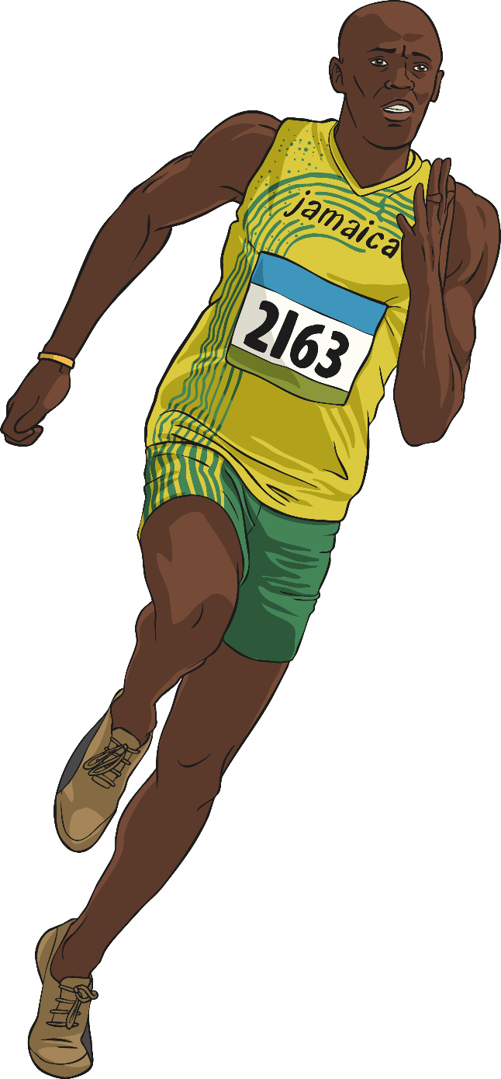
Famous Jamaicans
Who do you know from Jamaica?
Grace Jones
Model and Singer
Bob Marley
Musician
Usain Bolt
Athlete
Levi Roots
Musician, Chef and Businessman
Asafa Powell
Athlete
Portia
Simpson-Miller
Former Prime Minister
Marcus Garvey
Civil Rights Activist

Slide 12
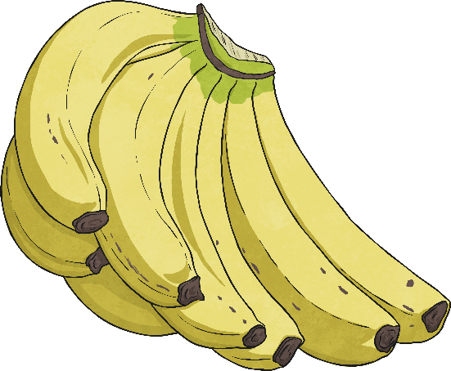
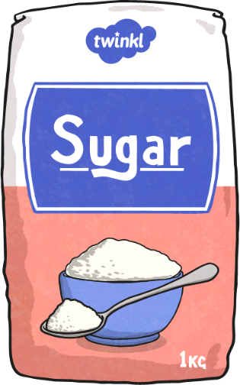

What Does Jamaica Produce?
Can you guess what the top three food products are on the island?
Bananas
Sugar
Coffee

Slide 13
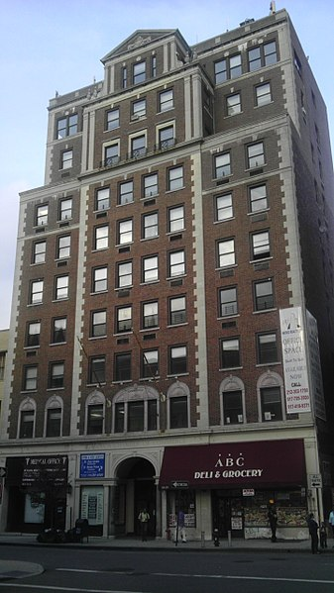
Earning a Living
There are a wide range of jobs in Jamaica, many of which are linked to the industries of agriculture, forestry and manufacturing alongside jobs such as those in teaching and medicine.
As the tourism industry is one of Jamaica’s top sources of income, many people work as part of the industry, in careers such as restaurants, hotels and at tourist sites.
Jamaica is also rapidly developing its ICT infrastructure and is increasingly becoming an attractive location for businesses involved in computing.
Photo courtesy of jim.henderson (@Wikimedia commons), CC BY-SA 3.0

