Slide 1
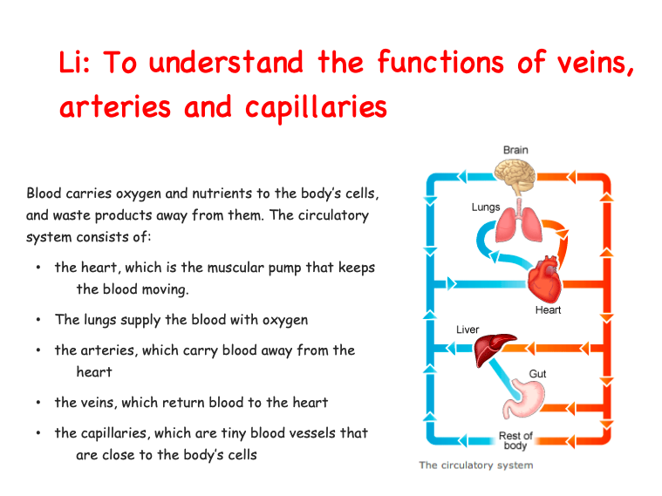

Slide 2
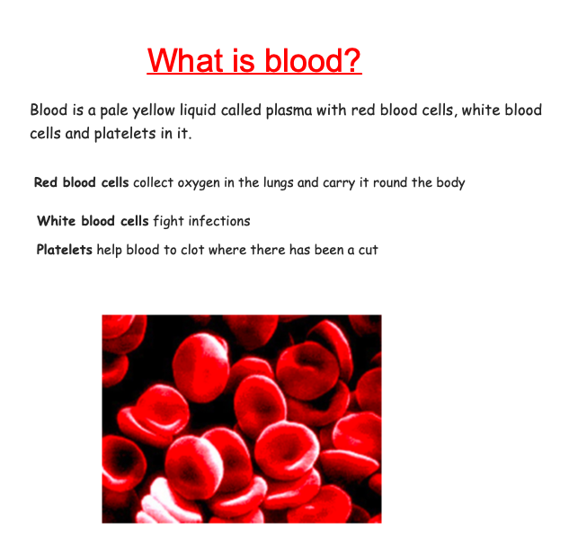

Slide 3
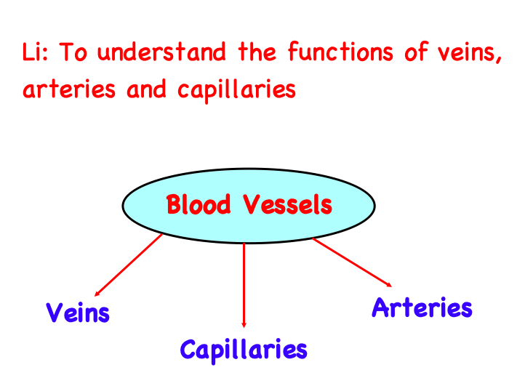

Slide 4
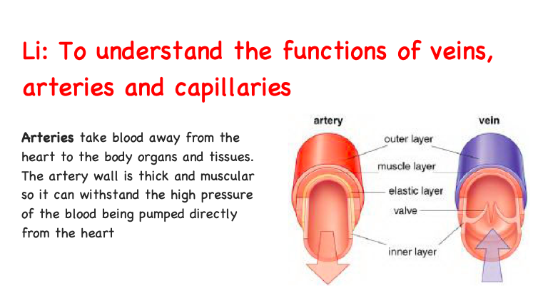

Slide 5
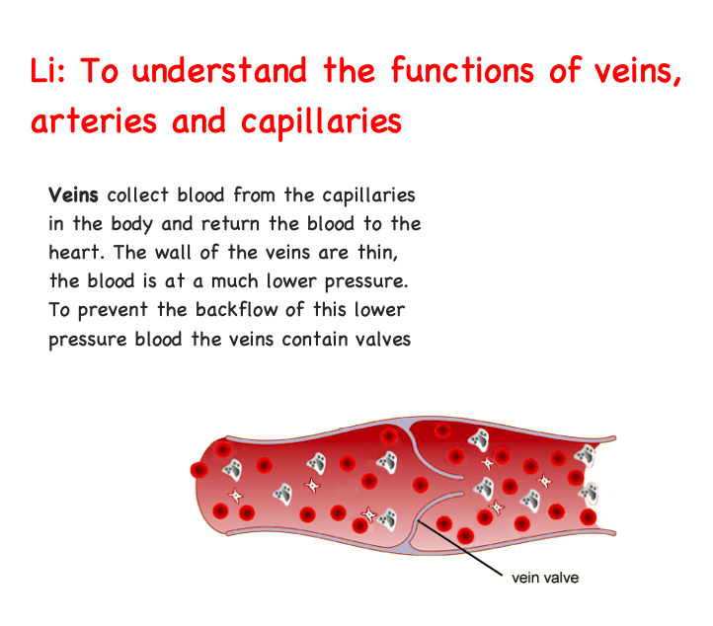

Slide 6
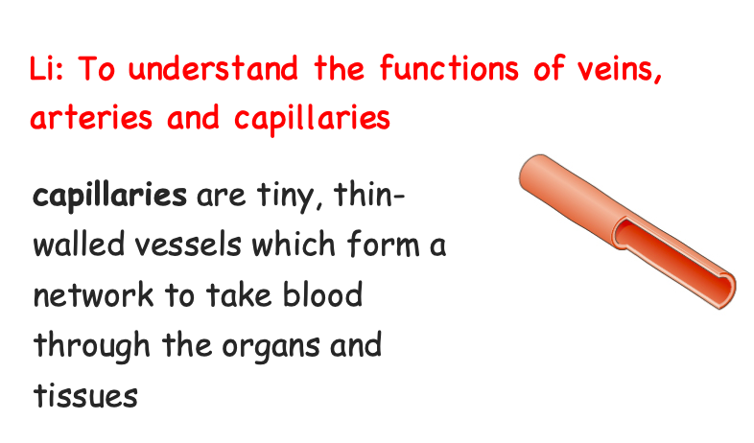

Slide 7
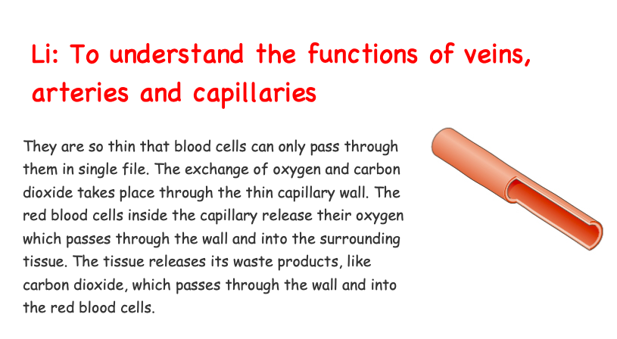

Slide 8
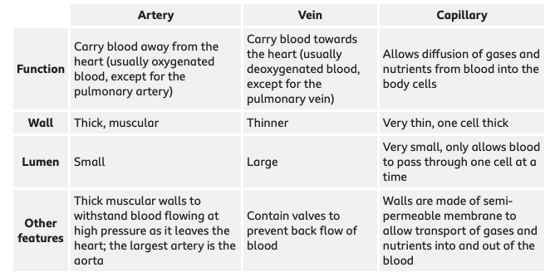
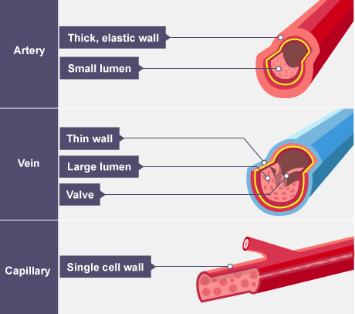
Lumen = space inside the blood vessel

Slide 9
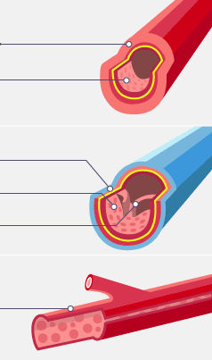
ACTIVITY
1)
Label each blood vessel (1, 2 and 3).
Then, use the sentence below to add some more information about the walls of the blood vessel, it’s lumen and any other information about it.
2)
QUIZ: -
https://docs.google.com/forms/d/e/1FAIpQLSdkXnz4YD8sfkUg_6jYelO_hBDGzvC8PBpPT5Zq-hasw6VU3Q/viewform?usp=sf_link
3)
I know this is a ______. This blood vessel has ________ walls because______________. Its lumen is _________. Furthermore,

