Slide 1
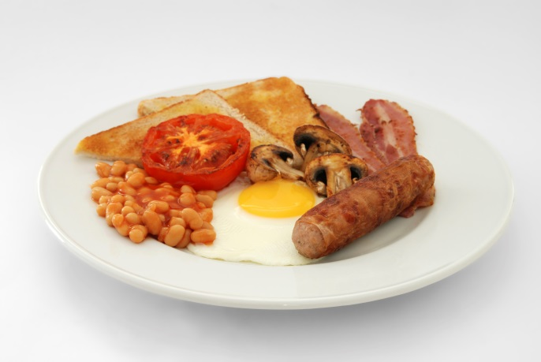
Breakfast
Menu
Cooked breakfast with toast, grilled bacon and sausage, fried mushrooms, tomato, and egg, and baked beans
What food groups can you see in this meal?

Slide 2
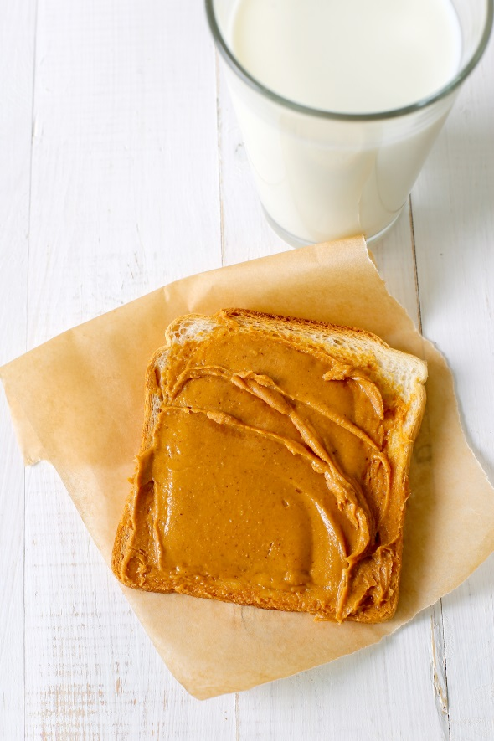
Breakfast
Menu
Peanut butter on white toast with a glass of semi skimmed milk
What food groups can you see in this meal?

Slide 3
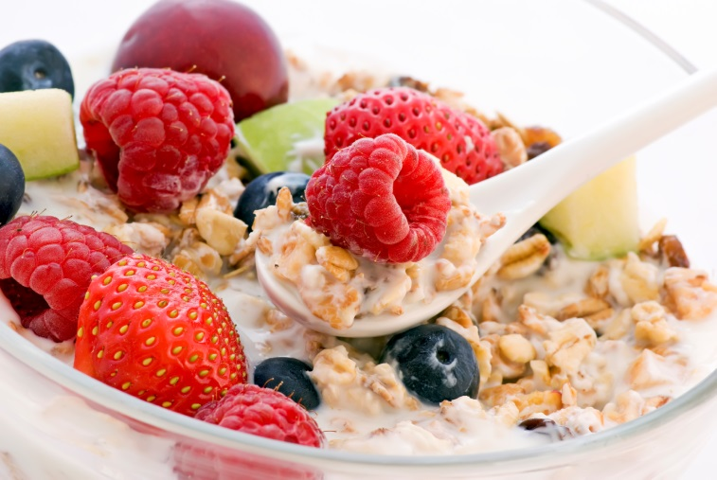
Breakfast
Menu
Museli with semi-skimmed milk and berries
What food groups can you see in this meal?

Slide 4
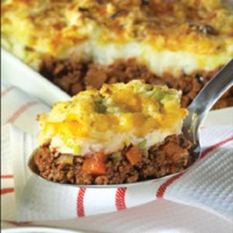
Lunch
Menu
Cottage pie with leek and potato topping
What food groups can you see in this meal?

Slide 5
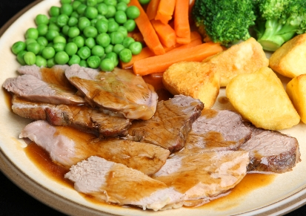
Lunch
Menu
Roast lamb with roast potatoes, broccoli, peas, carrots and gravy
What food groups can you see in this meal?

Slide 6
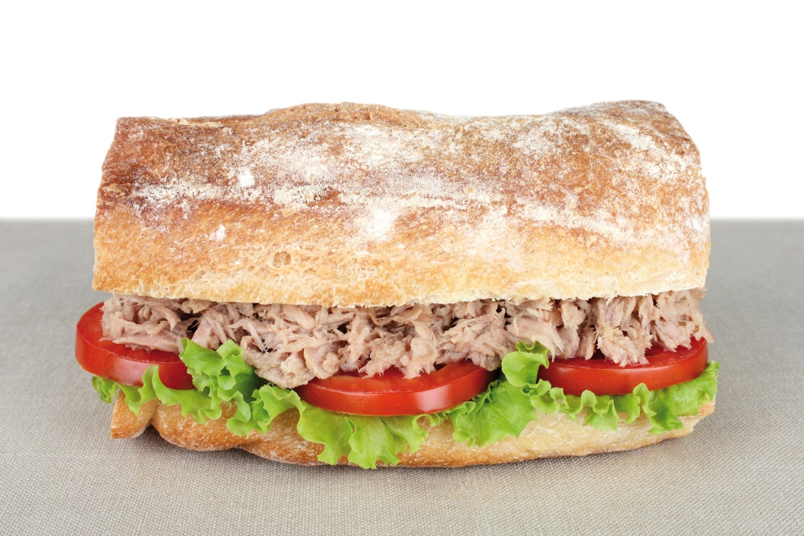
Lunch
Menu
Tuna and mayonnaise in a white baguette with lettuce and tomato
What food groups can you see in this meal?

Slide 7
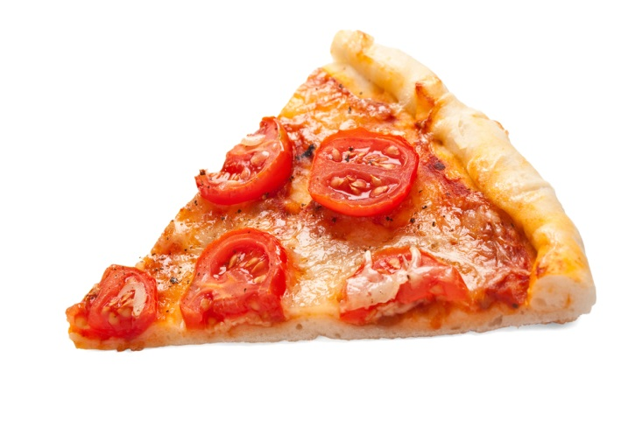
Lunch
Menu
Cheese and tomato pizza slice
What food groups can you see in this meal?

Slide 8
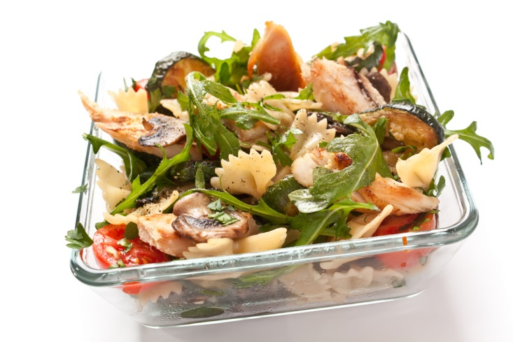
Lunch
Menu
Chicken and vegetable pasta salad
What food groups can you see in this meal?

Slide 9
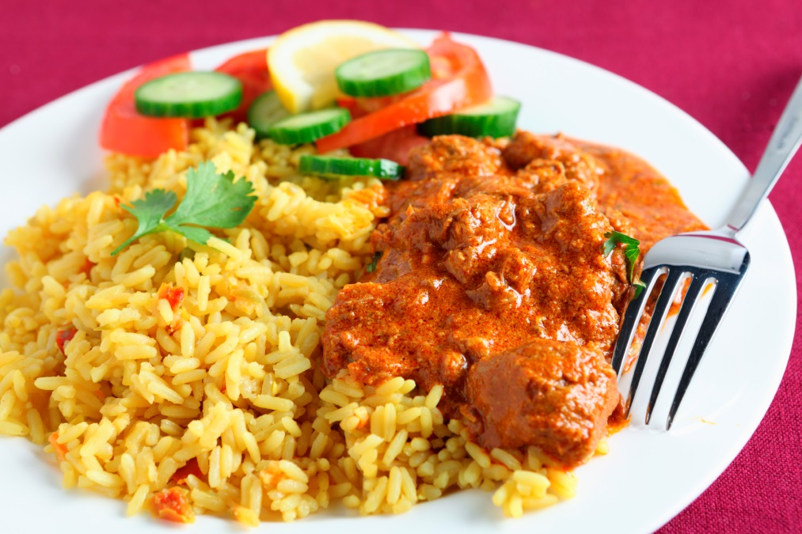
Main meal
Menu
Lamb curry with rice and salad
What food groups can you see in this meal?

Slide 10
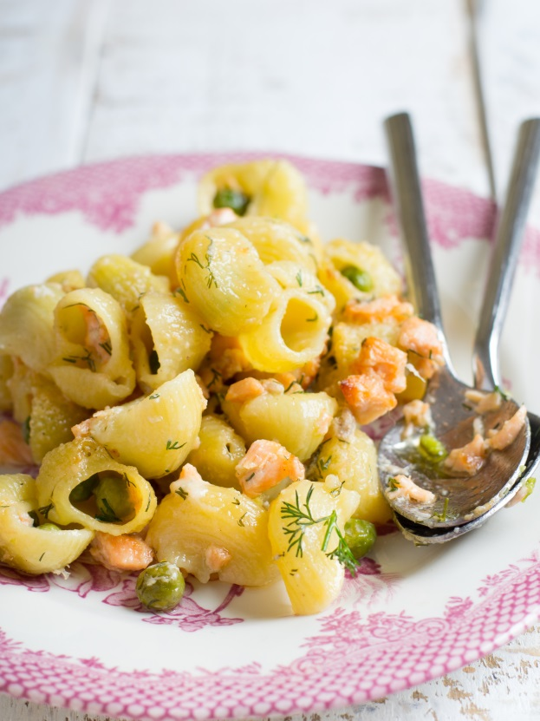
Main meal
Menu
Pasta with salmon and peas
What food groups can you see in this meal?

Slide 11
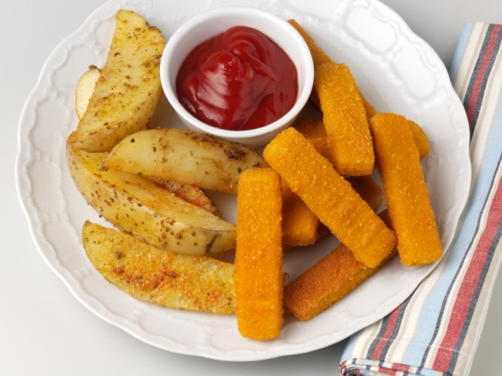
Main meal
Menu
Fried fish fingers and potato wedges with tomato ketchup
What food groups can you see in this meal?

Slide 12
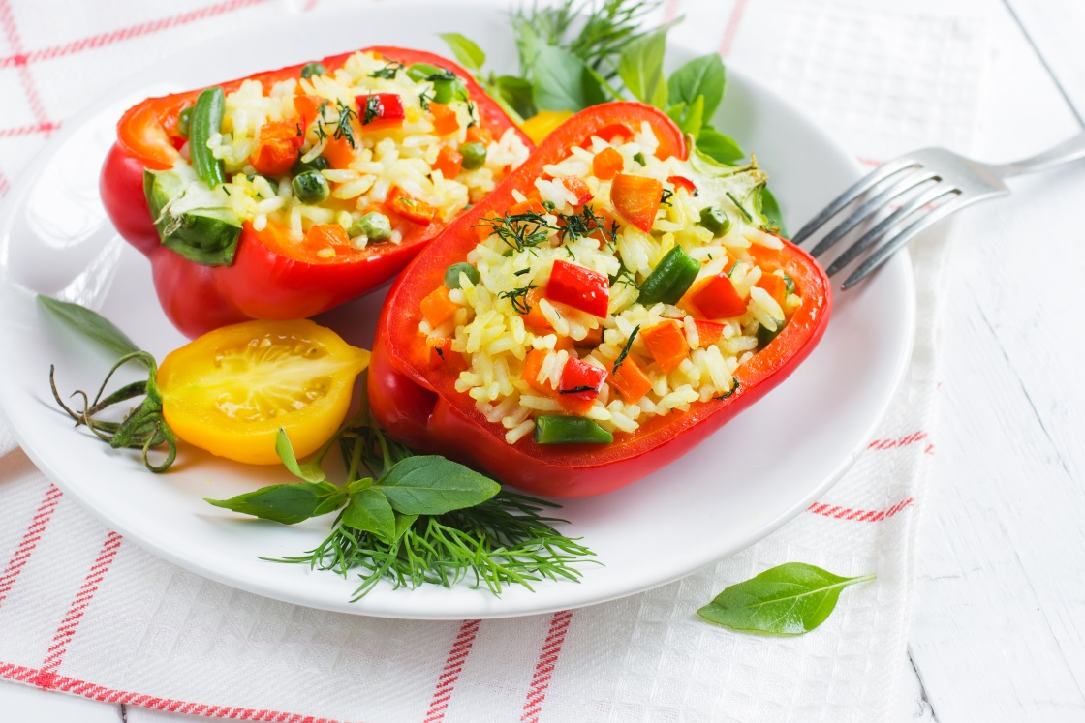
Main meal
Menu
Stuffed peppers with rice and vegetables
What food groups can you see in this meal?

