Slide 1

The big question…
…is graffiti ART or VANDALISM?

Slide 2

Which one do you think is false?
1. The term graffiti comes from the Greek word 'graphein' which means 'to write'.
2. Graffiti was first found on ancient Roman cereal packets.
3. Most graffiti artists prefer to be called 'writers' and each have their own unique 'tag'.
4. Graffiti refers to marks or writings, sometimes colourful, sometimes simple.
5. Communities of writers who are friends are known as 'crews'.
6. Those writers that are inexperienced or new to an area are called 'toys'.
7. Graffiti is now so popular it can be seen in many museums and art galleries.
8. Graffiti is still illegal in many places and you could be fined.

Slide 3


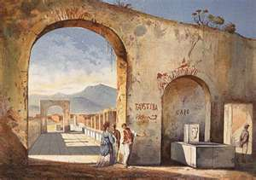
Graffiti was first found in Ancient Roman BUILDINGS!

Slide 4
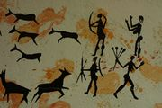

History of Graffiti
Graffiti has been around for millions of years. Romans wrote on the walls of buildings they conquered and cave men drew illustrations on cave walls.
Graffiti first became big in New York and spread through other states. It started as tagging or writing your name on a street sign. Then gangs used graffiti as a way to mark territory.
Not long after, graffiti became a form of art. It inspired young artists to come out and use this new art as a form of self expression. Whatever mood they were feeling they were able to make something beautiful.
Graffiti started moving from streets to subways and quickly became competitive. Graffiti artists had to compete for space and it inevitably offended property owners.
This, and the misunderstanding that all graffiti represented gang activity, led to community pressure on politicians.

Slide 5


Graffiti and the Law
Offenders can be fined up to £5,000 or given Community Service.
On the spot fines of £50 for anyone caught drawing on public property.
Under 16’s can not buy spray paint in cans. If shops sell it they can be fined £2,500!

Slide 6

5Pointz Graffiti Art Centre
In New York City an area has been created to allow graffiti artists to ‘decorate’ any walls they want to as long as it is done in a tasteful way.
Notes:
Click on the title for the hyperlink to youtube!

