Slide 1
Islam
By Edith Vaughan

Slide 2
The origin of Islam
Islam was believed to have been founded by the prophet Muhammad, who was born in A.D. 570 in Mecca-Saudi Arabia
The chain of prophets was believed to have started with Adam
These are the other Islamic prophets:Adam, Noah, Abraham, Ishmael, Isaac, Jacob, Joseph, Job, Moses, Aaron, David, Solomon, Elias, Jonah, John and Jesus

Slide 3
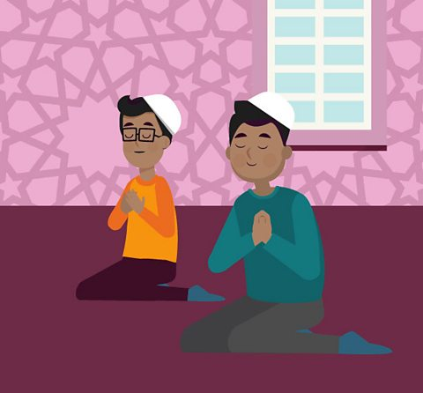
Main Beliefs
Some of the Muslims main beliefs are that Islam was revealed over 1400 years ago
When Muhammad’s name is heard people say ‘peace upon him’
Muhammad was the last prophet sent by god (allah)

Slide 4
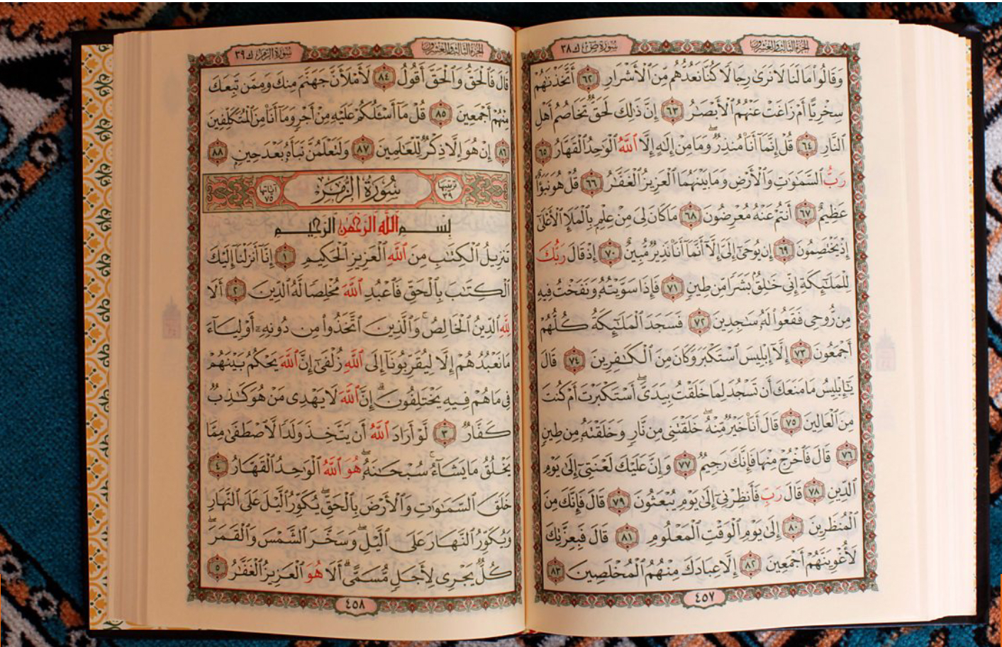
Sacred text
The Muslims most well-known sacred text is called the Quran
The Quran is the world of allah in the words of Muhammad the prophet
Another of the Muslims sacred texts is the sunnah
The sunnah is the practical example of Muhammad the prophet

Slide 5
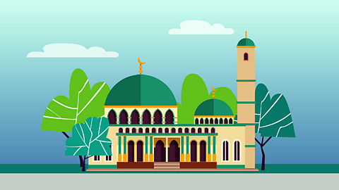
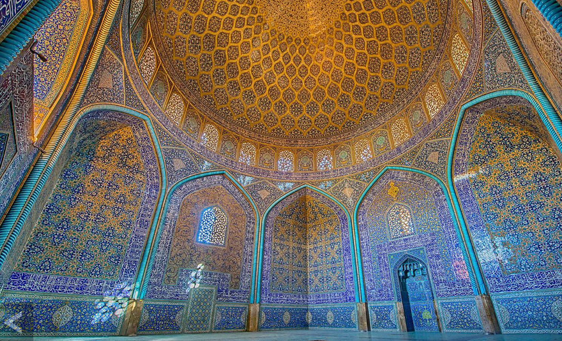
Sacred building
The Muslims most sacred building is called the mosque
The most important service of the week is at Friday at noon
When Muslims pray they face Mecca in Saudi Arabia
When Muslim man prayed they were small cap called taqiyah
When girls are at the mosque and are praying they are required to wear a long dress down to their feet and a scarf

Slide 6
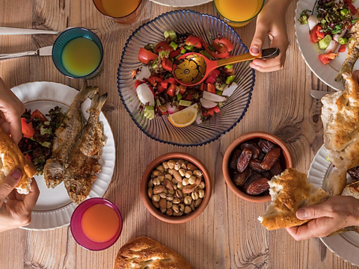
Major Festivals
The most famous festivals in the Muslim religion is Ramadan which leads up eid-al-fitr which is a big celebration for Muslims
Ramadan is a month of the year where Muslims fast which is where they don’t eat in daylight hours and they only have food when the moon is up
Ramadan leads up to Eid which is when the fasting ends and the Muslims have a big celebration exchanging gifts eating food and having a great time

Slide 7
Similarities and differences
Similarities:
They have a holy book and building
They have prophets
Differences:
They have they’re own god
They fast
They were unique clothes

Slide 8

5 pillars of Islam
Shahah- deceleration of faith
Salat- praying 5 times a day
Zakat- giving money to charity
Sawm- fasting during Ramadan
Hajj- A pilgrimage to God

