Slide 1
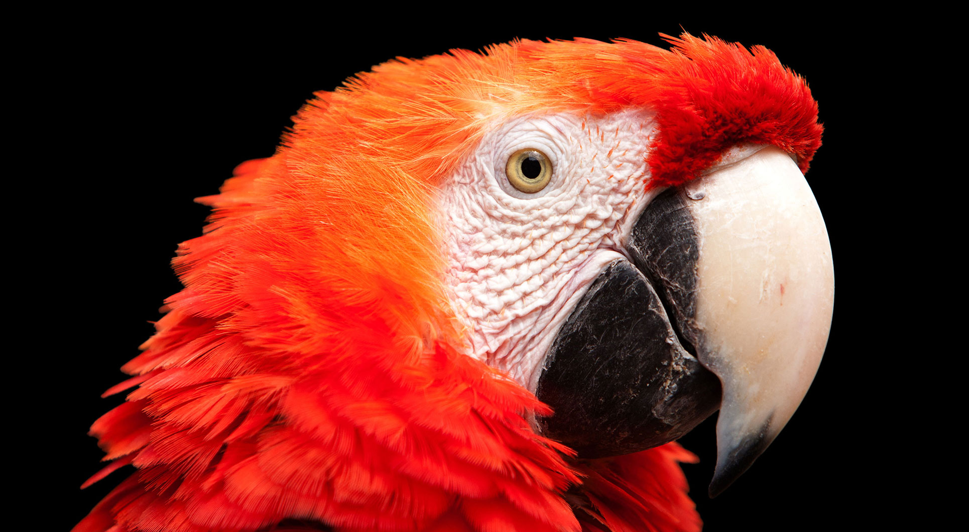
Christianity
By ilyes lafia

Slide 2
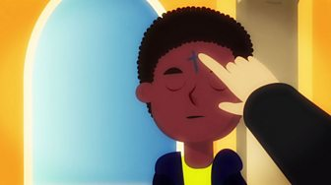
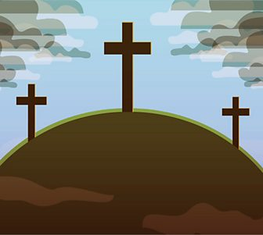
Christian origin
Jesus was born over 2000years ago Jesus was alive but was killed on a crussifcs
It is believed that he was reserrected no one knows how but people think he was
And one of there main beliefs are that there are 3 gods in on Jesus him self god and the Holy Spirit

Slide 3
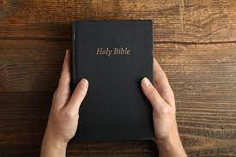
The sacred text of Christianity is the bible
The bible is a book but not just an ordinary book
It contains all the rules and thing about the religion
And contains story’s of all Christian beliefs
The bible can be read in the church in front of lots of people

Slide 4
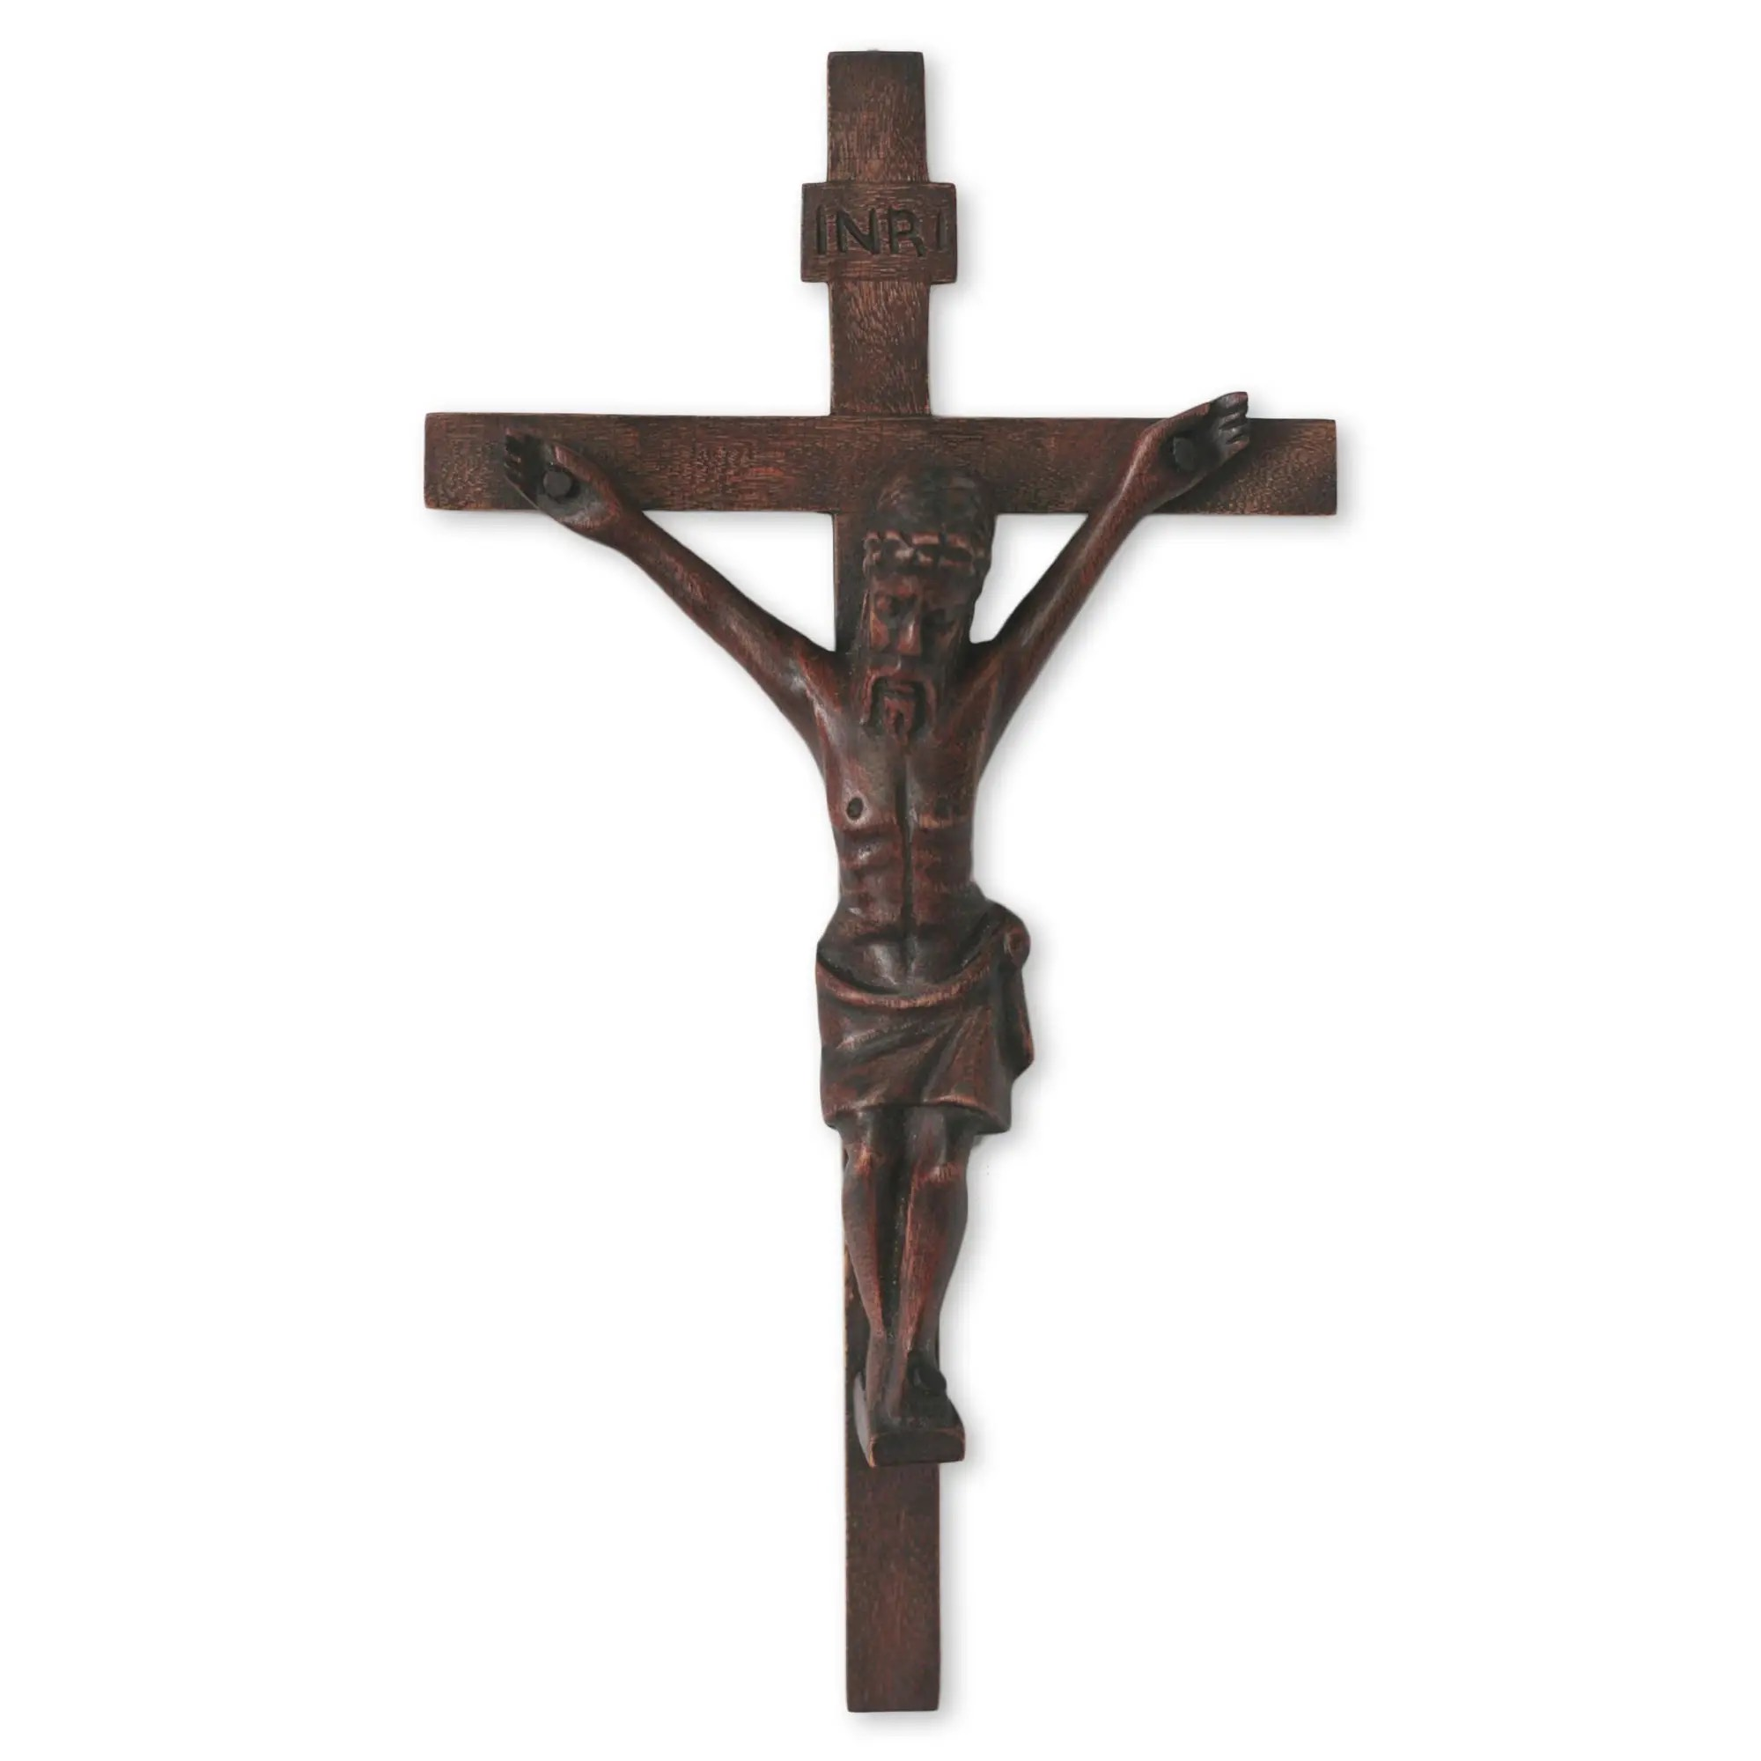
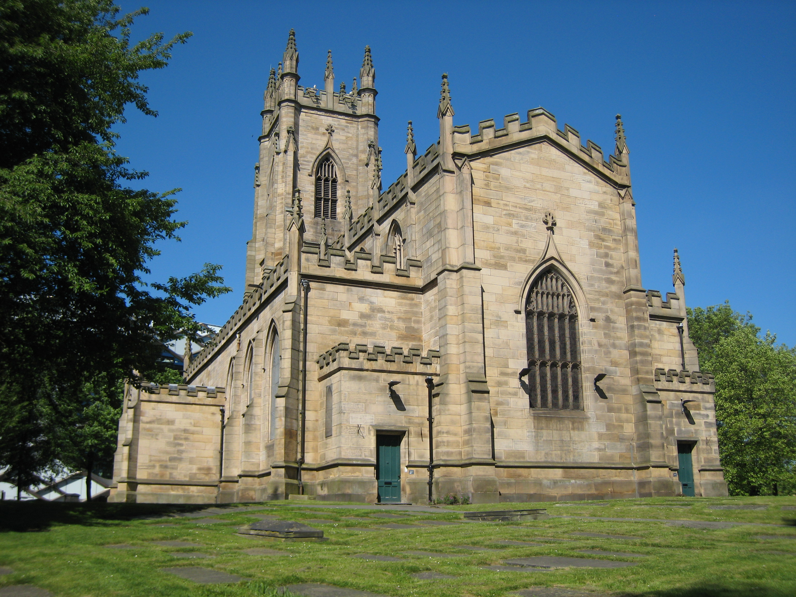
Sacred building of Christianity
And Christianity buildings

Slide 5
The crucifix is the sacred building of Christianity
It’s the sacred building because Jesus was killed on the crucifix
And they have made it hand size for memory of jesus
When Christians pray to there god they all pray together in a church
A church is like a mosque from the Muslim religion
We’re they pray read the bible and tell all the story’s of Christianity

Slide 6
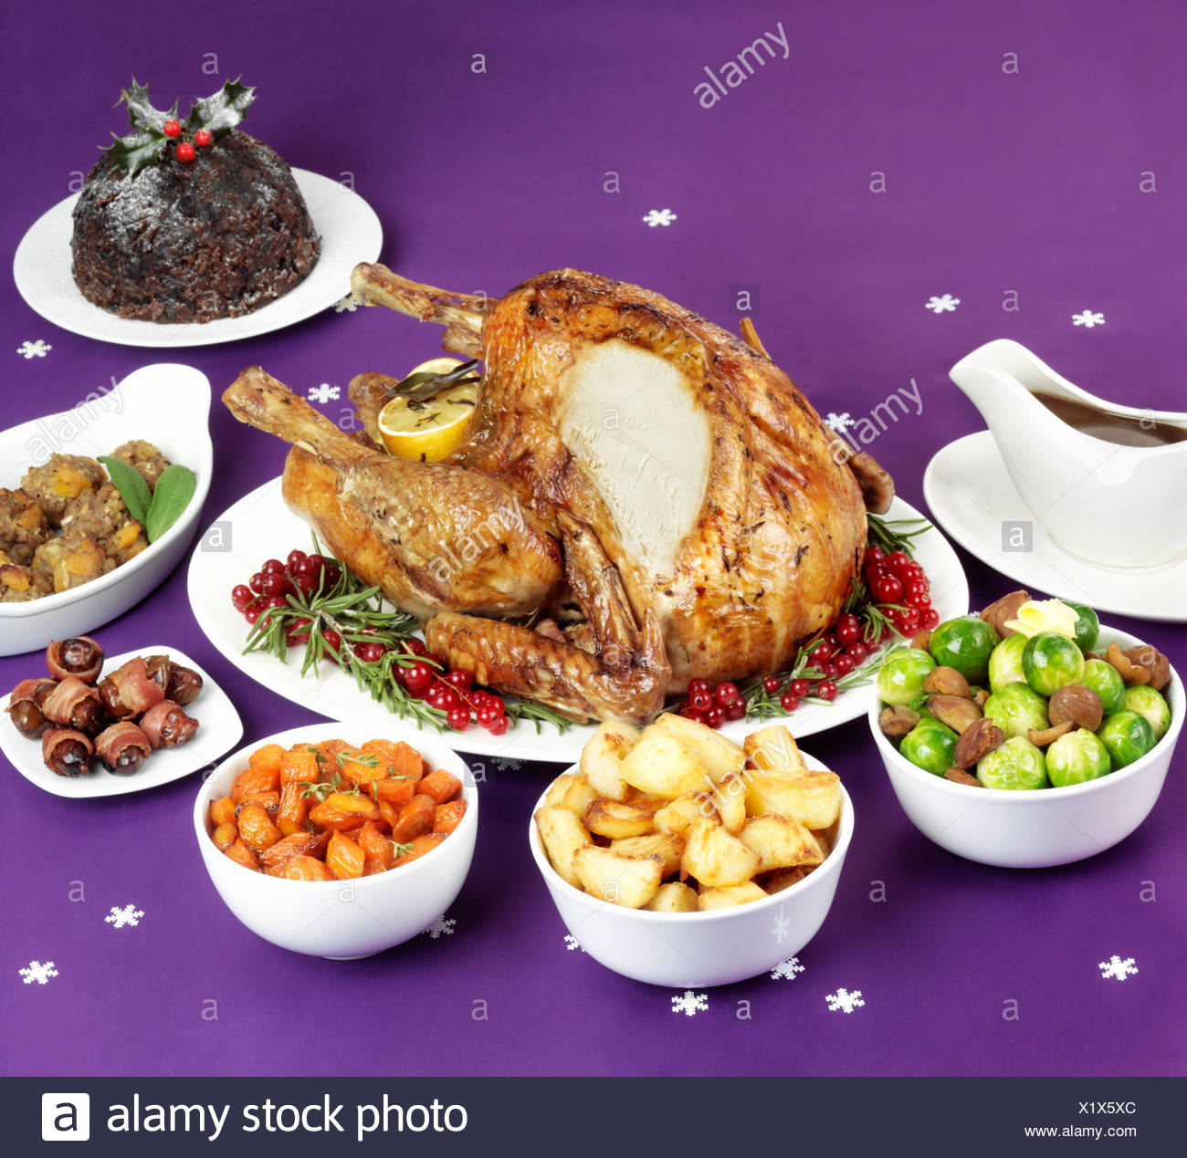
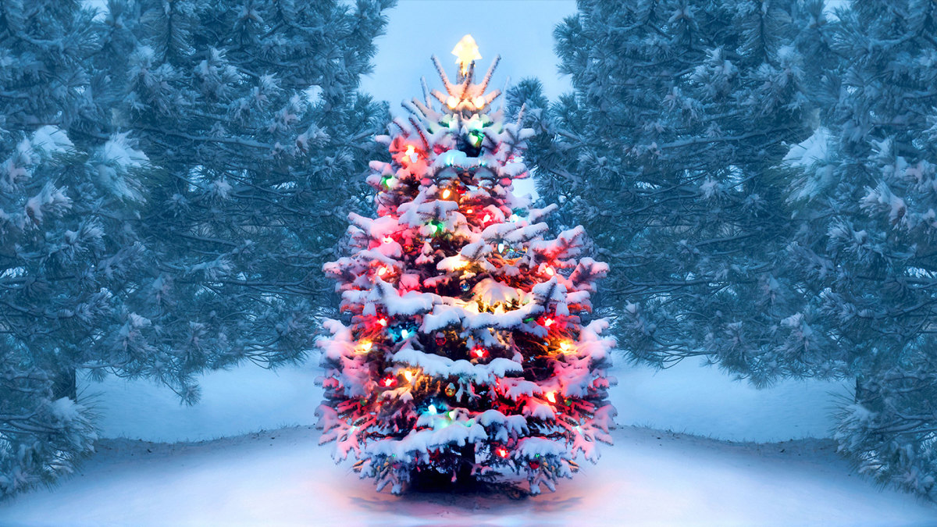
Christian festivals
And celebrations

Slide 7
Christian festivals and celebrations are are thing that Christians celibrate thing from the past
Like Christmas Christians celebrate it because on the 25th of December Jesus was born so they celibrate his birth day

