Slide 1
Hinduism
Faisa S

Slide 2

Origin of the religon
The religion is found in India.
Hinduism is 4,000 years old.
Hindu comes from the word Indus.
Brahma is the creator of the world and all creatures.

Slide 3
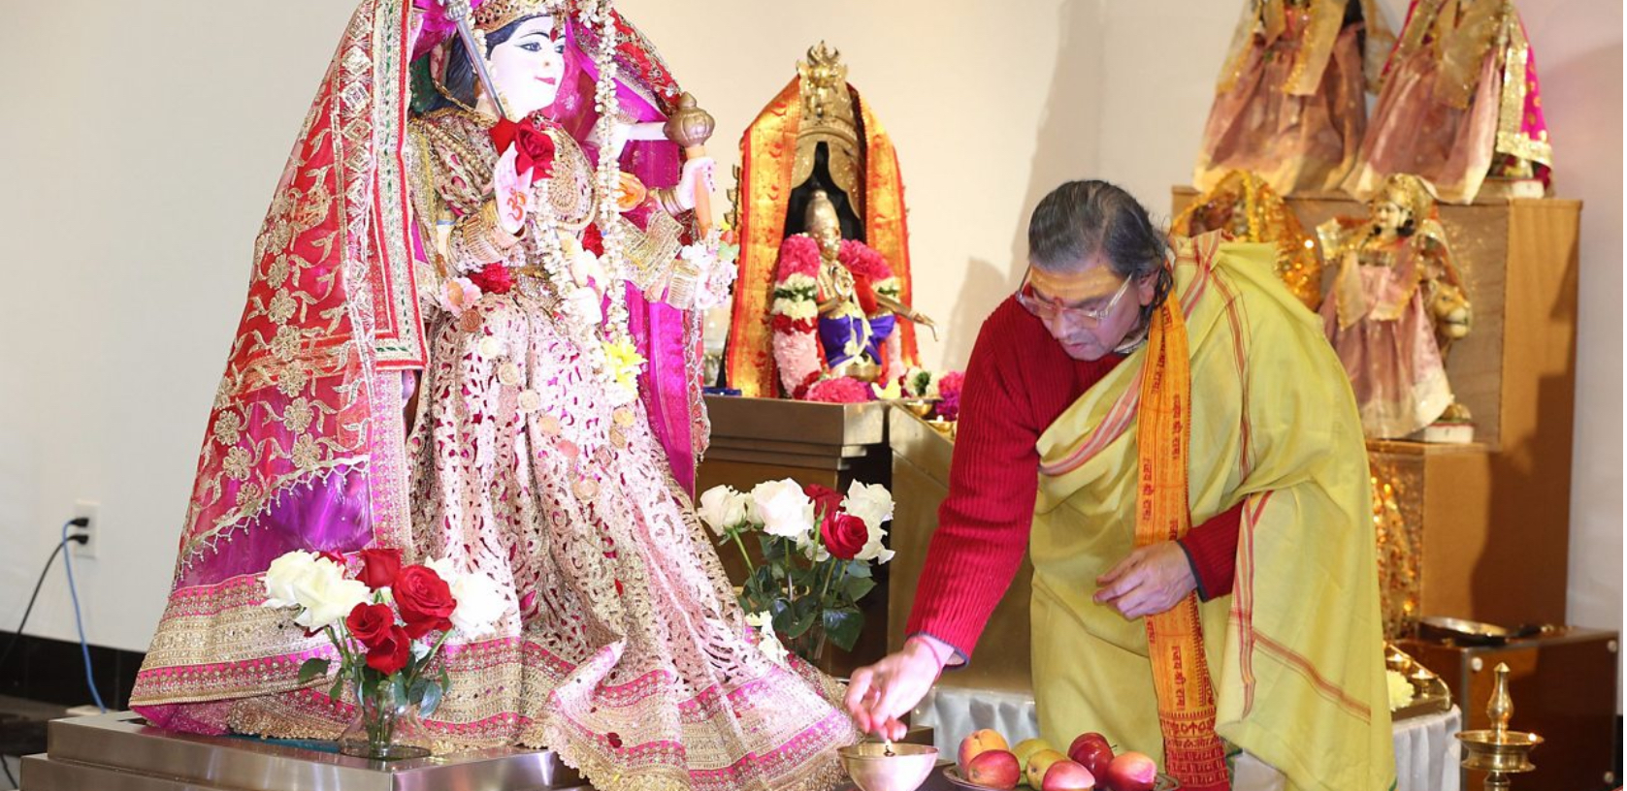
Main Beliefs
Everyone has a piece of Brahma in them.
Vinshu is the preserver of Brahma.
Shiva is the destroyer of the universe.

Slide 4
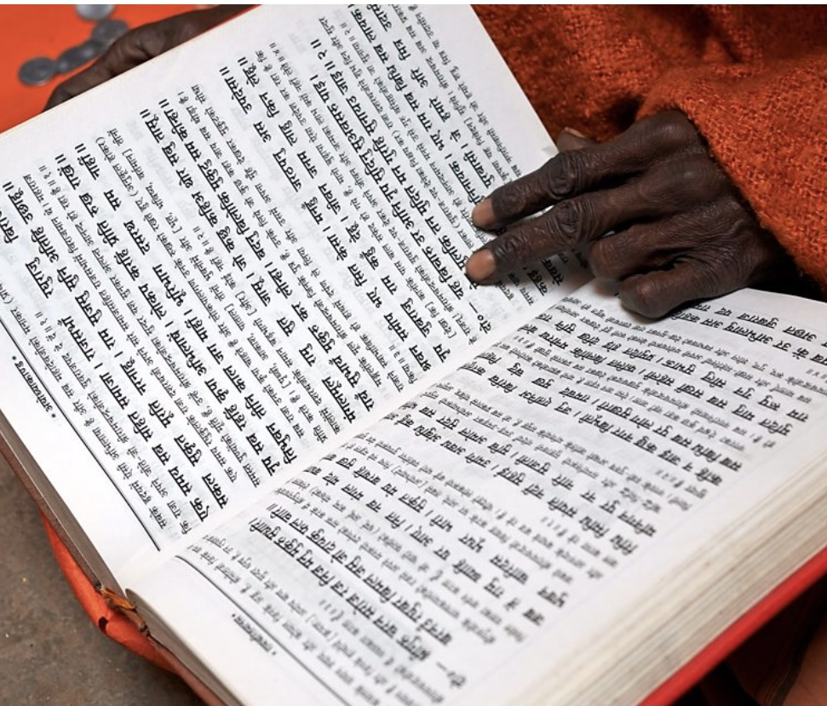
Sacred text
The vedas is a collection of hymns praising the Vedic gods.
The Ramayana is long epic poems about Rama and Sita.
The Mahabrata which includes the Bhagavad Gita.
The Puranas a collection of stories about the different incarnations.

Slide 5
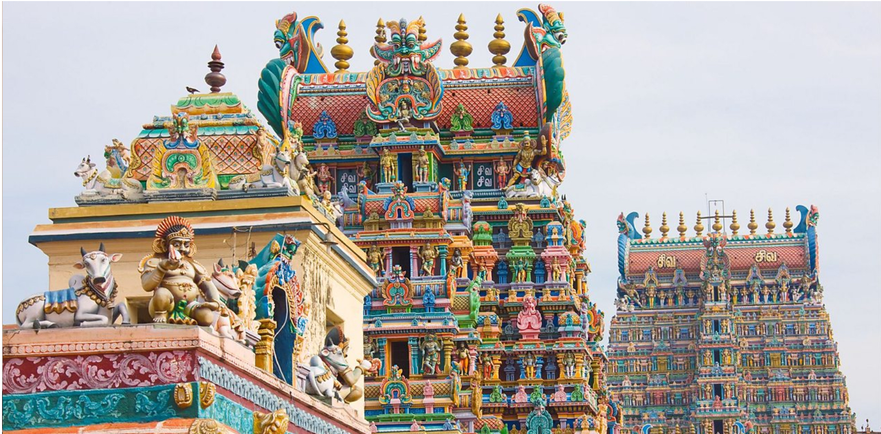
Hindus worships in temple a Madnair.
People can visit Madnair at any times to pray and take time at the bhajans
Hindus also worship at home.
They also have to wear ribbons on their hands when they pray.

Slide 6
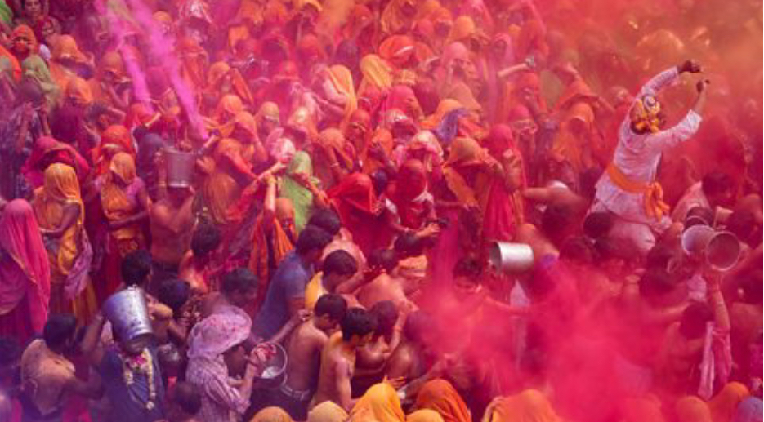
Major festivals
Holi is festival that happens at the the start of spring.
Holi also celebrate the Hindu god krinshu and the legend of holika and prahcad.
People light bonfires and throw roasting, grains, popcorn, coconut and chickpeas.

Slide 7
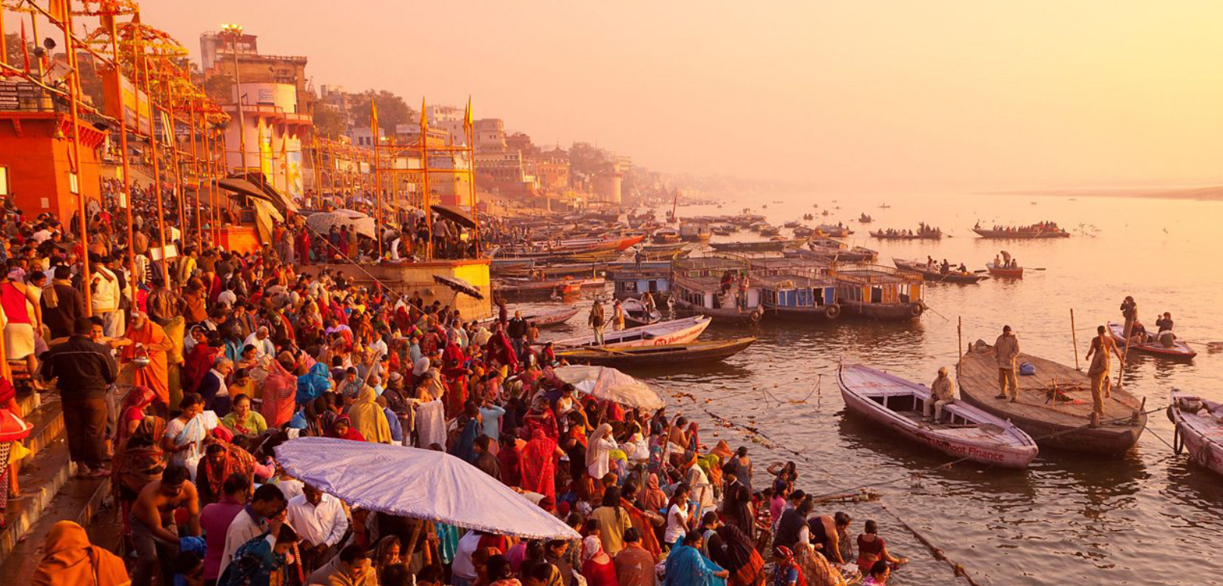
Similarities and differences
Like other religions they believe in god.
They believe in multiple gods.
They have a celebration which are Diwali and holi.

Slide 8
Any other interesting facts
When it’s Diwali Hindus wear new clothes .
The love to share sweets and dried fruits.
The clean there houses before Diwali to take away bad deeds.
A lot of huge fireworks displays.
It’s a Festival of Lights.

Slide 9
The end

