Slide 1
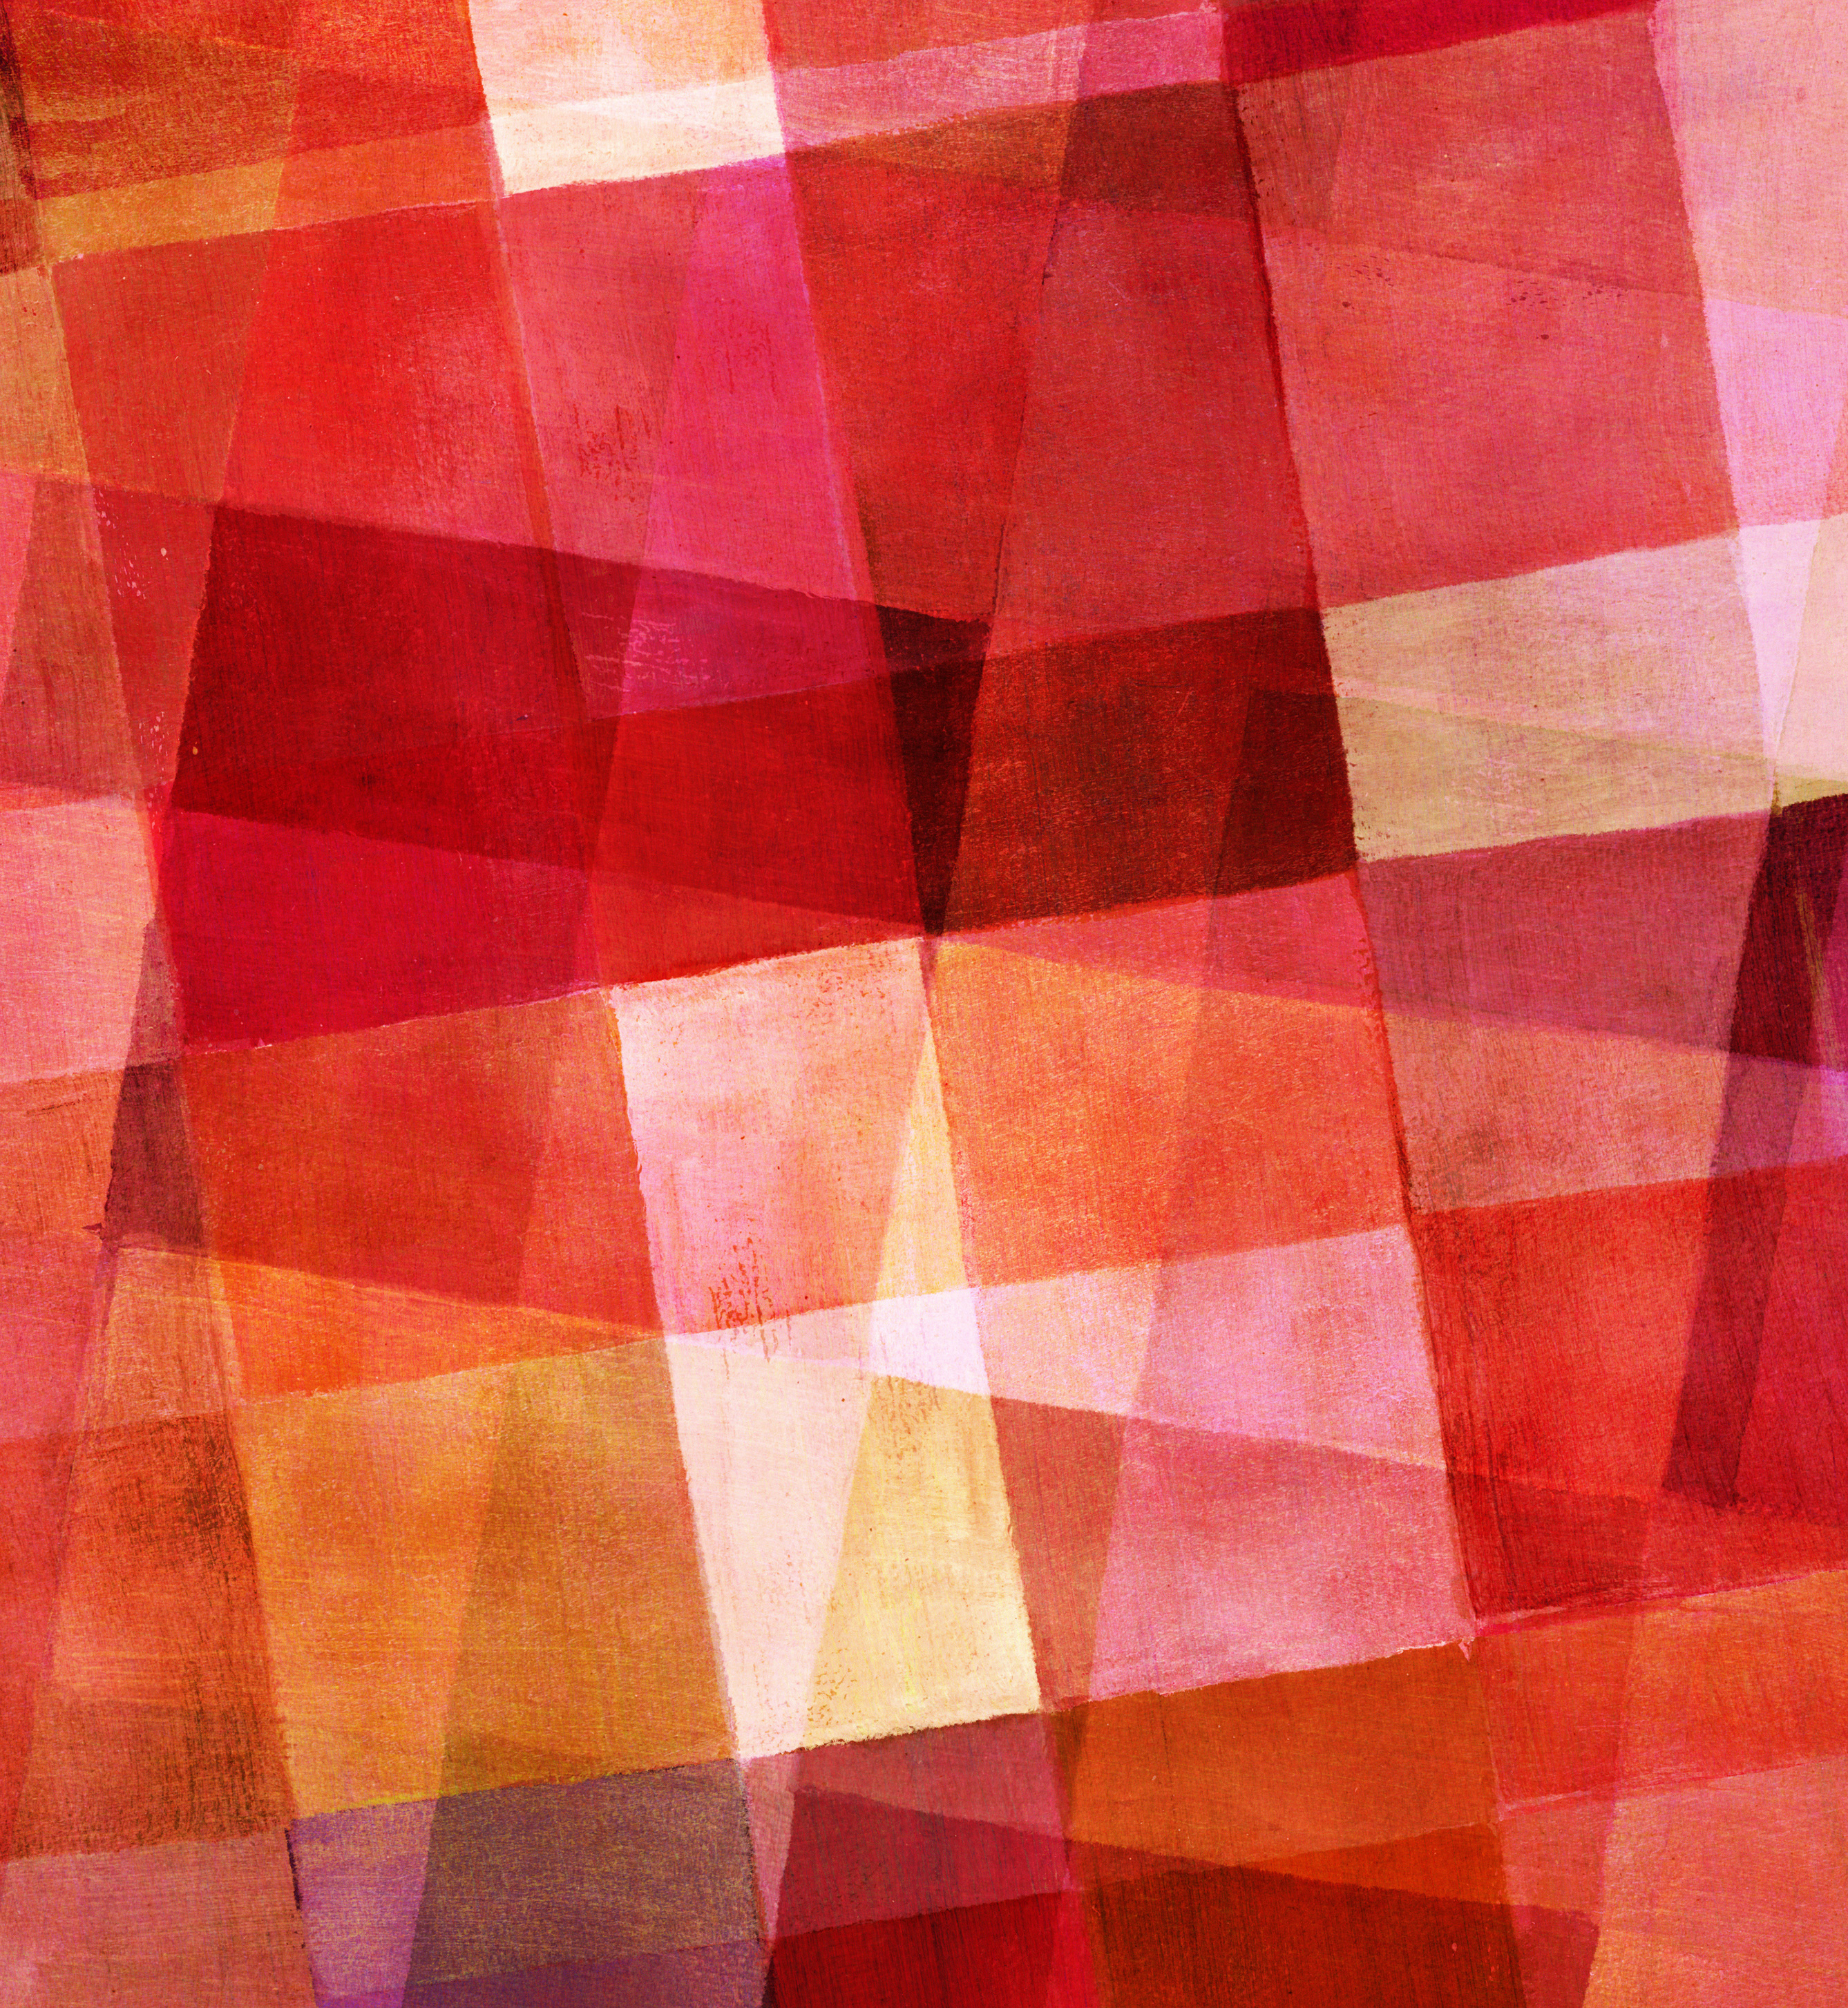
Judaism
By Xanthe Shaw

Slide 2
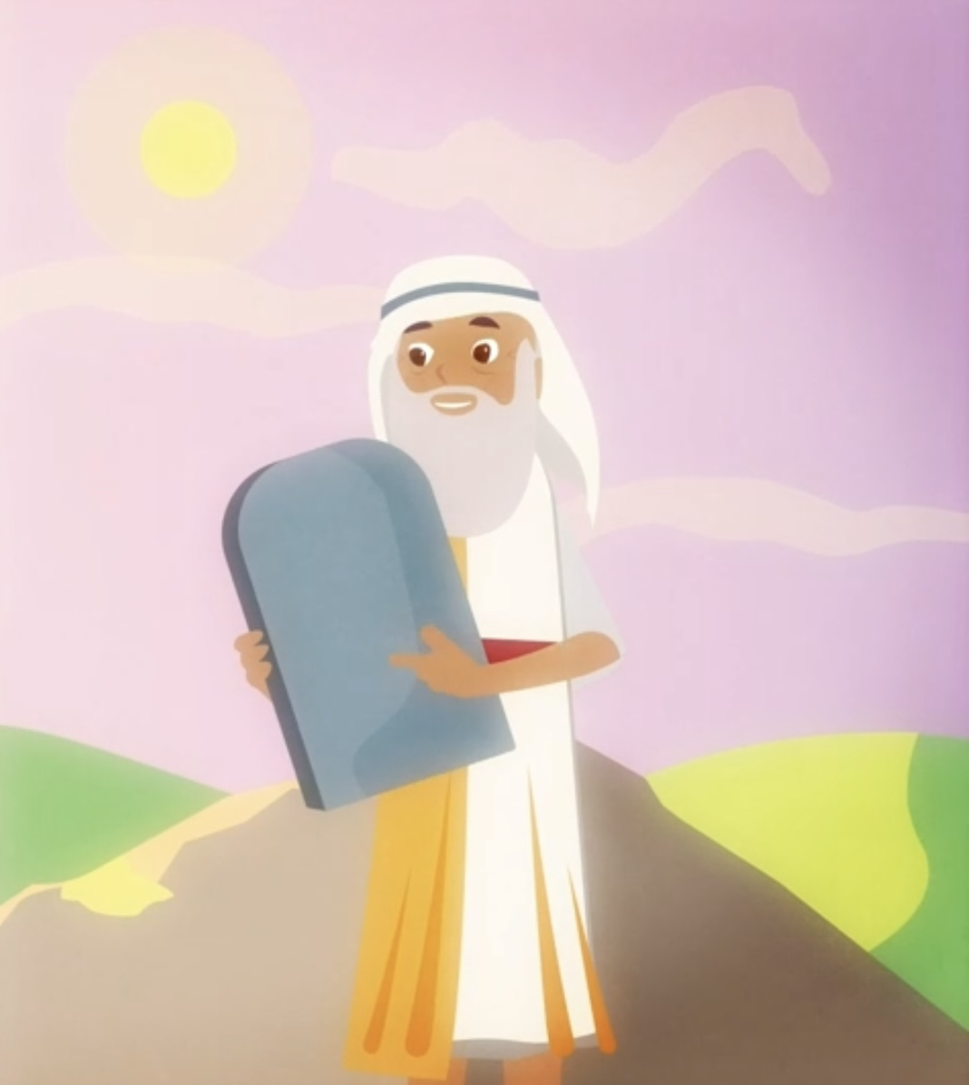
Jewish origin, beliefs and history
Over 4000 years ago in Jerusalem, it is believed that one god created the universe in 6 days. Not only this but, Jews were forced to work as slaves in Egypt. Some of the Jewish holy people include:
Abraham
Moses
etc.
The Jews were also abused and threatened during the Holocaust, and millions of them were killed by the Nazis.

Slide 3
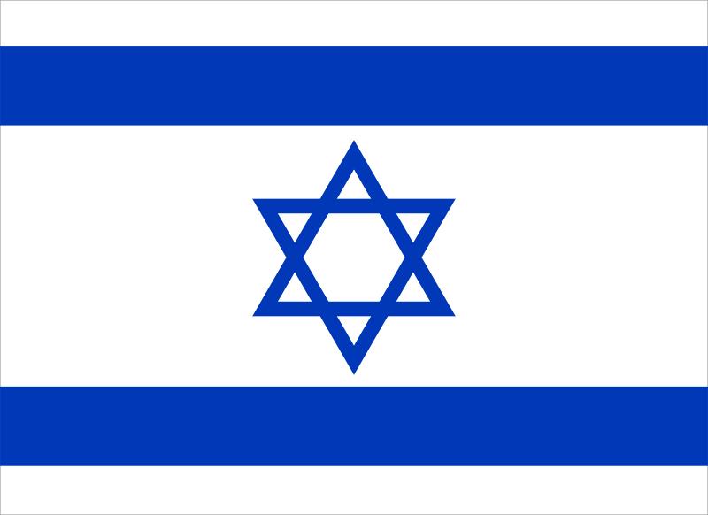
Jewish celebrations
In the religion of Judaism, many festivals and celebrations take place, such as:
Shabbat
Hanukkah- Lasts for 8 days.
Yom Kippur- Held in either September or October. The holiest day of Judaism.
Bah Mitzvah- Celebrated when a child turns 13 years old.

Slide 4
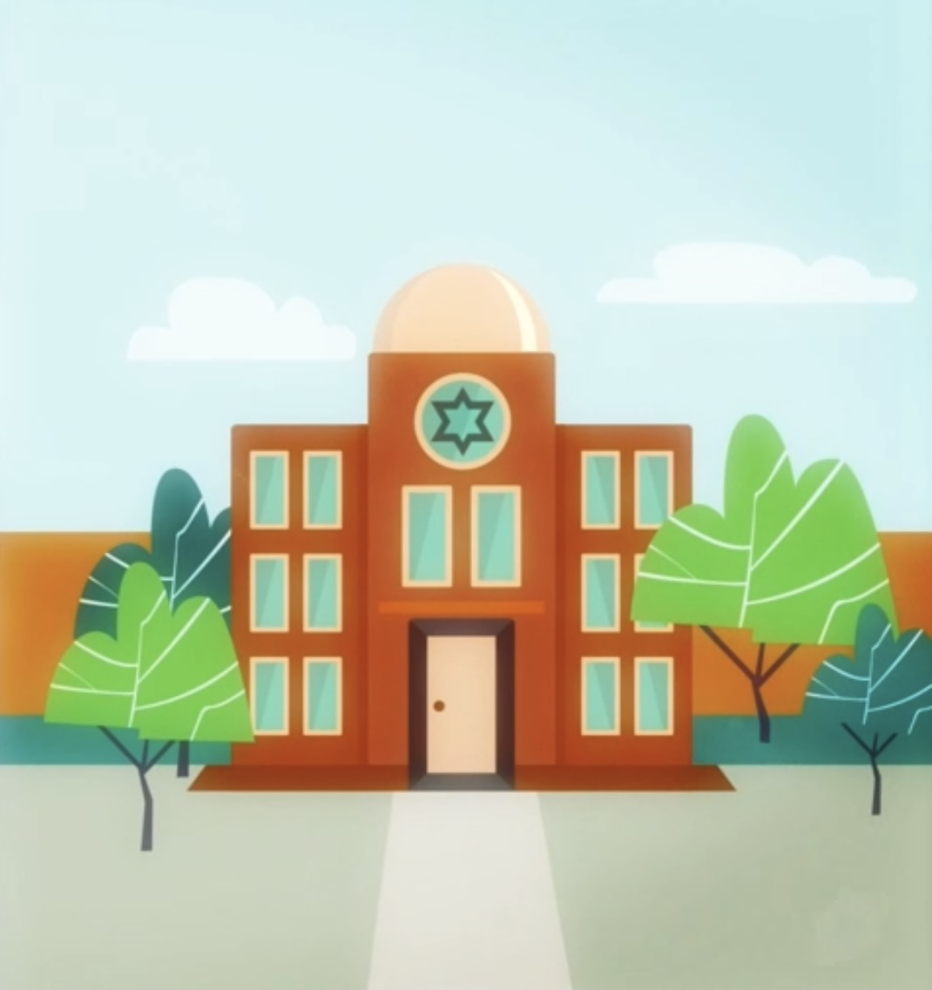
Sacred text and building
The sacred building of Judaism is called the Synagogue. The Synagogue is a place for Jews to pray, worship, etc. A Rabbi will lead the Jews in prayers and readings from the Torah. The Torah is the sacred text of Judaism and holds Jewish stories. However, the Torah is so important that not even the Rabbi can touch it, instead a stick is used to show which section of the Torah is being read. To prove how special the Torah is, it is the holiest book in Jewish history!

Slide 5
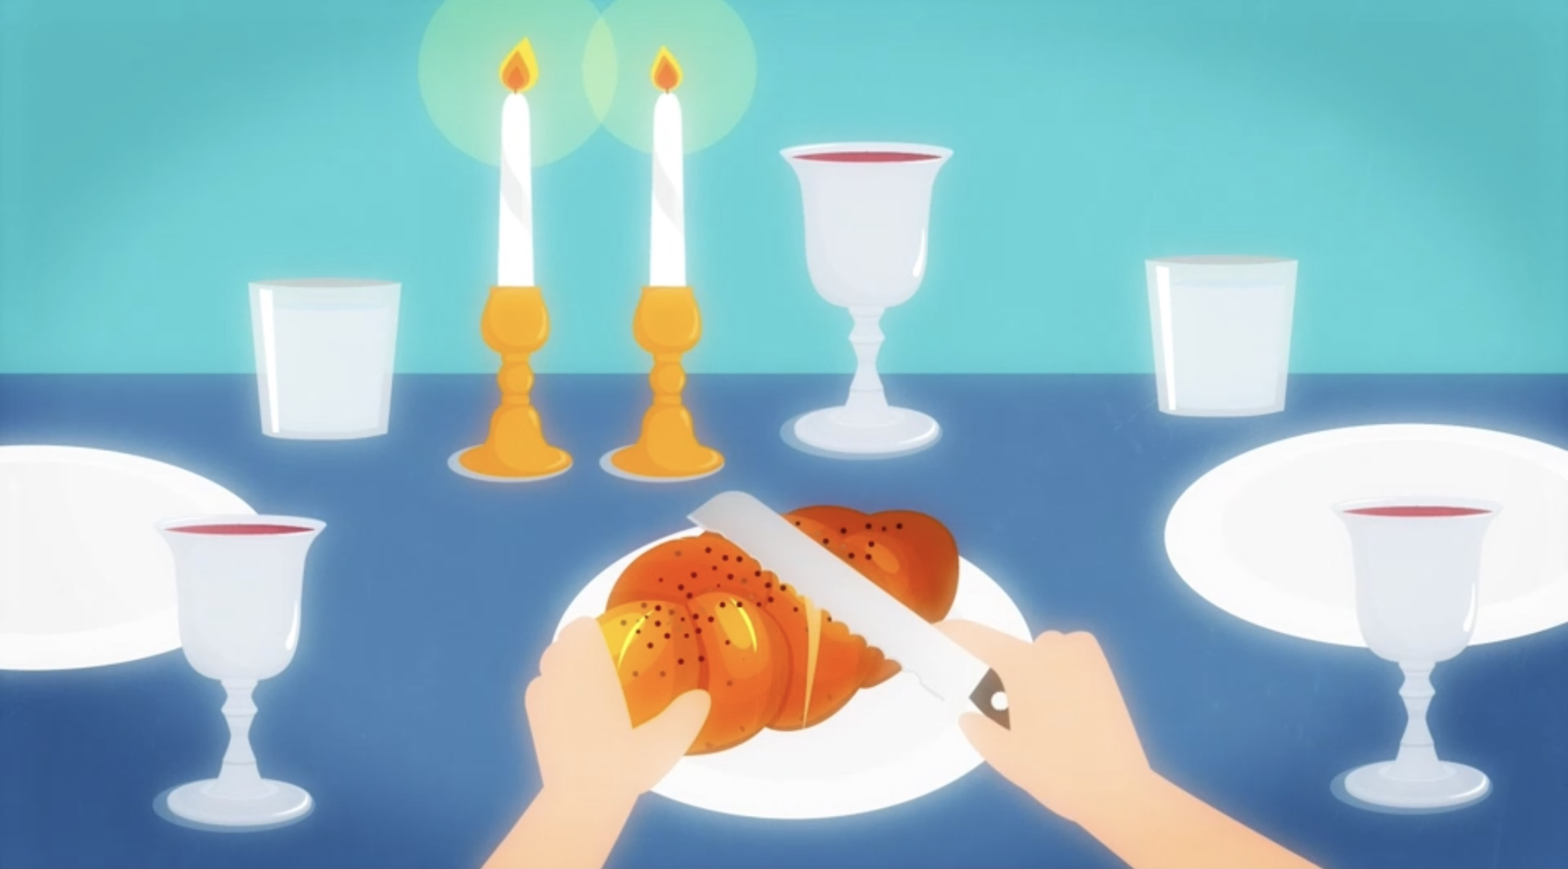
Similarities to other religions
Similarities
The similarities to other religions consist of the following:
Each religion has a god, who is believed to have done something great.
Most religions have a special foods e.g. Special foods in Judaism include: Challah and Matzah.
As well as Muslims, Jews take part in fasting.

