Slide 2
Who Was Henri Matisse?
Henri Matisse was a French artist known for his use of colour and shape. When he was young, he did lots of paintings but as he grew older he began to make striking collages, which are pictures made by using cut out bits of paper.
Here are some facts about him:
He was born in
1869, in northern France.
He studied law
and became a lawyer.
He went to school in Paris.
Some of his work
has sold for over £15 million.
Did You Know?
Henri Matisse became an artist after his mother bought him a set of paints when he was poorly, to keep him entertained.

Slide 3
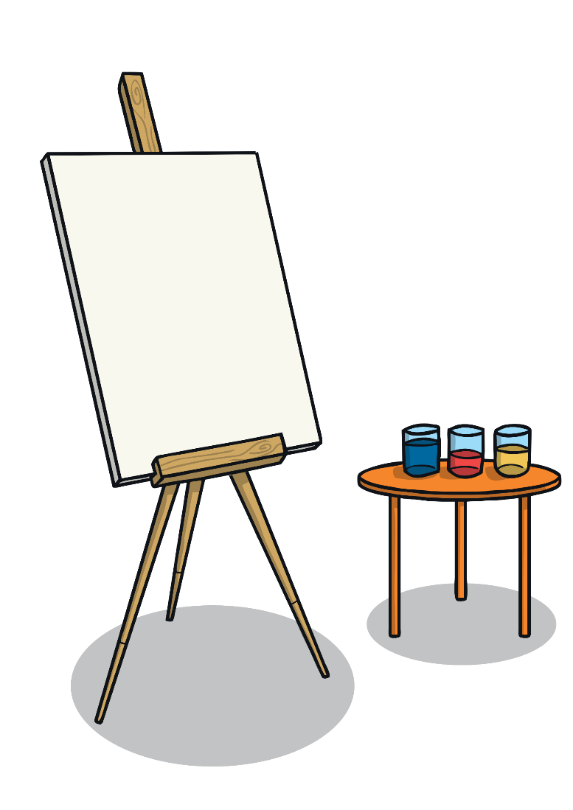
Fauvism
Henri Matisse’s early paintings were very exciting
and were full of lots of different colours. This
style was very different to the work of most
artists at the time.
One art critic called Matisse and others who painted like him ‘fauves’. This is French for ‘wild beasts’. The insult started the beginning of Fauvism, a style of painting Matisse is remembered for.
Talk About It
‘Woman With a Hat’, was painted in 1905. You can view it here.
Can you see all the different colours the artist has used?

Slide 4

The Colour Red
The painting ‘The Dessert: Harmony in Red’, which you can view here, was painted over 100 years ago, in 1908.
It was originally called ‘Harmony in Blue’ but the artist did not like the painting when it was finished so he changed the blue to his favourite colour, red.
This painting is thought to be Matisse’s masterpiece, which means it is an important and impressive painting.
Talk About It
How would the painting look if all the red was blue?

Slide 5
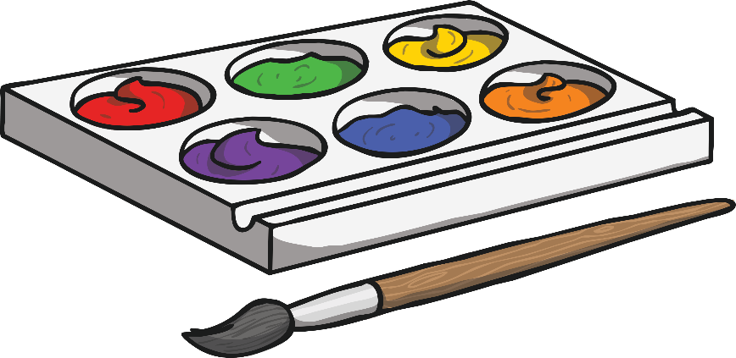
A Change of Style
This painting is called a portrait because it is a painting of a person. The painting, ’Purple Robe and Anemones’, which you can view here, was painted in 1937. Can you see a difference in the artist’s style to the
other paintings?
When he painted this portrait, Matisse did not want it to look like real life at all. When asked if he could make it seem more real, he said that he did not create women, he made a picture.
Did You Know?
Matisse collected patterned materials from different places he visited, then used the patterns in his paintings later.

Slide 6
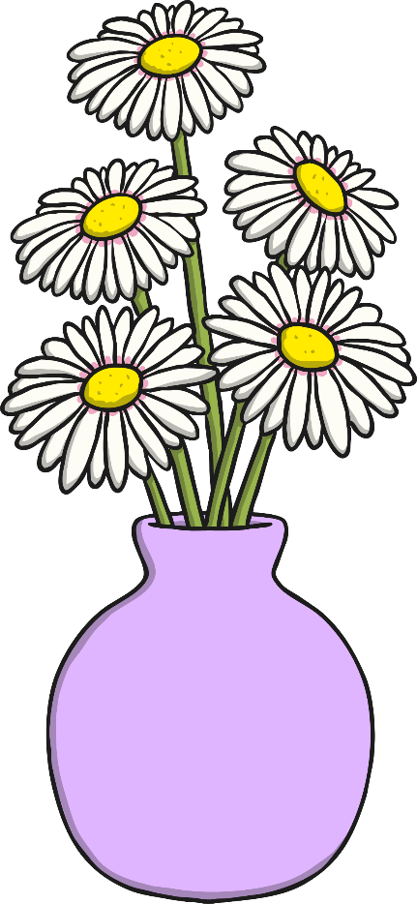
Still Life
The painting ‘Daisies’, which you can view here, was
painted in 1939. It is what is known as a still life.
Still life paintings are a collection of objects. It could
be fruit or flowers that feel soft, with vases, bowls
or other things that feel hard.
Matisse made this painting different to other still life paintings, by adding the
two figures.
Talk About It
Why has the artist painted the two figures in different ways? Why is one of them completely red?

Slide 7

Later Life
In his later years, Matisse began to experiment with cut outs. He made collages from these using different coloured paper.
In 1947, he published a book called ‘Jazz’ that became really popular. Some of the collages in the book have become famous works of art.
This collage is called ‘The Knife-Thrower’. Can you see the figures in the picture?
Did You Know?
In 1906, Matisse met Pablo Picasso. They became lifelong friends, as well as rivals.

