Slide 1
Adding to make twenty:
1
1
2
3
3
Add any four digits to make the total 20
4
5
6
7
7
8
9
9
There are 12 possible solutions - can you find the other 11?
Answer

Slide 2
Find the link:
The set of numbers below are linked by the same mathematical process.
5
1
7
7
+ 4
9
5
11
x 7
63
35
77
Answer: Add 4 to the top box and multiply your answer by 7.
Try these

Slide 3
Find the process
A
2
3
5
5
B
10
8
13
13
4
5
7
12
10
15
16
20
28
6
4
9
C
3
5
8
8
D
21
7
35
35
9
15
24
3
1
5
19
25
34
8
6
10

Slide 4
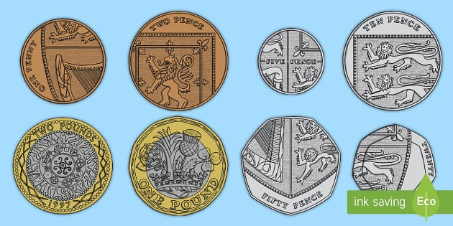
Fifteen coins make a pound.
How many different combinations of 15 coins can you find that will make exactly £1?
Coins may be used more than once.
TRY: starting with two fifty pence pieces and cascading [changing them] coins until you reach £1 with 15 coins.
THINK: Once you have found one combination change coins to find others.

