Slide 1
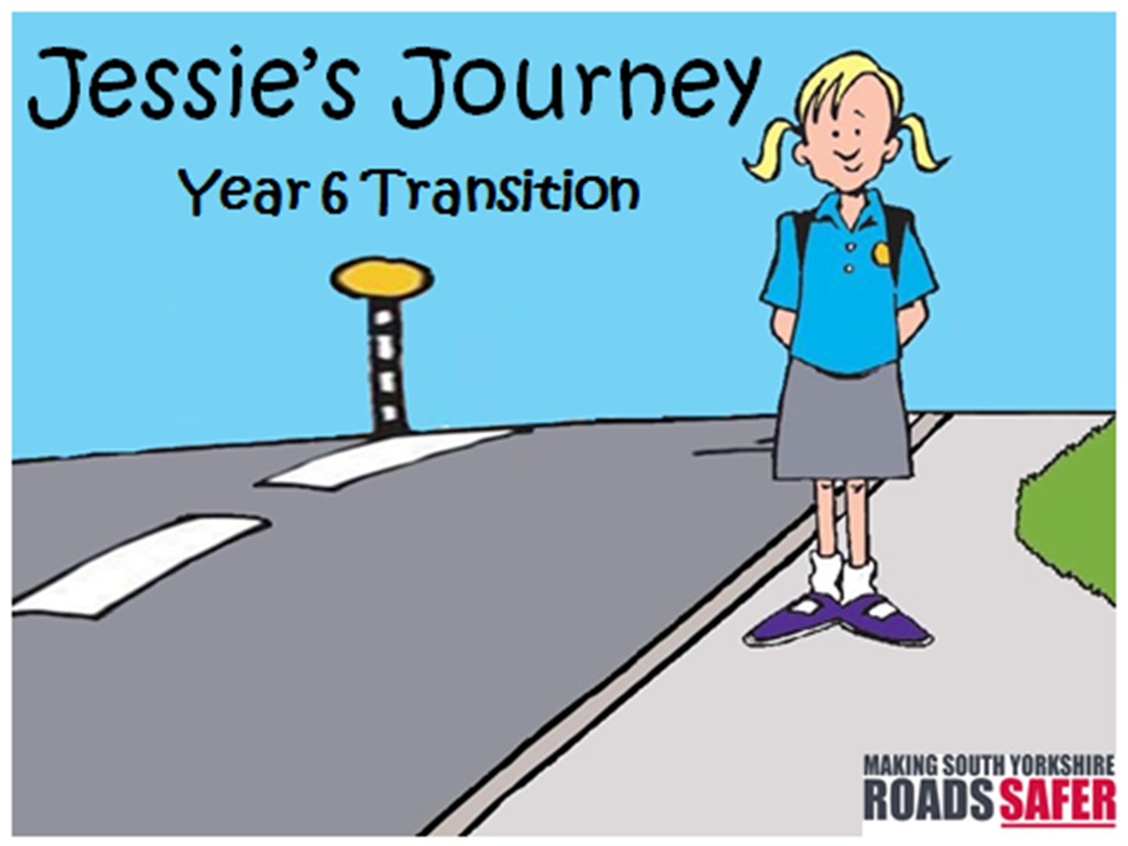
At this time of year, we would normally be busy in schools delivering our transition session
Alongside our Y6 pupil, Jessie, we will be looking at the topics she needs to think about for her new journey to her new school.
Take a look at what Jessie finds out – maybe you will pick up some tips ☺

Slide 2
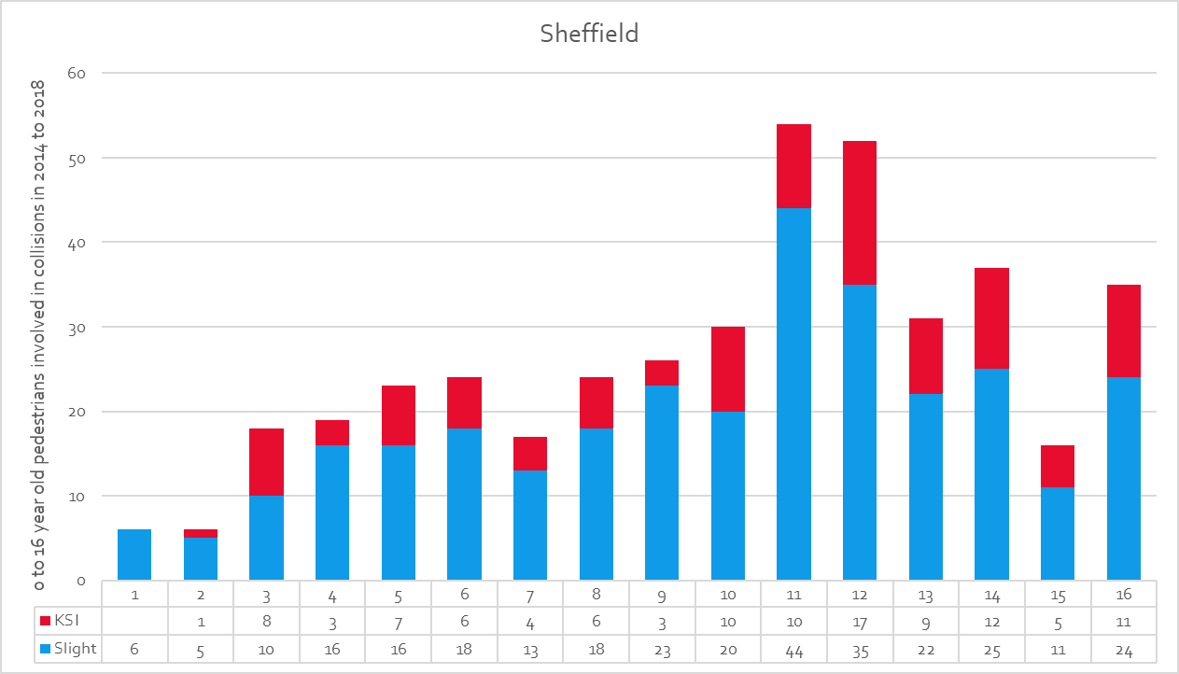
As you can see from the graph, every year we see a spike in child casualties at 11yrs, coinciding with their transition up to secondary school.
This could be due to a number of reasons = new independence, distractions, new journeys…………………………so please remember to stay alert & aware

Slide 3
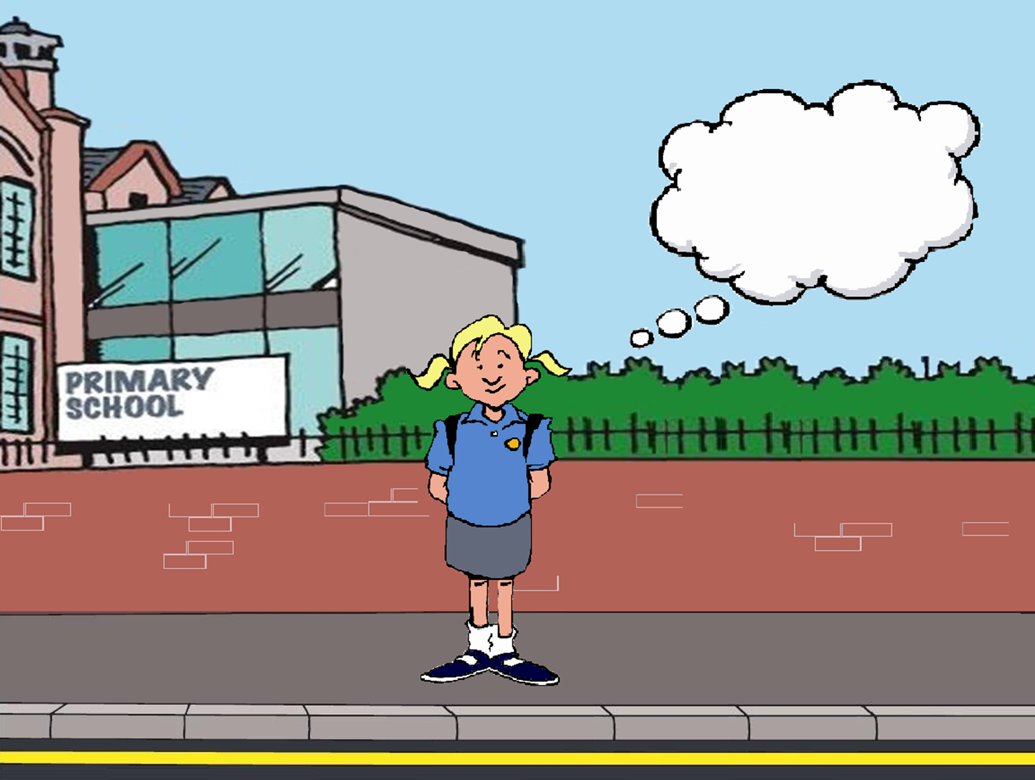
The journey to secondary school may be a lot different to the journey you now take to primary school………………………
So Jessie started to think about her new secondary school and how she would get there………………………..
Things to think about:
Where is my secondary school?
Which route will I take?
How will I travel to school?
Why not take this ‘lock down’ opportunity to plan your route to secondary school and if you can have a trial run to work out the best and safest way to school and see how long it takes you
Check out https://www.google.co.uk/maps

Slide 4
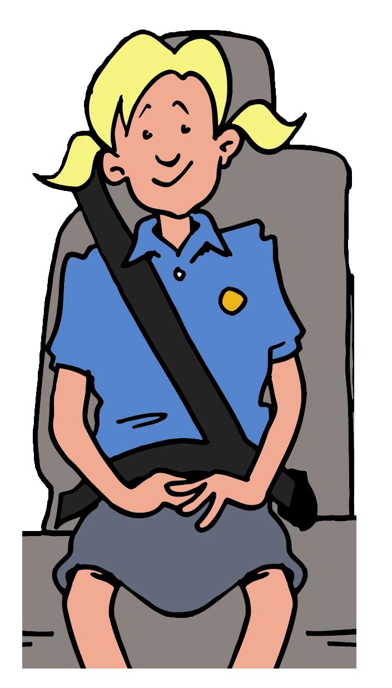
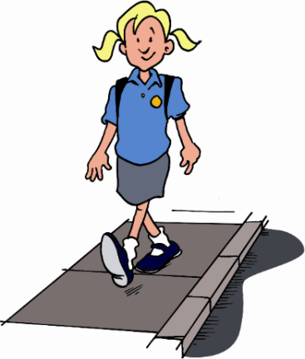
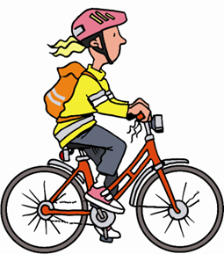
How am I going to travel to school? – things to think about
Travelling in the car to school may be convenient – but is it environmentally friendly?
If you are in the car always remember to put on the seatbelt……. It is the law!
Walking to school is a healthy option and you can meet your friends to walk together.
Remember – the shortest way isn’t always the safest.
Also remember – not to be distracted as you are walking.
Remember to use the Green Cross Code (stop, look, listen)
Cycling to school is another healthy option.
Remember your safety – wear something bright & reflective and remember your helmet!
Think about what you have to carry to school – don’t have bags hanging from the handlebars!!!

Slide 5
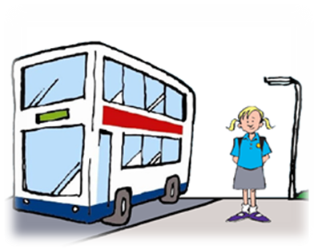
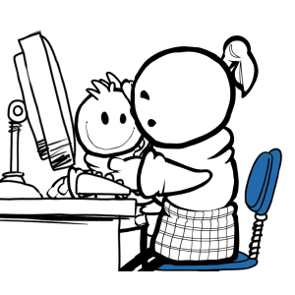
Catching a bus or a tram is an option if it is too far to walk.
Remember your bus pass and money.
Also remember there may be other people using the bus – so be considerate to others.
Have you got yours yet??....................
The MegaTravel Pass. Get it online, save all the time!
If you live in South Yorkshire and you’re under 16 years old you can apply for a MegaTravel Pass, which gives you concessionary travel on the bus, tram or train in South Yorkshire.
With a MegaTravel Pass you can travel anytime, anywhere in South Yorkshire for a single fare of 80p per journey on bus or tram and travel half price on local trains.
Under 16s travelling without a valid pass may be charged full fare, so please apply before September to prove you’re eligible for concessionary travel.
Apply online now : https://www.travelsouthyorkshire.com/megatravelpass/

Slide 6
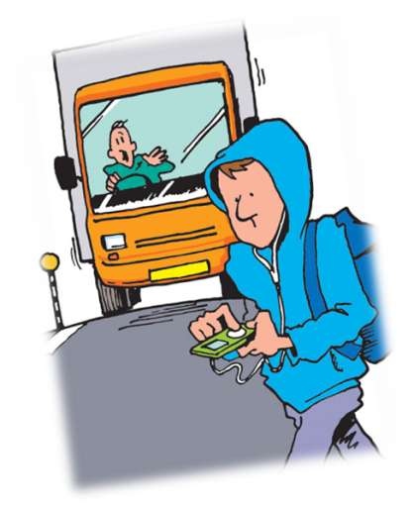
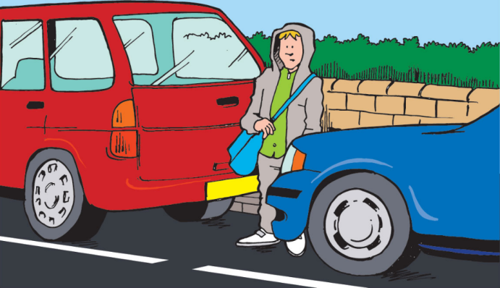
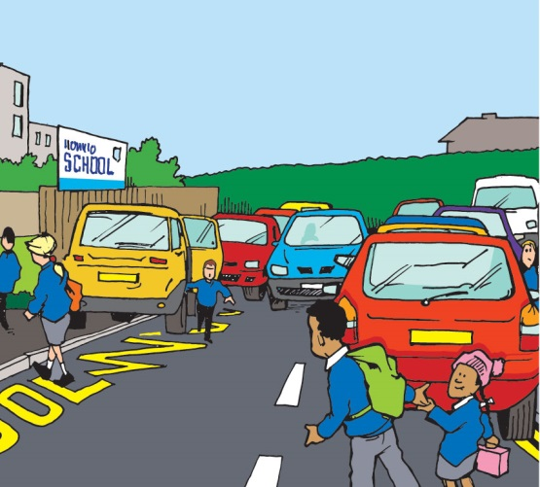
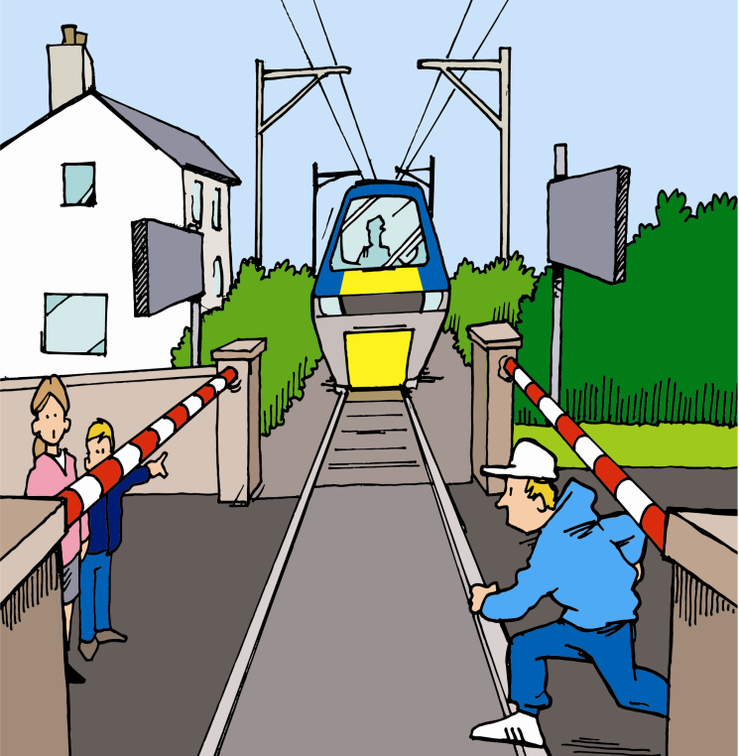
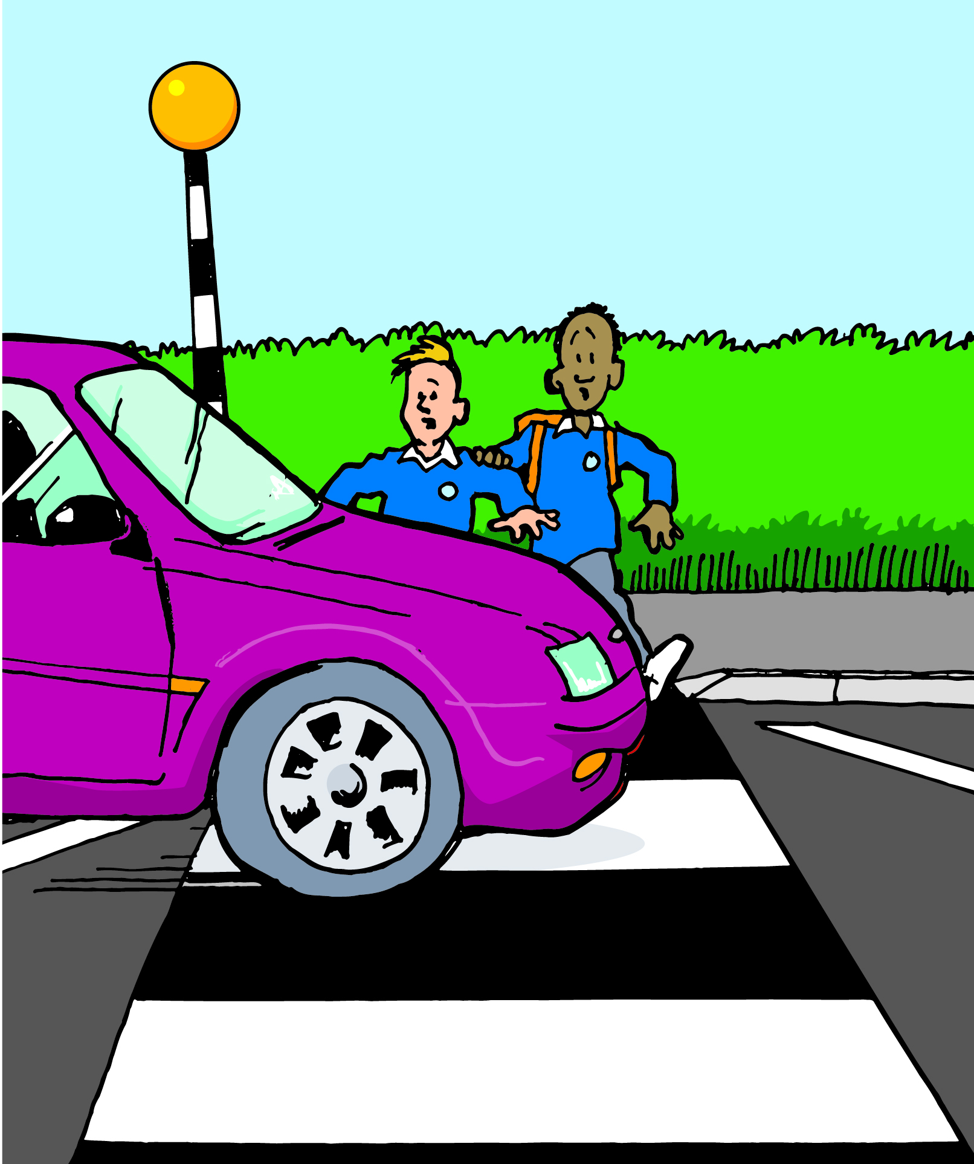
How to keep safe on your way to school
Try not to cross the road between parked cars – but if you do, make sure you can see and drivers can see you
Zebra crossings are for pedestrians to cross the road safer – but wait on the kerb until you know the car is stopping – unfortunately not all cars stop.
Always pay attention, don’t be distracted
Outside secondary school is just a busy as outside primary – so be careful and think about being safe crossing the road
Don’t take risks

Slide 7
How to keep safe on your way to school – things to think about
Plan your route to school, arrange where to meet your friends, but remember the shortest way is not always the safest
Use any pedestrian crossings on your way – they are the safer place to cross a road
Can you hear electric cars or bicycles on the road? No, so you need to be looking
Can you hear what or who is around you if you have earphones in? No, so stay alert and aware of who or what is near you
Be careful of driveways – cars may be reversing from a drive and may not see you straight away
Always have a back-up plan in case you miss the bus, or are later leaving school
Make sure your contacts (including the schools number) are up-to-date in your phone

Slide 8
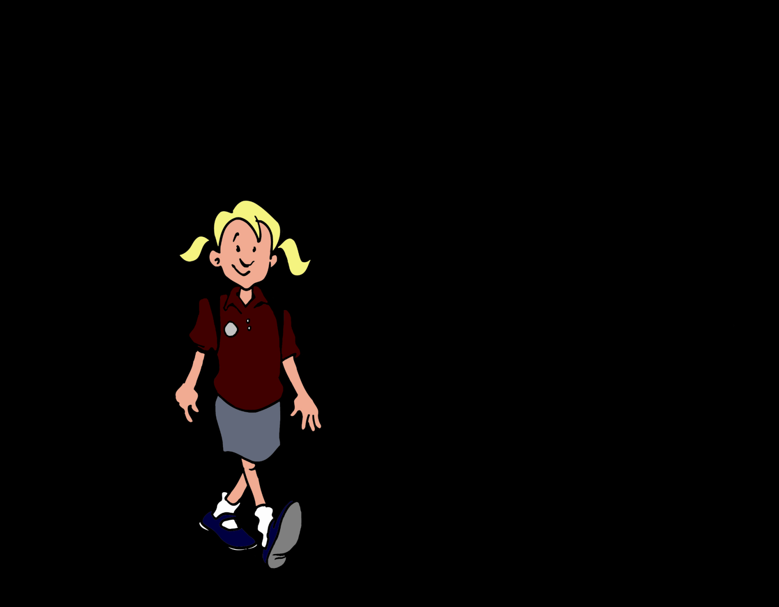
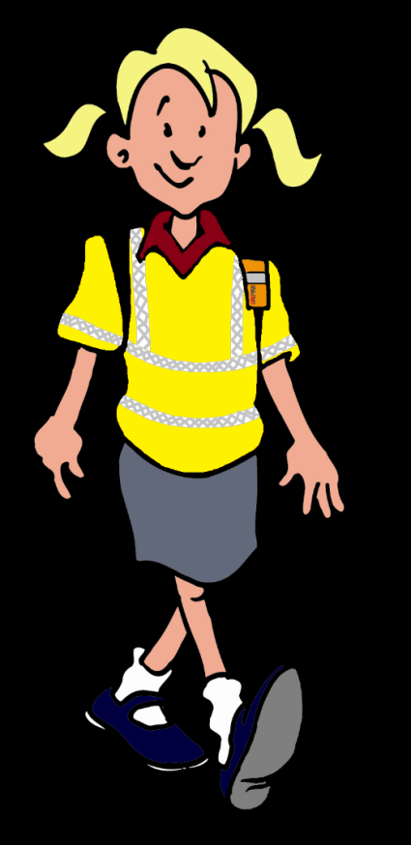
Be Bright Be Seen
Jessie also started to think about when she started school in September, it would be dark in the mornings and at the end of the school day, and her new uniform is dark
How can you make yourself more visible and safer?

Slide 9
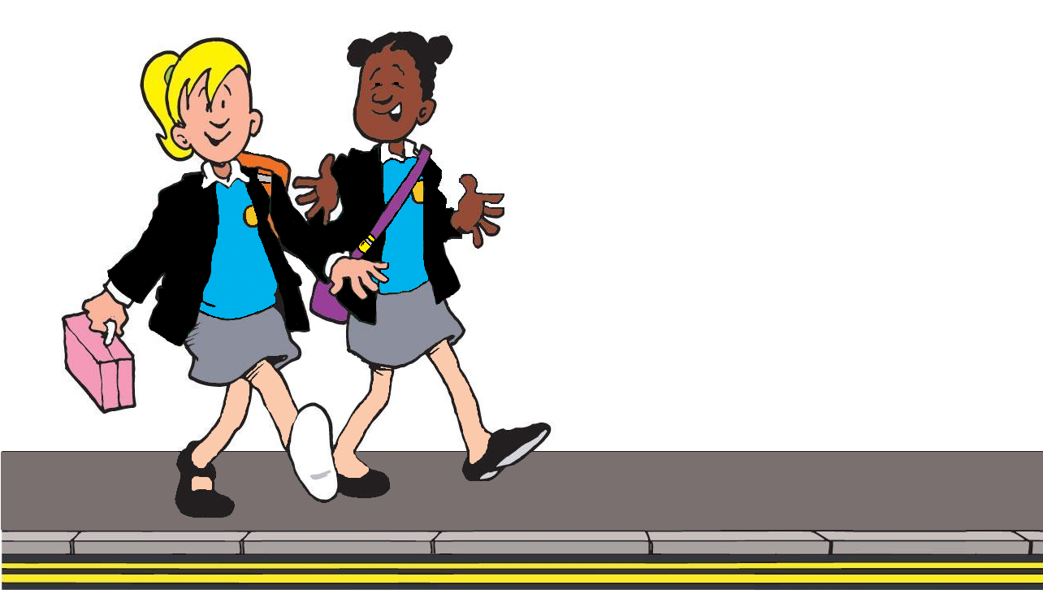
Good luck with your next step into secondary school. Make the most of it and enjoy it!
But please remember to keep yourself and your friends safe
Use the summer to prepare, plan and practise so that you are ready for September

