Slide 1


LEGO Spelling Game
This game is for two people to play. The aim of the game is to be the first one to get to the finish box.
You will need 2 counters, 2 white-boards and 2 pens
Take turns to role the dice and move your counter as needed.
If you land on a square that looks like this
your partner will need to pick up a “spell it out” card then read out the word you need to spell. If you spell it correctly then bravo! If it is incorrect then your partner will need to show you the card so you can try again.
If you land on a square that looks like this
your partner will need to pick up a “write it down” card then read out the word you need to write down on a white-board. If it is correct then bravo! If it is incorrect then your partner will need to show you the card so you can have another go ☺
The first person to the finish box WINS!

Slide 2
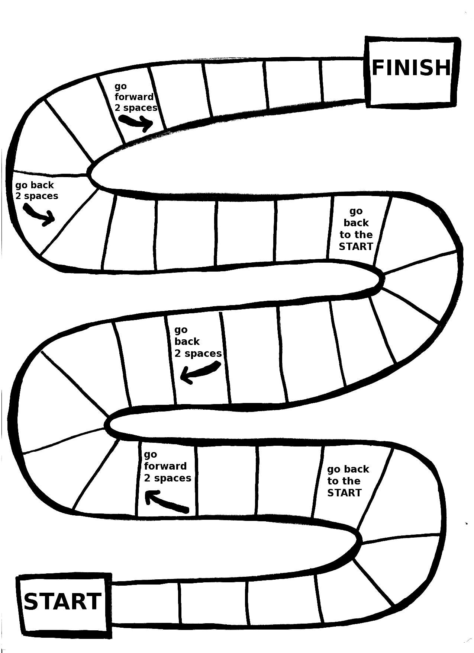
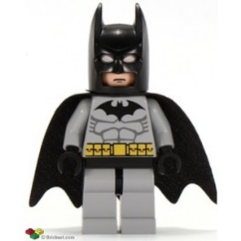
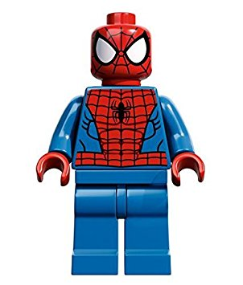
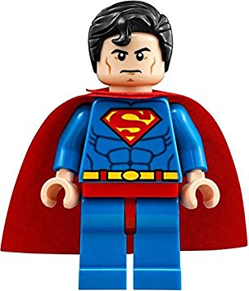

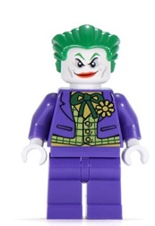


Year 3 LEGO Spelling Game
Joker says “go back to the start”

Slide 3

“Spell it out” cards
C
Can you spell the word pretty?
p-r-e-t-t-y
Can you spell the word beautiful?
b-e-a-u-t-i-f-u-l

Slide 4
Can you spell the word could?
c-o-u-l-d
C
Can you spell the word every?
e-v-e-r-y
Can you spell the word hour?
h-o-u-r

Slide 5
Can you spell the word climb?
c-l-i-m-b
C
Can you spell the word because?
b-e-c-a-u-s-e
Can you spell the word people?
p-e-o-p-l-e

Slide 6
Can you spell the word water?
w-a-t-e-r
C
Can you spell the word only?
o-n-l-y
Can you spell the word great?
g-r-e-a-t

Slide 7
Can you spell the word Christmas?
c-h-r-i-s-t-m-a-s
C
Can you spell the word improve?
i-m-p-r-o-v-e
Can you spell the word dress?
d-r-e-s-s

Slide 8

“Write it down” cards
C
Can you spell the word favourite?
f-a-v-o-u-r-i-t-e
Can you spell the word where?
w-h-e-r-e

Slide 9
Can you spell the word were?
w-e-r-e
C
Can you spell the word believe?
b-e-l-i-e-v-e
Can you spell the word address?
a-d-d-r-e-s-s

Slide 10
Can you spell the word also?
a-l-s-o
C
Can you spell the word one?
o-n-e
Can you spell the word school?
s-c-h-o-o-l

Slide 11
Can you spell the word half?
h-a-l-f
C
Can you spell the word thought?
t-h-o-u-g-h-t
Can you spell the word special?
s-p-e-c-i-a-l

Slide 12
Can you spell the word whole?
w-h-o-l-e
C
Can you spell the word eye?
e-y-e
Can you spell the word father?
f-a-t-h-e-r

